Slide 1
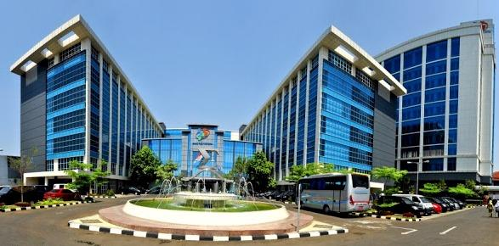
LABOR FORCE STATISTICS
NATIONAL LABOR FORCE SURVEY
(SAKERNAS)
by :
Wachyu Winarsih
Head of Labor Force Statistic Subdirectorate
Statistics Indonesia

Slide 2
Source of Labour Force Statistics
Population Census (SP)
Intercensal Population Survey (SUPAS)
National Socio-Economic Survey (SUSENAS)
National Labor Force Survey (SAKERNAS)
Sakernas is survey that conducted specially to collect labor force information, therefore employment data released formally and regularly reviewed by the Statistics Indonesia is the employment data results of Sakernas

Slide 3
History of Sakernas…(1)
Sakernas is a household survey carried by BPS and specially used to collect employment data periodically
Sakernas has been conducted since 1976, but on a regular basis starting in 1986
Since 1984, Sakernas using Basic Concepts of Labor Force set out in the International Conference of Labour Statisticians (ICLS) to 13th 1982
In 2013, the ILO organized the 19th ICLS which result in development of some variable concepts and definitions. It made the reason of redesigned on Sakernas 2016
There is the addition of other variables such as the formal and informal sector, decent work, home based workers, workers with disabilities, and labor mobility
it expected to meet the needs of employment data and improve the international comparability

Slide 4
History of Sakernas…(2)
Year | Period | Estimation Level | Coverage | Method
1976-1985 | not every year | Province | Indonesia* | Cluster
1986-1989 | quarterly | Province | Indonesia | Rotation
1990-1993 | quarterly | Province | Indonesia | Three stage sampling
1994-1999 | yearly | Province | Indonesia | Three stage sampling
2000 | biannually | Province | Indonesia** | Three stage sampling
2001 | biannually | Province | Indonesia | Two stage sampling
2002-2004 | biannually and quarterly | Province | Indonesia | Two stage sampling
2005-February 2007 | biannually | Province | Indonesia | Two stage and three stage sampling
August 2007-2010 | biannually | Regency | Indonesia | Two stage sampling (Rotation)
2011-2014 | quarterly | Regency | Indonesia | Three stage sampling (Rotation)
2015-2019 | biannually | Regency | Indonesia | Three stage sampling (Panel Cencus Block)

Slide 5
The purposes of Sakernas
General
Provide basic data of employment continuously
Specific
Estimate the number of people working, unemployment, and the principal indicators of employment and also its development in the provincial and national levels

Slide 6
Coverage of Sakernas 2016
Enumeration period
biannually
February
5.000 CB
August
20.000 CB
Sakernas cover the whole provinces
Determination of census blocks based on Industrial Stratification from SP2010 :
Strata of agriculture and mining
Strata of industry, construction and finance
Strata of trade and services
other strata
Census Blocks stratification is done to improve the precision and efficiency of design and ensure the representativeness of the sample from each group/strata

Slide 7
Concepts and definitions…(1)
The concept and definition of employment used by Statistics Indonesia refers to a concept that applies internationally (ILO Concept Approach)
It aims for comparability between countries

Slide 8
Concepts and definitions…(3)
Working age
The lower limit, varying between countries
Indonesia, using the lower limit of the age of 15 years, but in the survey accounted for more than 10 years, Egypt (6 years), Brazil (10 years), Sweden, USA (16 years), Canada (14 and 15 years), India (5 and 15 years), Venezuela (10 and 15 years).
The upper limit, varying between countries
Denmark, Sweden, Norway, Finland (74 years), Egypt, Malaysia, Mexico (65 years), many countries including Indonesia there is no upper limit

Slide 9
Concepts and definitions…(2)
Population
Working Age
Outside The Working Age
Labor Force
Outside The Labor Force
Employed
Unemployed
Working
Temporarily not working
Seeking job
Establish a new business
Discouraged
Have a job but has not started yet
The 13th ICLS

Slide 10
Adoption of the 19th ICLS

Slide 11
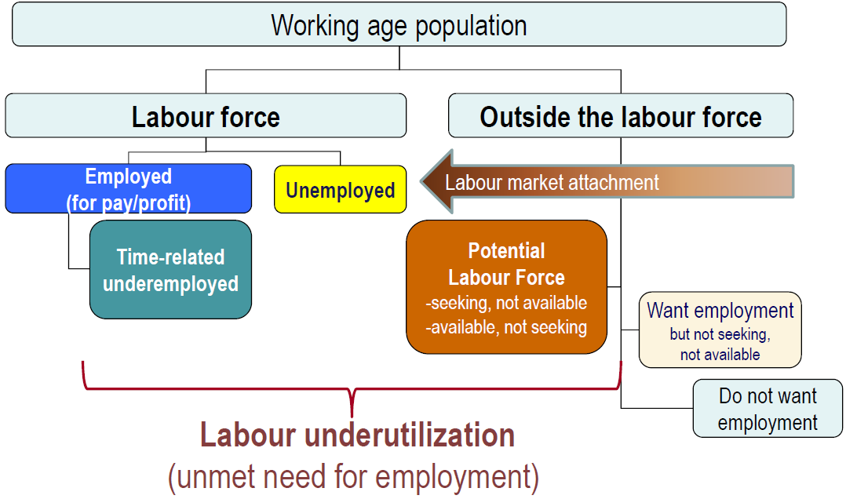
Labor Concepts…(1)
The 19th ICLS

Slide 12
Labor Concepts…(2)
Employement
SAKERNAS 2015
2016
19th ICLS
Activities to obtain or help earn income or profit, for at least 1 (one) hour SUCCESSIVE WITHOUT UNINTERRUPTED a week ago.
Activities to obtain or help earn income or profit, for at least 1 (one) hour CUMULATIVE during the past week.

Slide 13
Labor Concepts…(3)
Examples | SNA concept in Sakernas | SNA concept in 19th ICLS
1. Farmers subsistence/cultivation of food crops (rice, corn, sago and or crops (cassava, sweet potato, potato), the result is used for own consumption. | Including work category | Excluding the category of work, but in the category of own-use production
2. People who take advantage of his profession for their own domestic purposes. Example: Physicians who treat members of their own households, builders repairing their own homes and tailors who sew their own clothes | Including work category | Excluding the category of work, but in the category of own-use production

Slide 14
Labor Concepts…(4)
Unemployment
POPULATION DOES NOT WORK and:
A MONTH AGO ON seeking work or preparing a business, and ready/willing to work within an interval TWO WEEKS AHEAD.
Not looking for a job for reasons already received work but have not yet started work, the commencement of such work within LESS THAN 3 MONTHS FUTURE, and admitted today in a condition ready/willing to immediately work in the intervening TWO WEEKS AHEAD (future starter).
Not looking for work because they feel it is impossible to get a job (desperate), excluded from unemployment.
19
^{th} ICLS
S
A
K
E
R
N
A
S
2
0
1
5
POPULATION DOES NOT WORK and:
A WEEK AGO looking for a job, or preparing a business. (Including the ONLY is awaiting the results of application).
Not looking for a job for reasons already received work but have not yet started work.
Not looking for work because they feel it is impossible to get a job (desperate).

Slide 15
Labor Concepts…(5)
Includes:
Potential labor force (Potential Labor Force), includes those who:
Looking for work/preparing for business, but not willing/ready to immediately start a job.
Not looking for a job/preparing for business, but claimed to be willing/ready to immediately start a job. Including who find it impossible to get a job (desperate).
People who want a job but are not looking for a job/prepare the business and claimed not currently willing/ready to immediately start a job.
People who do not want a job.
Outside Labor Force
Includes:
Schooling
Taking care of household
Other activities
SAKERNAS 2015
19th ICLS

Slide 16
Questionare

Slide 17
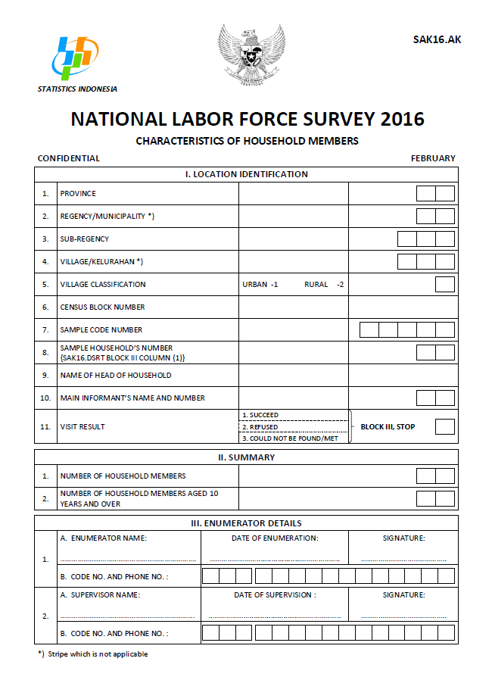
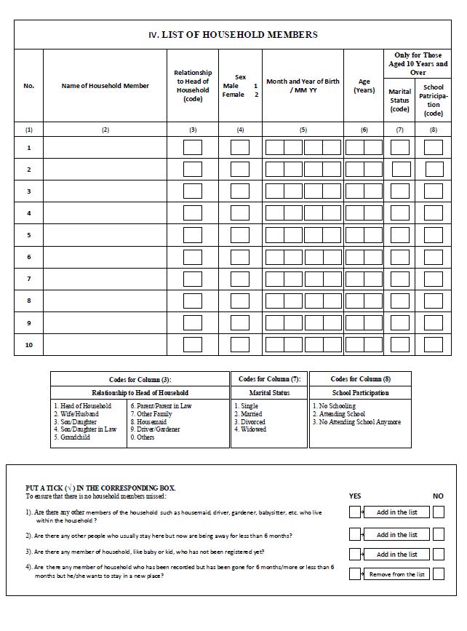

Slide 18
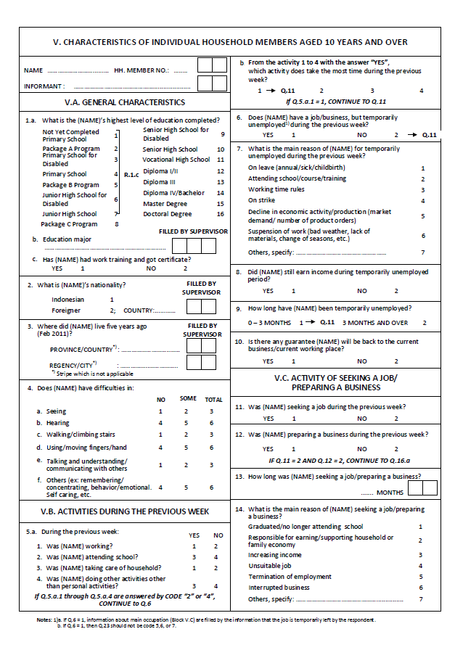
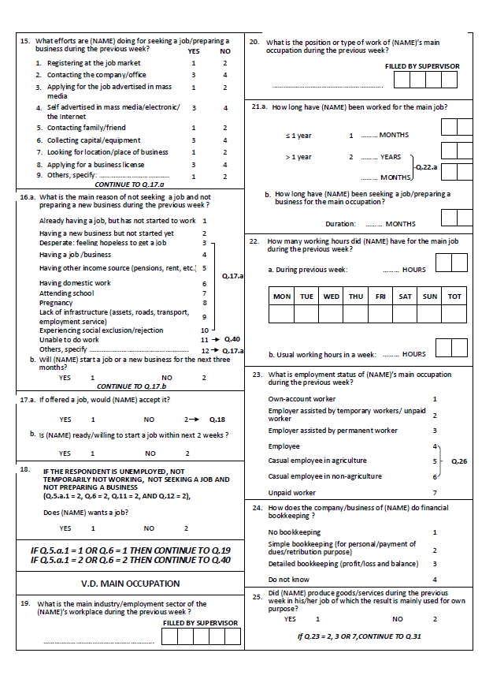

Slide 19
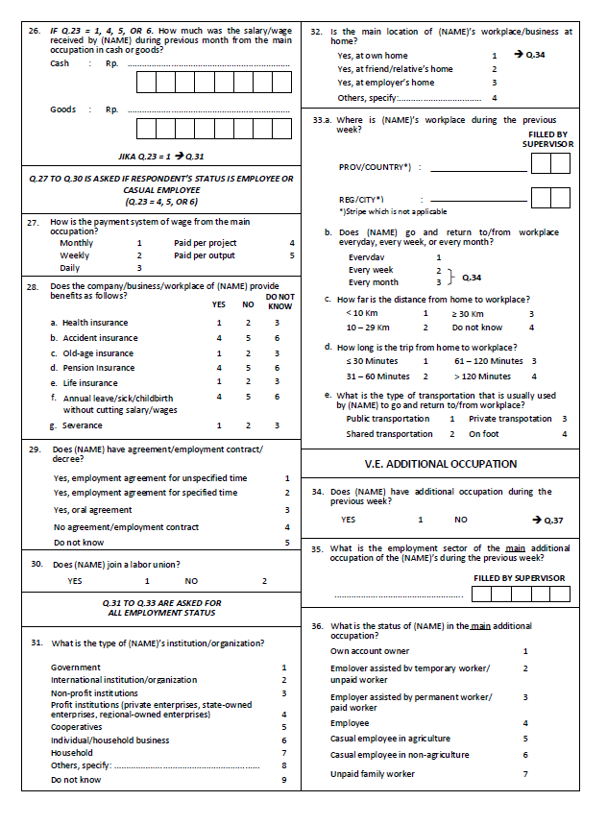
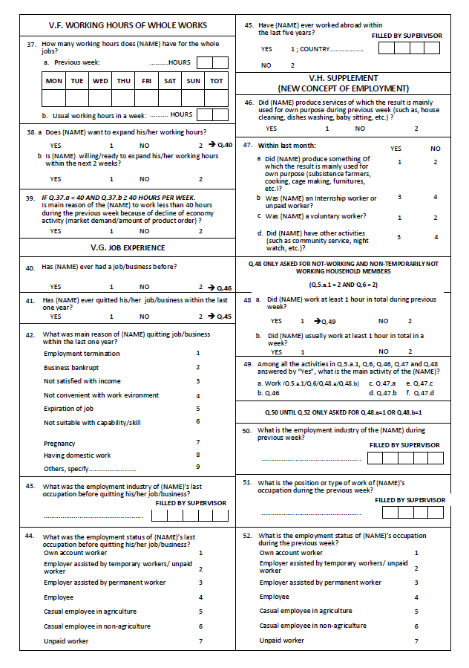

Slide 20
Labor Force Statistics Results of Sakernas

Slide 21
Working Age Population Structure of Indonesia (Million) August 2014 - February 2016
↓ 0.63 million
↑ 0.51 million
August 2014
February 2015
August 2015
February 2016
Outside Labor Force
Labor Force
In February 2016 from 187.6 million working-age population (15 years and above) approximately 127.7 million people are active in economic activities

Slide 22
LFPR by Gender in Indonesia (Percent), August 2014 - February 2016
August 2014
February 2015
August 2015
February 2016
LFPR
Men LFPR
Women LFPR
There is still a gap between male and female participation in the labor market.
In February 2016, that of men by 83.46 per cent while LFPR of women amounted to only 52.71 percent.
In the past year, both that of men and women has decreased, respectively by 1.12 percentage points and 1.77 percentage points.

Slide 23
Indonesian Labor Force Structure (Million), August 2014 - February 2016
121.87
128.30
- 0.20 million
+ 0.19 million
August 2014
February 2015
August 2015
February 2016
Employement
Unemployement
In February 2016, from 127.7 million labor force of about 120.7 million people of which work (absorbed by the labor market)

Slide 24
Unemployment Rate (TPT) Indonesia, August 2014 - February 2016
_{August 2014:}
_{7.24 million}
_{February 2015:}
_{7.45 million}
_{August 2015:}
_{7.56 million}
_{February 2016:}
_{7.02 million}
+ 0.24 poin (320 thousand)
- 0.31 poin (430 thousand)
In the past year, the Unemployment Rate (UR) decreased from 5.81% (February 2015) to 5.50% (February 2016) and the number of unemployed decreased by 430 thousand people.

Slide 25
TPT According to Education (Percent)
August 2014 - February 2016
Education | 2014 | 2015 |  | 2016
 | August | February | August | February
(1) | (2) | (3) | (4) | (5)
Elementary School and under | 3.04 | 3.61 | 2.74 | 3.44
Junior High School | 7.15 | 7.14 | 6.22 | 5.76
Senior High School | 9.55 | 8.17 | 10.32 | 6.95
Vocational Senior High School | 11.24 | 9.05 | 12.65 | 9.84
Diploma I/II/III | 6.14 | 7.49 | 7.54 | 7.22
University | 5.65 | 5.34 | 6.40 | 6.22
Total | 5.94 | 5.81 | 6.18 | 5.50
In February 2016, the lowest UR was in the elementary school and under education amounted 3.44 percent, while the highest UR was vocational education amounted 9.84 percent
In the past year, UR of vocational senior high school increase (0.79 percentage points) and the University increase (0.88 percentage points)

Slide 26
Work According to Education (percent)
August 2014 - February 2016
In February 2016:
The quality of labor force dominated by workers under the elementary education to 52.4 million people (43.46 percent)
Diploma I/II/III and the University worker were only about 13.7 million people (11.34 percent)
26

Slide 27
Employment Population Structure (Million)
August 2014 - February 2016
Main Industry | 2014 | 2015 |  | 2016
 | August | February | August | February
 |  |  |  | total | percentage
(1) | (2) | (3) | (4) | (5) | (6)
Agriculture | 38.97 | 40.12 | 37.75 | 38.29 | 31.74
Industry | 15.26 | 16.38 | 15.25 | 15.97 | 13.24
Construction | 7.28 | 7.72 | 8.21 | 7.71 | 6.39
Trade | 24.83 | 26.65 | 25.68 | 28.50 | 23.62
Transportation, storage & communication | 5.11 | 5.19 | 5.11 | 5.19 | 4.30
Finance | 3.03 | 3.65 | 3.27 | 3.48 | 2.88
Social and personal services | 18.42 | 19.41 | 17.94 | 19.79 | 16.40
Other^{*)} | 1.73 | 1.73 | 1.61 | 1.72 | 1.43
Total | 114.63 | 120.85 | 114.82 | 120.65 | 100.00
NB: ^{*)} Other sectors consists of: Mining sector and electricity, gas and water sector
Industry structures
The structure of employment in February 2016 has not changed.
Agriculture, Trade, Social and personal services and Industry sector are still the largest contributor to employment in Indonesia.

Slide 28
Working Population According to Employment Status (Million)
August 2014 - February 2016
Status Pekerjaan Utama | 2014 | 2015 |  | 2016
 | August | February | August | February
 |  |  |  | Total | Percentage
(1) | (2) | (3) | (4) | (5) | (6)
Own Account Worker | 20.49 | 21.65 | 19.53 | 20.39 | 16.90
Employer assisted by temporary workers / unpaid worker | 19.27 | 18.80 | 18.19 | 21.00 | 17.41
Employer assisted by permanent workers / paid worker | 4.18 | 4.21 | 4.07 | 4.03 | 3.34
Employees | 42.38 | 46.62 | 44.43 | 46.30 | 38.38
Casual employee in agriculture | 5.09 | 5.08 | 5.09 | 5.24 | 4.34
Casual employee not in agriculture | 6.41 | 6.80 | 7.45 | 7.00 | 5.80
Unpaid family worker | 16.81 | 17.69 | 16.06 | 16.69 | 13.83
Total | 114.63 | 120.85 | 114.82 | 120.65 | 100.00
In the past year the number of the working population decreases, except:
Employer assisted by temporary workers increased by 2.2 million people (11.70 percent)
Casual employee in agriculture increased by 160 thousand (3.15 percent)
Casual employee not in agriculture increased by 200 thousand (2.94 percent)

Slide 29
Formal and Informal activities (million people),
August 2014 - February 2016
Informal and formal activities can be identified based on employment status
In February 2016, approximately 50.3 million people (41.72 percent) work in the formal sector and 70.3 million people (52.28 percent) work in informal activities
during the past year :
Formal workers fell from 42.06 percent to 41.72 percent
Informal workers rose from 57.94 percent to 58.28 percent.
August 2014
February 2015
August 2015
February 2016

Slide 30
Less than Normal Working Hours (Million)
August 2014 - February 2016
Working population | 2014 | 2015 |  | 2016
 | August | February | August | February
 |  |  |  | Total | %
(1) | (2) | (3) | (4) | (5) | (6)
Less than Normal Working Hours | 35.77 | 35.68 | 34.31 | 36.33 | 30.11
Underemployement | 9.68 | 10.04 | 9.74 | 10.46 | 8.67
- Part-time workers | 26.09 | 25.64 | 24.57 | 25.87 | 21.44
Full-time workers | 78.86 | 85.17 | 80.51 | 84.32 | 69.89
Total | 114.63 | 120.85 | 114.82 | 120.65 | 100.00
In February 2016, the working population of 120.7 million, approximately 36.3 million people (30.11 percent) of them work less than normal working hours (35 hours per week)

Slide 31
Unemployment Rate (UR)
UR by Province, February 2016
The highest UR 9.03%
Prov. Kep. Riau
The lowest UR 2.12%
Prov. Bali

Slide 32
Thank You
Terima Kasih
www.bps.go.id
Jl. Dr. Sutomo 6-8 Jakarta 10710
bpshq@bps.go.id
(021) 3841195, 3842508, 3810291
Badan Pusat Statistik (Page)
(021) 3857046
@bps_statistics

