Slide 1

أليكوم السلام ورحمة الله
PESNET Second Meeting Ankara, Turkey

Slide 2
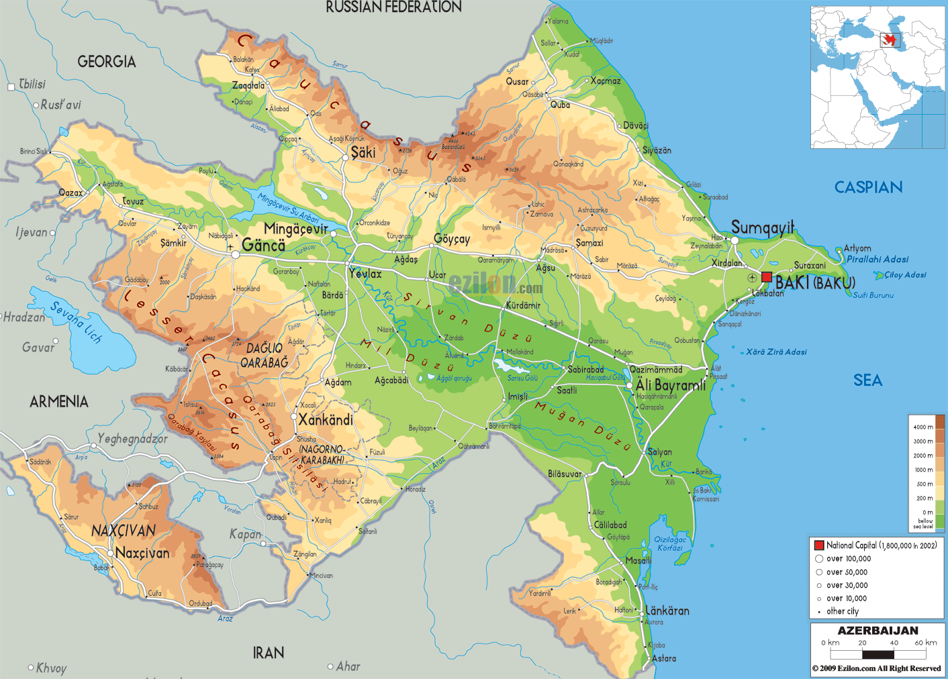
The Republic of Azerbaijan

Slide 3


Establishment: 28 May 1918
Independence: 18 October 1991
Area: 86.6 thsd km2
Population: 9.37 million
Official Language: Azerbaijani
Government system: Presidential Republic
Membership in: UN (Non-permanent member of UN Security Council
1st democratic republic in the Islamic world
1st Opera in the Islamic world
Women voting right in 1918

Slide 4
State Employment Service of the Republic of Azerbaijan
Within 2015 year by State Employment Service was registered 59252 people, 28 930 out them were employed, 3500 people received unemployment status, 4147 people involved in professional training course, 1626 in public works.

Slide 5



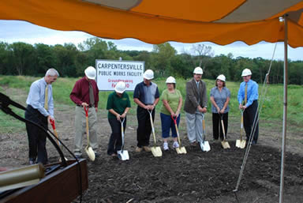

State Employment Service of Azerbaijan Republic
ASSIST IN JOB FINDING
PROFESSIONAL TRAINING
CAREERS COUNSELING
PUBLIC WORKS
UNEMPLOYMENT STATUS

Slide 6

State Employment Service of the Republic of Azerbaijan
JOB PROVISION
Labour Exchange
Labour Fairs
Information about existing vacancies

Slide 7

State Employment Service of Azerbaijan Republic
First Step in Career
First step in career
In all universities of the Republic implemented events under slogan First Step in Career .

Slide 8



State Employment Service of the Republic of Azerbaijan
CAREERS COUNSELING
With the aim of assisting jobseekers State Employment Service provide social and psychological counseling.

Slide 9

State Employment Service of Azerbaijan Republic
PROFESSIONAL TRAINING
Professional training, retraining and skill raising is very important link in the employment of peoples.
Professional training cources implemented in the vocational schools of the Ministry of Education and in the Regional Vocational Centers of the State of Employment Service. SES provide the jobseekers with training and skill raising on base of 85 traditional and 15 modul program (for 3 months) Courses are carrying out by public funds.

Slide 10


Slide 11

Business Start Up
Self employment
Business plan
Training provision
Business basics
Marketing and management

Slide 12
Programme cover all regions of the country
Famaly in the each regions involving to this programme received finance assistance to buy tools, equipment and material to implement own business idea.
Business plans cover urban and agricultural segments.
Finance assistance is irrevocable

Slide 13





Syslab’s job searching methods:
The training and coaching on the following segments:
CV and cover letter writing
different job search methods and techniques
interview behavior
networking
company visit
motivation
communication and interaction
introduction to business plan

Slide 14


Slide 15
THANK YOU FOR
ATTENTION

