Slide 1
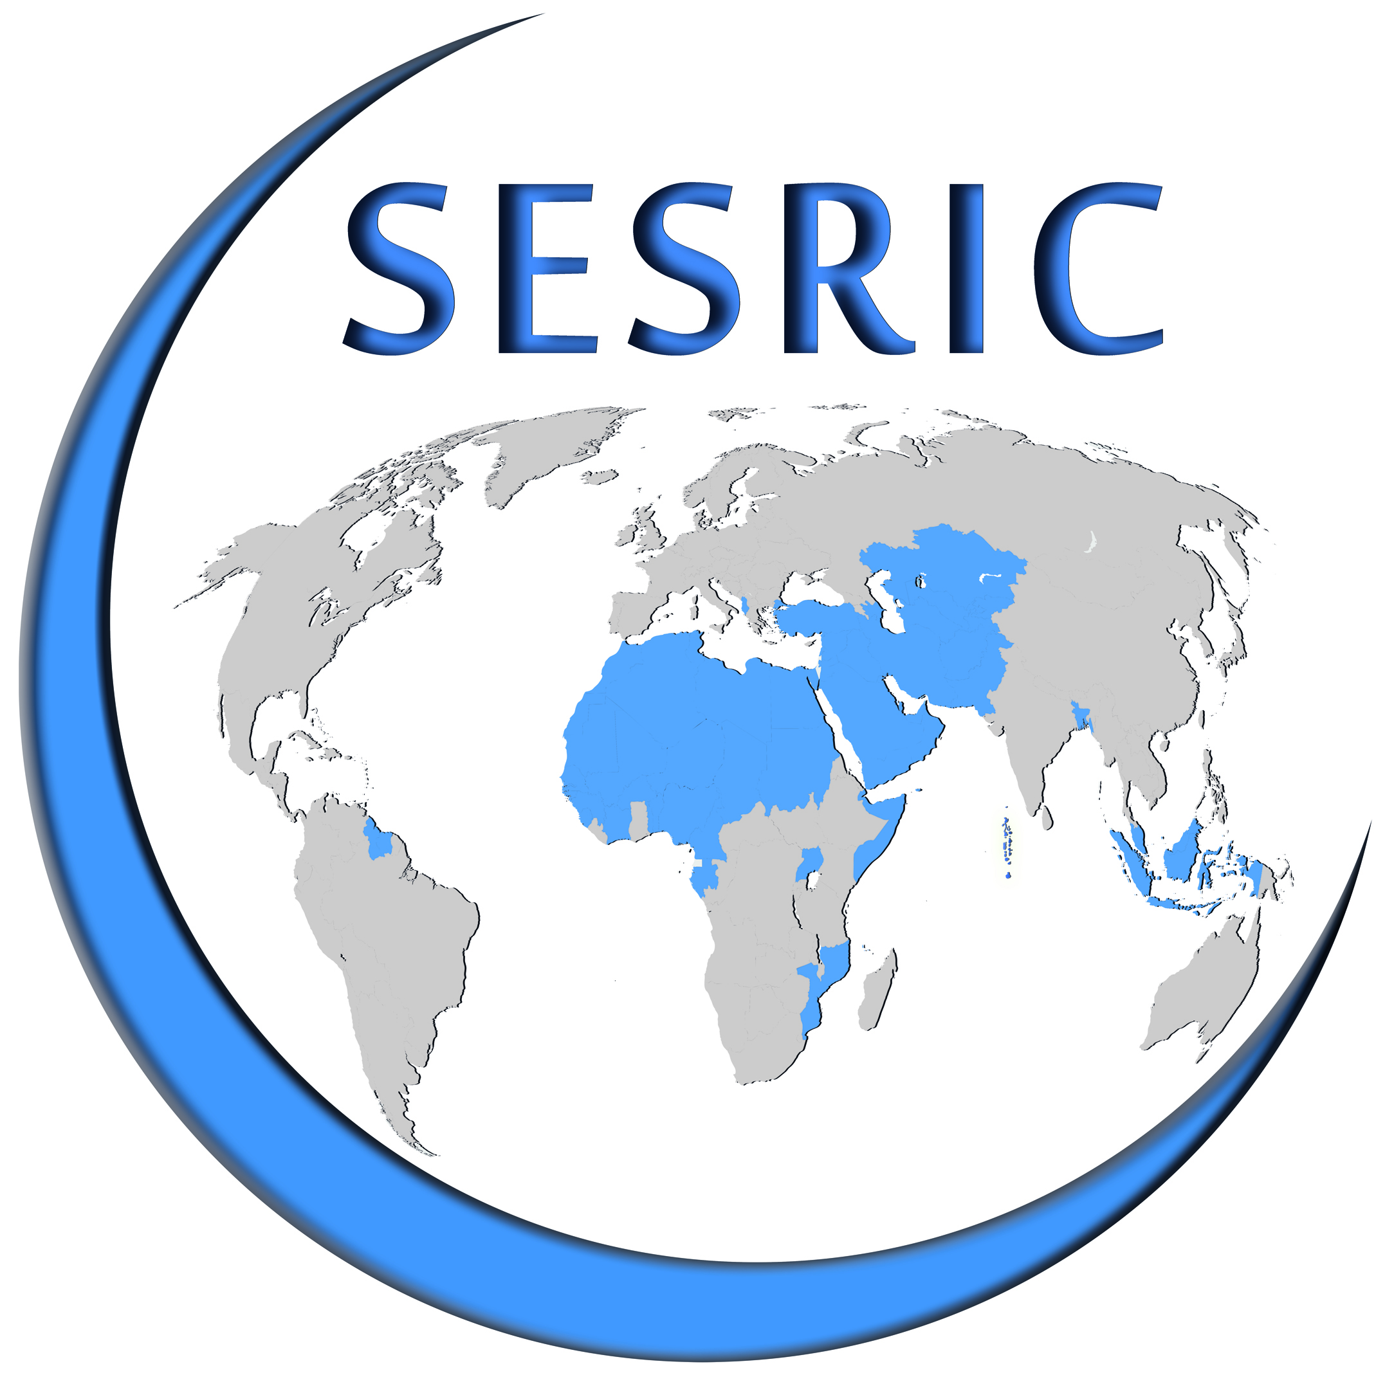
State of Gender in OIC Countries: Prospects and Challenges
Statistical, Economic And Social Research And Training Centre For Islamic Countries (SESRIC)
Organization Of Islamic Cooperation (OIC)
DR. CEM TINTIN
Workshop on the Role of Women in the Development of OIC Member States
3-4 October 2016,
Ankara, Republic of Turkey

Slide 2
Outline
1. Introduction
2. Overall State of Gender
3. Education and Health Status of Women
4. Violence Against Women in the Family and Work
5. Social Security and Women
6. Role of Women in Decision-Making
7. Role of NGOs in Addressing Women Issues
8. Concluding Remarks
9. Policy Implications

Slide 3
1. Introduction
Aim of the Report
The Report aims to investigate the state of women in OIC Member States in comparative perspective, assess the current state of gender and reveal key challenges of women living in OIC member countries.
The Report also provides concrete policy-recommendations to policy-makers in addressing the problems of women with a view to ensure their full and equal participation into socio-economic life as well as to the development process of their respective countries.
Workshop on the Role of Women in the Development of OIC Member States, 3-4 October 2016, Ankara, Republic of Turkey
Notes:
Workshop on the Role of Women in the Development of OIC Member States, 3-4 October 2016, Ankara, Republic of Turkey

Slide 4
2. Overall State of Gender
Figure 2.1. Global Gender Gap Index Scores in the World
Gender Gap Index of WEF
It captures the magnitude of gender-based disparities and tracking the progress on this track.
It covers four main dimensions:
a) economic participation and opportunity;
b) educational attainment;
c) health survival; and
d) political empowerment.
Workshop on the Role of Women in the Development of OIC Member States, 3-4 October 2016, Ankara, Republic of Turkey

Slide 5
2. Overall State of Gender
Gender Equality Index of CIVICUS (2013)
It captures the magnitude of gender-based disparities and tracking the progress on this track.
It covers three main dimensions:
Seats in National Parliaments (% female)
b) Gender Inequality Index of UNDP
c) Gender Equity Index of Social Watch
Figure 2.3. Global Gender Equality Index Scores in the World
Workshop on the Role of Women in the Development of OIC Member States, 3-4 October 2016, Ankara, Republic of Turkey

Slide 6
3. Education and Health Status of Women
Education
Figure 3.1. Adult Literacy Rates (%), 2010-15
Both Adult Literacy and Youth Literacy Rates of Female Population in OIC Countries are relatively lower when compared to Male Population.
Some Other Highlights on Education
In OIC Countries, on average:
In Primary Education and Secondary Education, a small disparity exists in favour of boys in terms of Gross Enrolment Rates.
Completion Rate of Male Pop. is relatively higher in Primary Education. In secondary education Female Pop. has a higher completion rate .
Female population also has a higher transition rate to secondary education and a lower repetition rate in primary education.
Figure 3.2. Youth Literacy Rates (%), 2010-15
Workshop on the Role of Women in the Development of OIC Member States, 3-4 October 2016, Ankara, Republic of Turkey

Slide 7
3. Education and Health Status of Women
Health
Figure 3.11. Life Expectancy at Birth
For Male Pop. Life Expectancy at Birth in OIC Countries rose from 63.5 to 65.2 years between 2008 and 2014. In the same period, it increased from 67 to 68.9 years for Female Pop.
Some Other Highlights on Health
Fertility Rate of Women living in OIC Countries, on average, is declining over time. (Possible Reasons: Family-Planning policies, Increasing divorce rates, Rising Marriage Age of Women, i.e. Late marriage).
Adult Mortality Rate for Female Population and Maternal Mortality Ratio were going down, on average, thanks to the major national and international efforts such as increasing the number of births attendded by skilled health staff and delivering more compherensive prenatal care to female population.
Figure 3.13. Fertility Rate (Births Per Women)
Workshop on the Role of Women in the Development of OIC Member States, 3-4 October 2016, Ankara, Republic of Turkey
Notes:
Women in Lebonan is living the most (82 years) . The lowest life exp. For women seen in Sierra Leone (45.5 years).
However, in the OIC Group, on average, Still as of 2012, fertility rate is the highest when compared to other country groups (2.2 times higher than the average of developed countries). And prenatal care coverage is still lower than the average of the world.
Almost 38 % all of births happen without attendance of any skilled health staff. Therefore, despite showing significant progress, Maternal Mortality Rate is almost 27 times higher when compared to developed countries.

Slide 8
4. Violence Against Women in the Family and Work
Violence
In developing countries, including the OIC Group, Violence against women is more common when compared to the average of developed countries and the world average.
Among 3 types of Violence: Physical Violence is the most prevalent one in the OIC Group.
Figure 4.1. Intimate Partner Violence (%), 2012
Figure 4.2. Women Who Believe a Husband is Justified in Beating His Wife When She Argues with Him (%), 2006-2014
Perception of women in the OIC group against Violence is slightly different than seen in non-OIC developing countries.
Workshop on the Role of Women in the Development of OIC Member States, 3-4 October 2016, Ankara, Republic of Turkey
Notes:
OIC countries host more than 750 million women that represent 48.4% of their total population. According to United World (2013), more than 370 million women in OIC member countries live without legal protection from violence.

Slide 9
4. Violence Against Women in the Family and Work
Violence
Figure 4.3. Female Genital Mutilation/Cutting (FGM/C) Prevalence among Girls and Women Aged 15 to 49 Years (%), 2015
Figure 4.4. Age at First Marriage, 2006-2014
Figure 4.5. Child Marriage (%), 2005-2014
Workshop on the Role of Women in the Development of OIC Member States, 3-4 October 2016, Ankara, Republic of Turkey
Notes:
Female Genital Mutilation/Cutting is seen in 29 countries in the world where 22 are OIC member countries. It is traumatic procedure that negatively affects physical and mental health of women throughout their entire life.
In the OIC Group Age at First Marriage is lowest both for male and female. Child Marriage refers to the marriage before 18 according to UN. Child marriage is a serious issue that needs to be addressed , which mostly hit vulnerable girls and leads to life-long negative consequences from health to participation into labour market.
In the OIC Group marriage before 15 and 18 is more prevalent when compared to all country groups.

Slide 10
4. Violence Against Women in the Family and Work
Divorce and Marriage
Figure 4.6. Crude Marriage and Divorce Rates, 2007-2011
OIC Countries, on average, has a higher crude marriage rate (8.45) and a lower crude divorce rate (1.45).
Figure 4.7. Change in Divorce Rates between 2010-2014
However, the trends in divorce rate in the OIC group is alarming that jumped from 1.5 in 2010 to 1.7 in 2014 incidence of divorce per 1000 population.
It is a high risk factor for the unity and well-being of family structure in the Islamic World.
Workshop on the Role of Women in the Development of OIC Member States, 3-4 October 2016, Ankara, Republic of Turkey

Slide 11
5. Social Security and Women
Labour Force Participation Rate of Female in the OIC Group is the lowest but it is on the rise.
Figure 5.2. Labour Force Participation Rate (%), by sex and country groups, 2000 vs. 2014
Unemployment seen among Women is higher than unemployment seen among Men.
Young Girls are more disadvantaged in job-search that they suffer the most in terms of unemployment.
Figure 5.4. Adult and Youth Unemployment Rates(%) in OIC Member Countries, by Sex
Workshop on the Role of Women in the Development of OIC Member States, 3-4 October 2016, Ankara, Republic of Turkey

Slide 12
5. Social Security and Women
Working Women in OIC Countries are more concentrated in agriculture compared to Non-OIC Developing countries and the world average.
The share of industry is only 11.5% in terms of employment of women whereas services sector gets the lion share of 64.7 % in the OIC group.
Figure 5.5. Sectoral Distribution of Employed Persons, by country groups and sex, 2014
Workshop on the Role of Women in the Development of OIC Member States, 3-4 October 2016, Ankara, Republic of Turkey

Slide 13
5. Social Security and Women
Wage Inequality is very high in the OIC Countries among Men and Women.
Figure 5.6. Wage Equality between Women and Men for Similar Work, 2015
The right to have a minimum 12-week Maternity Leave stipulated by the ILO stays as a challenge in 17 out of 50 data available OIC Countries.
Distribution of 50 OIC Countries by legislated length of maternity leave*, 2013
Workshop on the Role of Women in the Development of OIC Member States, 3-4 October 2016, Ankara, Republic of Turkey
Notes:
As a result of concentration in agriculture and services sectors that allow more shadow economy, wage inequality in the OIC group is high amon men and women that disfavour women. 0 is perfect equality
The highest equality is seen in Malaysia and the highest inequality recorded in Suriname according to Global Gender Report 2014.

Slide 14
6. Role of Women in Decision-Making
Figure 6.3. Seats Held by the Women in National Parliaments of OIC Countries
Women are Underepresented in the Parliaments of OIC Countries compared to non-OIC developing countries.
The number of Female Legislators, Senior Officials and Managers are far from being sufficent in the OIC Group (16.5%) that these Female decision-makers are underrepresented in their respective institutions.
Figure 6.7. Female Legislators, Senior Officials and Managers (% of total)
Workshop on the Role of Women in the Development of OIC Member States, 3-4 October 2016, Ankara, Republic of Turkey
Notes:
Senegal has the highest percentage of Women in Single (lower house) Parliamenterian System that 42.7 of all Representatives are women. In Malaysia (among Senate or Upper House) 28.8 of all Representatives are women.
The share of women ministers in the cabinets of OIC is equal to 12.4% where the world average of 17.7%.
The OIC avearage is 15.6% where the average of the world is 28.8% in terms of the share of female legislators, senior officials and managers as a percentage of total.

Slide 15
7. Role of NGOs in Addressing Women Issues
NGOs became more influential all across the globe including OIC Counties in the field of women empowerment and family well-being.
Different approaches adopted by NGOs ‘empowerment’ vs. ‘Rights-based’.
From provision of training to microcredits in OIC Countries there are many successful NGOs in different fields of women empowerment. For instance: Nijera Kori (Bangladesh), Action Aid (Uganda).
However, NGOs in OIC Countries need more sources (financial and human) to be more impactful on empowering women and strengthening the familly well-being.
It is also part of the responsibility operating in OIC Countries to take local conditions carefully into consideration in order to reach their goals in empowering women and strengthening the familly well-being.
Workshop on the Role of Women in the Development of OIC Member States, 3-4 October 2016, Ankara, Republic of Turkey

Slide 16
7. Role of NGOs in Addressing Women Issues
Weak Legal Context and Improper Public Image of NGOs in OIC countries negatively affect the success and scope of operations of NGOs working in the domain of gender issues and empowerment of women.
Figure 7.2. NGO Legal Context Scores, 2013
Figure 7.3. Public Image of NGOs, 2013
Workshop on the Role of Women in the Development of OIC Member States, 3-4 October 2016, Ankara, Republic of Turkey
Notes:
Heritage Foundation of Pakistan

Slide 17
8. Concluding Remarks
On the Positive Side
OIC Countries, on average, achieved to improve the state of women and family well-being in many dimensions from education, and employment to the delivery health services.
As a result, OIC countries witnessed significant improvements in the literacy rates, enrolment and life expectancy of female population and major reductions in maternal mortality rates. Therefore, the gaps between the global average and the OIC average narrowed down in several indicators.
Many OIC countries also saw some remarkable positive changes in terms of employment of women in labour markets of the OIC counrtries in different sectors and in terms of designating women in decision-making positions both at public and private circles.
Moreover, many OIC countries started to allow civil society organisations to function and actively support NGOs working on empowerment of women and family-well being. In this regard, it is possible to say that women in OIC countries are in a relatively better position as of 2015 when compared to the 2000s.
Workshop on the Role of Women in the Development of OIC Member States, 3-4 October 2016, Ankara, Republic of Turkey

Slide 18
8. Concluding Remarks
On the Negative Side
Although OIC Countries, on average, achieved to improve the state of women and family well-being in many dimensions from education and employment to the delivery of health services, the OIC averages still lag behind the global averages and the average of non-OIC developing countries as well as the average of developed countries. For instance in health sector, in terms of the coverage of prenatal care, almost 27 % all of births happen without attendance of any skilled health staff in the OIC group. Maternal Mortality Rate is almost 27 times higher when compared to developed countries.
Violence against women in OIC Group still remains as a major challenge where only some limited development was recorded. In particular, child marriage, female genital cutting, physical and sexual violence, abuse during pregnancy are among the most common forms of violence that OIC Countries need to address urgently that threaten the family unity and health status of women.
Another alarming trend that poses a risk on the state of women and family unity in OIC Countries is the positive trend seen in divorce rates, which needs to be included into the agenda of policy-makers.
NGOs operating in OIC countries on women empowerment issues have their own challenges such as weak financial sources, lack of legal arrangements, and social barriers (e.g. public image).
Workshop on the Role of Women in the Development of OIC Member States, 3-4 October 2016, Ankara, Republic of Turkey

Slide 19
9. Policy Implications
At the National Level (I)
Enlarging the coverage of health services and training more health staff for the health of mother and newborn. Re-addressing the high fertility rates seen especially among adolescents aged between 15-19 years.
Investing into education, especially into vocational education and training (VET) programmes to empower women.
Encouraging women to be more active in politics through cooperating with national political parties.
Supporting (both financially and non-financially) NGOs and collaborating with them to empower women and strengthen the family well-being in OIC Countries.
Cooperating with the private sector for positive discrimination of women both in terms of employment and assignments of women into decision-making positions.
Workshop on the Role of Women in the Development of OIC Member States, 3-4 October 2016, Ankara, Republic of Turkey
Notes:
Carrying out national diagnostic studies to find out the root-causes of the positive trends seen in divorce rates and draw national policies based on these findings.
Adopting a zero-tolerance policy against violence and implementing national campaings to increase public awareness and offering state-of-art solutions to women (e.g. Distributing panic buttons, building protection houses for women etc.)
All in all, to develop a national action plan to be able to address and include all different dimensions with key performance indicators for timely asssessment and evaluation of policies.

Slide 20
9. Policy Implications
At the National Level (II)
Carrying out national diagnostic studies to find out the root-causes of the positive trends seen in divorce rates and draw national policies based on these findings.
Adopting a zero-tolerance policy against violence and implementing national campaigns to increase public awareness and offering state-of-art solutions to women (e.g. distributing panic buttons, building protection houses for women etc.)
Developing a national action plan (including all different dimensions) with key performance indicators (for timely asssessment and evaluation of gender policies).
Workshop on the Role of Women in the Development of OIC Member States, 3-4 October 2016, Ankara, Republic of Turkey

Slide 21
9. Policy Implications
At the OIC Level
I. OIC Ten-Year Programme of Action, 2005: recommended that attention should be paid to
the rights of women and the needs of the youth and families in the world.
a) Establishment of dedicated department at the OIC GS on family and women affairs.
b) Establishment of a specialized body of the OIC on Women Advancement in Cairo.
II. OPAAW (OIC Plan of Action for the Advancement of Women), 2008
III. OIC Ten-Year Programme of Action, 2016-2025:
IV. 5 Ministerial Conferences held on Women between 2006 and 2015 (Istanbul-Cairo-Tehran-Jakarta- Baku). ***The Conference in Baku (2014) called for a meeting of experts to assess OPAAW.
V. After 8 years of its adoption, the OPAAW document needs to be assessed and updated by taking changing needs of women living in OIC countries into account.
Workshop on the Role of Women in the Development of OIC Member States, 3-4 October 2016, Ankara, Republic of Turkey

Slide 22
Thank You!
Statistical, Economic and Social Research and Training Centre For Islamic Countries (SESRIC)
Organisation of Islamic Cooperation (OIC)
Workshop on the Role of Women in the Development of OIC Member States
3-4 October 2016,
Ankara, Republic of Turkey

