Slide 1


State and Importance of
Muslim Friendly Tourism (MFT) in
OIC Member Countries
SESRIC Commemoration of Dhaka
The OIC City of Tourism 2019
STATISTICAL, ECONOMIC AND SOCIAL RESEARCH AND TRAINING CENTRE FOR ISLAMIC COUNTRIES (SESRIC)
ORGANISATION OF ISLAMIC COOPERATION (OIC)
International Seminar on
“Development of Muslim Friendly Tourism in the Dhaka City”
Dr. Cem Tintin, SESRIC
15 October 2019, Dhaka, People’s Republic of Bangladesh

Slide 2

OUTLINE
Part I
International Tourism in OIC Member Countries
Part II
Muslim Friendly Tourism in OIC Member Countries

Slide 3
PART I.
International Tourism in
OIC Member Countries

Slide 4
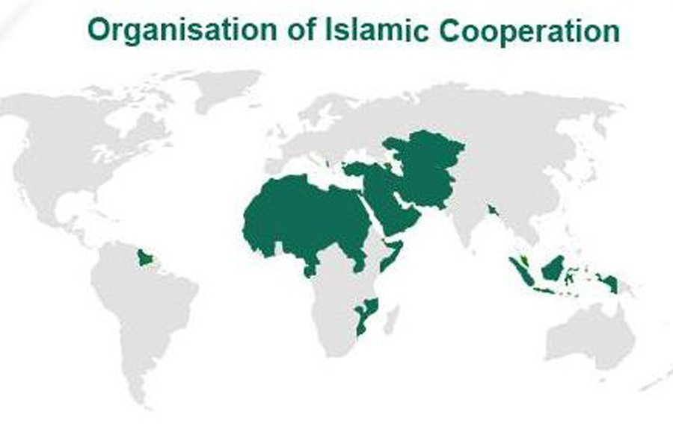
ORGANISATION OF ISLAMIC COOPERATION (OIC)
Outline
I. Highlights on International Tourism Worldwide
II. Highlights on International Tourism in OIC Member Countries
Islamic Tourism in OIC Member Countries
Strategic Plan for the Development of Islamic Tourism in
OIC Member Countries
V. Concluding Remarks
Notes:
ORGANISATION OF ISLAMIC COOPERATION (OIC)

Slide 5
Why Tourism is important?
A) One of the world’s largest industries and categories of international trade.
B) All the activities that are directly/indirectly involved in providing goods and services to tourists (According to SICTA: 185 supply-side activities).
C) Transportation and communication, hotels and lodging, food and beverages, cultural and entertainment, banking and finance, promotion and publicity services, etc.
D) Tourism helps people and nations know about each other, eliminate prejudices and promote international cooperation.

Slide 6
Contribution of International Tourism in the Economy (I)
Source: WTTC *projection
The total contribution of tourism to GDP in the OIC countries was measured at 8.7 per cent in 2018.

Slide 7
Contribution of International Tourism in the Economy (II)
Source: WTTC *projection
The total contribution of international tourism to employment in the OIC group was around 6.4 per cent in 2018.

Slide 8
Facts on the Tourism Performance of OIC Countries
OIC Countries represented about 26% of the world population in 2017.
OIC Countries hosted 184.5 million international tourists in 2017. In terms tourist arrivals, the share of the OIC Countries in the world was only 13.7% in 2017.
Tourism receipts in OIC Countries reached 165.7 billion US$ in 2017. The share of OIC countries in world tourism receipts accounted for only 10.9% in 2017.
According to the latest available data, intra OIC tourist arrivals was recorded at 68.4 million, accounting for 39.9% of OIC total tourist arrivals.

Slide 9
Major Challenges in the area of OIC Tourism Cooperation
Non-targeted tourism marketing policies and weak know-how;
High-cost of transport;
Distribution of Member Countries in 4 continents and physical distances;
Visa issues;
No unified Standards/Certificates including Halal standards; and
Lack of diversification such as underutilization of Islamic (Halal/Muslim Friendly) Tourism Activities.

Slide 10
State of Tourism in OIC Countries in Brief
International tourism is a very important sector that could play a significant role in the development of the OIC countries.
The development level of the tourism sector in OIC countries continues to stay under its potential compared to the world averages whether it is measured in terms of the contribution of the tourism sector into employment or GDP.
Intra-OIC cooperation is improving in the area of tourism but only a few OIC countries highly benefit from intra-OIC tourism activities.
Having a successful tourism industry requires better planning, diversification and marketing, tourism governance as well as more investment.

Slide 11
PART II:
Muslim Friendly Tourism in
OIC Member Countries

Slide 12
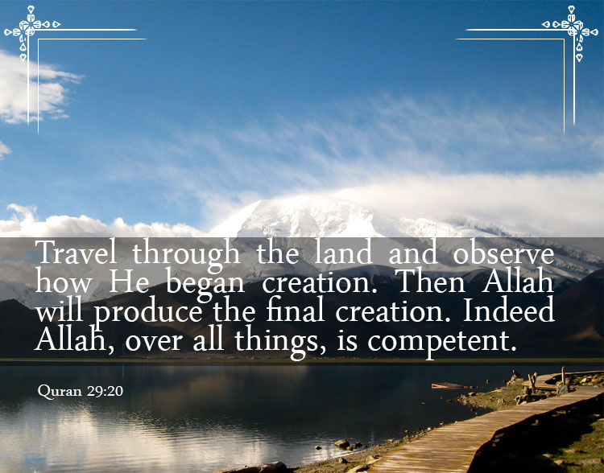

Basics of MFT in OIC Countries (I)
Over the two last decades, demand for Sharia’h complaint products and services increased tremendously all across the world including the OIC countries.
In this context, Halal Hotels, Halal Food Premises, Halal Tour Packages, and Halal Transport (airlines) became components of Islamic Tourism.
The Muslim tourism market has witnessed rapid growth over the years and emerged as one of the fastest growing segments of the global tourism market.
Its growth rate has been consistently found to be higher than the conventional tourism market.

Slide 13



Basics of MFT in OIC Countries (II)
Islamic Tourism
Halal Tourism
Muslim Friendly Tourism
Sharia’h Tourism

Slide 14
Basics of MFT in OIC Countries (III)
Muslim minority countries such as Japan, South Korea and Australia are reaching to Muslim travellers by:
    - Promoting Muslim friendly destinations in their countries and/or
    - Providing Muslim friendly tourism services like halal food and facilities to pray in their destinations.

Slide 15
Some Common Features of Muslim Tourists
The New Generation of Muslim Tourists have some features such as:
Highly Educated
Awareness on Trends (fashion, travel, tourism, food etc.)
Second and Third generations from Europe/UK and USA with a high purchasing power
Increasingly seeking out goods and services with Islamic Value
Source: Global Muslim Lifestyle Travel Market 2012, Landscape and Consumer Needs Study.

Slide 16
How Muslim Tourists Decide?
Decisions of Muslim Tourists are affected mainly by Halal Food, Price and Overall MFT Experience
Main Factors that Affect the Decision of Muslim Tourists When Travelling For Leisure

Slide 17
Importance of MFT in OIC Countries (I)
Developing and expanding MFT and capitalizing on its potentials can play a significant role in the socio-economic development of many OIC countries. Because:
Muslim tourism market increased from around $80 billion in 2006 to $145 billion in 2014, corresponding to an impressive increase of 81 per cent.
The size of the global Islamic tourism market is estimated around $177 billion in 2017.

Slide 18
Importance of MFT in OIC Countries (II)
Developing and expanding MFT and capitalizing on its potentials can play a significant role in the socio-economic development of many OIC countries. Because:
c) It is projected that the size of the market will reach $243 billion in 2021 with an annualized growth rate of 8.3 per cent.
d) More than 230 million Muslim tourists are expected to travel both locally and abroad by 2026 and this activity is expected to inject $300 billion into the global economy (Mastercard and Crescent Rating, 2019).

Slide 19
Importance of MFT in OIC Countries (III)
Projected Annual Compound Growth Rate (%) in the Global and Islamic Tourism Market Size: 2014-2020
It is expected that Islamic tourism market will grow about 3 per cent faster than the global conventional tourism market over the period 2014-2020.

Slide 20
State of MFT in OIC Countries: GMTI
Source: MasterCard and Crescent Rating, 2019

Slide 21
Top Performer OIC Countries in the Global Muslim
Travel Index, 2019
Source: MasterCard and Crescent Rating, 2019
Notes:
Area 1 Family-friendly holiday and safe travel destination
Area 2 Muslim-friendly services and facilities available at the destination
Area 3 Communication and Outreach
Area 4 Ease of Access

Slide 22
Top Performer non-OIC Countries in the Global Muslim
Travel Index, 2019
Source: MasterCard and Crescent Rating, 2019
Notes:
Area 1 Family-friendly holiday and safe travel destination
Area 2 Muslim-friendly services and facilities available at the destination
Area 3 Communication and Outreach
Area 4 Ease of Access

Slide 23
Performance of Bangladesh in the Global Muslim
Travel Index, 2019
Country | Score | Rank in the World
Bangladesh | 56 | 19
Source: MasterCard and Crescent Rating, 2019
Notes:
Area 1 Family-friendly holiday and safe travel destination
Area 2 Muslim-friendly services and facilities available at the destination
Area 3 Communication and Outreach
Area 4 Ease of Access

Slide 24
Challenges for the Development of MFT in OIC Countries
Major Challenges remain unaddressed:
lack of coordination among public institutions;
standards and certification issues on MFT;
underdeveloped national rules and regulations on MFT;
ineffective marketing and promotion strategies;
problems on data and monitoring;
lack of national strategies;
financial constraints; and
human capital shortages.

Slide 25
Addressing Challenges: Strategic Roadmap Document
In order to enhance cooperation at intra-OIC level as well as to improve Islamic tourism ecosystem in OIC member countries, the 9th Islamic Conference of Tourism Ministers (ICTM) requested preparation of a Strategic Roadmap for Development of Islamic Tourism in OIC Member Countries. It aims at:
  Providing a study on the background of Islamic tourism, aspects and dimensions and its importance in OIC member countries;
  Conducting a situation analysis on the state of Islamic tourism in OIC member countries; and
  Proposing a strategic direction to be taken with an action plan to develop and promote Islamic tourism in OIC member countries.

Slide 26
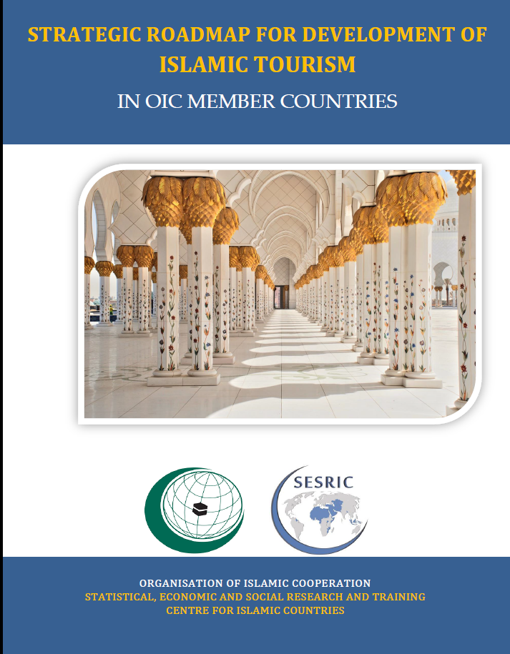
Five Dimensions of the Strategic Roadmap
The document identifies five key
specific thematic areas of cooperation in the
domain of Islamic tourism:
Data and monitoring,
Policy and regulation development,
Marketing and promotion,
Destination and industry development,
Capacity development.
The Plan was adopted during the 10th Session of Islamic Conference of Tourism Ministers that took place in Dhaka, Bangladesh in Feb. 2018.

Slide 27
How to Develop Islamic Tourism?
5 Thematic Areas of Cooperation
80 Pages
Towards Improved
Intra-OIC Cooperation
Implementation Matrix
27

Slide 28
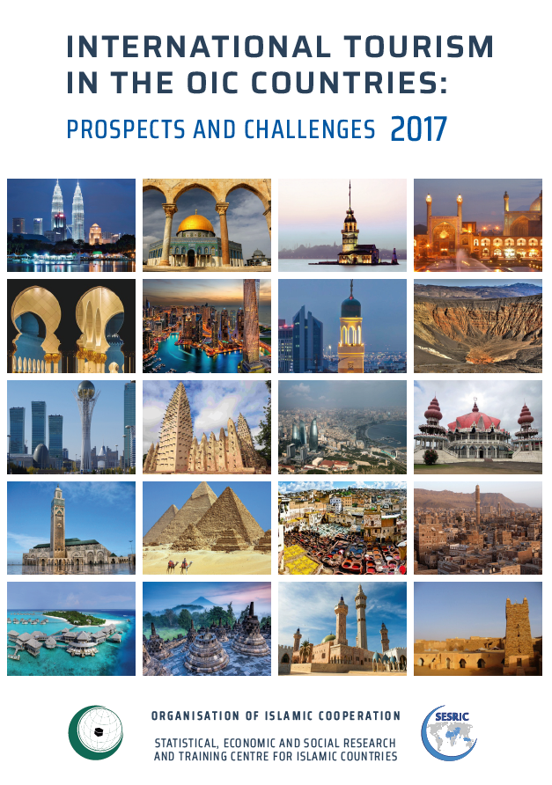
You can find more information in the Report, available at:
www.sesric.org

Slide 29
SESRIC Commemoration of Dhaka
The OIC City of Tourism 2019
THANK YOU
Statistical, Economic and Social Research and Training Centre For Islamic Countries (SESRIC)
Organisation of Islamic Cooperation (OIC)
International Seminar on
“Development of Muslim Friendly Tourism in the Dhaka City”
15 October 2019, Dhaka, People’s Republic of Bangladesh

