Slide 1
Qatar’s Practice on Islamic Finance and Islamic Finance Statistics
25- 26 March 2014
Ankara, Turkey

Slide 2
Outline
Regional mandate
Current practice on Islamic Financial Service Industry
Current practice on Islamic Finance Statistics
Data sources
Data collection
Data Dissemination
Outstanding Issues and Challenges
Expert Group Meeting on Islamic Banking and Finance Statistics

Slide 3
OIC-StatCom Strategic Vision for 2020
Development of common methodologies for indicators specific to the OIC Member Countries
IBF Statistics is not incorporated into the National Statistical Systems (NSS) of most of the OIC Member Countries, which prevents official collection and dissemination of related data.
Secondly, for the member countries where the IBF Statistics are covered in NSS, there is not adequate level of coordination and communication mechanism among the agencies of NSS on this matter.
Thirdly, there is lack of harmonization and convergence in terms of definitions of Islamic Banking and Finance instruments and transactions. This prevents the adoption of a generally accepted standardized methodology for the collection, processing, and dissemination of relevant statistical data in the member countries.
Expert Group Meeting on Islamic Banking and Finance Statistics
Notes:
In 2013, 18 OIC Member Countries, namely Afghanistan, Azerbaijan, Bangladesh, Comoros, Egypt, Gambia, Iran, Jordan, Kazakhstan, Malaysia, Maldives, Mali, Palestine, Sudan, Qatar, Togo, Tajikistan and Turkey, had declared their intention to be a part of the TCE on IBFStat.
Why ?
IBF Statistics is not incorporated into the National Statistical Systems (NSS) of most of the OIC Member Countries, which prevents official collection and dissemination of related data.
Secondly, for the member countries where the IBF Statistics are covered in NSS, there is not adequate level of coordination and communication mechanism among the agencies of NSS on this matter.
Thirdly, there is lack of harmonization and convergence in terms of definitions of Islamic Banking and Finance instruments and transactions. This prevents the adoption of a generally accepted standardized methodology for the collection, processing, and dissemination of relevant statistical data in the member countries.

Slide 4
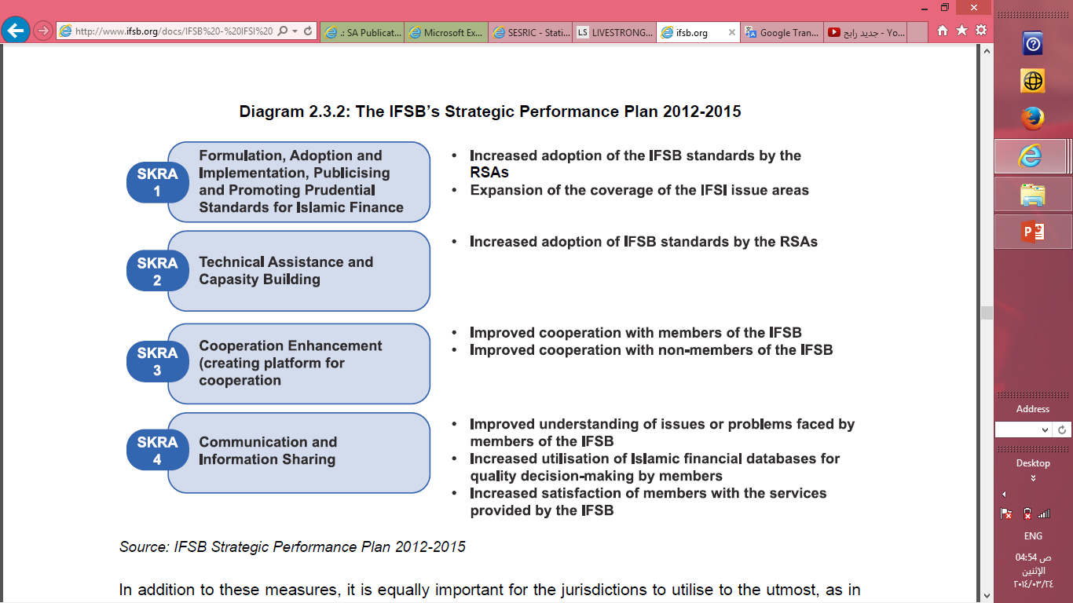
The IFSB also collaborates with multilateral organizations such as the IDB, the World Bank, the IMF and the Asian Development Bank (ADB)
OIC Mandate
The IFSB’s Strategic Performance plan 2012 - 2015
These institutions have not only recognized the importance of the role which Islamic finance can play in the global financial system, but have also offered their support for its promotion and for capacity building of supervisory authorities and industry players
Expert Group Meeting on Islamic Banking and Finance Statistics
Notes:
On the whole, while capital adequacy and profitability have trended favorably despite weathering the
financial crisis and the ensuing economic downturn, asset quality has deteriorated from the pre-crisis
levels. Having said this, some jurisdictions in GCC are still contending with the effects of high provision
on financing while managing the restructuring of financing portfolios on their balance sheets. Going
forward, enhancing the overall external and internal aspects related to the financial stability of Islamic
banks will require concerted efforts by both the banking community and the regulators in terms of the
factors below (listed in no particular order):
• Regulatory environment: Further enhancement of the regulatory environment, which includes the
regulatory framework and related legislation.
• Infrastructure: Development of ancillary areas – such as the Sharī`ah Advisory Board, arbitrative
system and rating agency catering to Islamic finance.
• Products and services: Gauging the extent and evolution of the extensiveness of products and
services offered, which is also a proxy for the level of demand from customers.
• Ease of doing Islamic finance business: Facilitating and providing initiatives by governments to
accommodate the development of and to encourage Islamic finance business opportunities.
• Statistics, marketing and education: Driving initiatives and efforts to promote Islamic finance
through marketing, education and reliability of collected data for study.
Organization of Islamic
37
Cooperation (OIC) member
states (2011)

Slide 5
Qatar’s practice on Islamic Finance services
Islamic Financial Services Industry, STABILITYREPORT 2013;
“ Qatar outperformed the GCC market average In recent years, Islamic banks have been prolific in terms of introducing new products with increasing sophistication”
Expert Group Meeting on Islamic Banking and Finance Statistics

Slide 6
Qatar’s practice on Islamic Finance services statistics
Data sources
Collection and processing
Reports and dissemination
Ministry of development planning and statistics
Economic statistics department
Annual bulletin and website
Qatar Central bank
Stability
Annual report , quarterly bulletin and website
Qatar Exchange
Receive reports from source
Financial reports published on their website
Expert Group Meeting on Islamic Banking and Finance Statistics

Slide 7
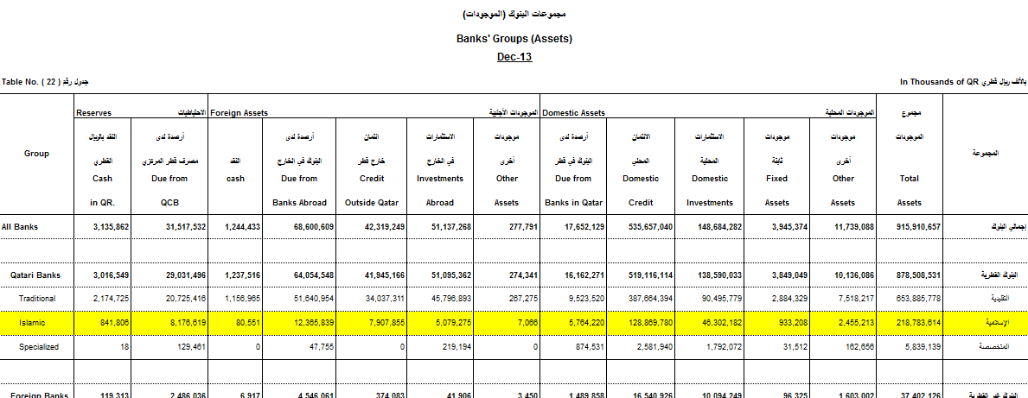
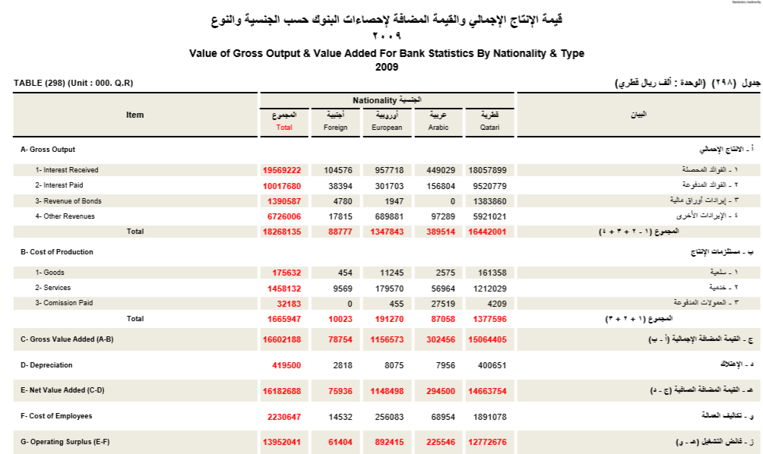
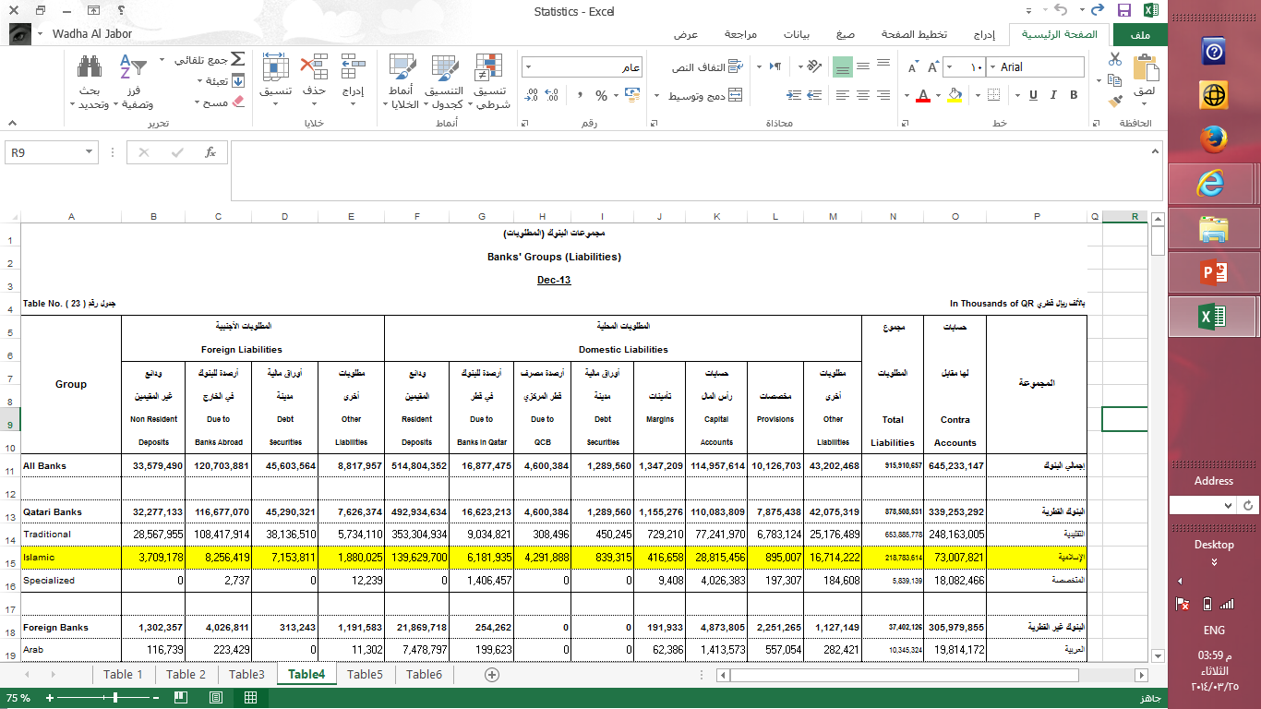
Presentation of information on Islamic Banking and Finance Statistics
Expert Group Meeting on Islamic Banking and Finance Statistics

Slide 8
Key Statistics and Benchmarking
Largest Islamic institutions
Sukūk Issuance
Takāful Operators
Market derivers
Average growth trend
Assets
Financing
Deposits
Equity
Net Profit
Investment
Contribution into financial sector and total economy

Slide 9
National Coordination
Currently, coordination is driven by national projects relates responsible agencies responsible for finance statistics falling under the National Statistical Systems (ministry of development planning and statistics, Central Bank, Qatar Exchange )
Expert Group Meeting on Islamic Banking and Finance Statistics

Slide 10
Proposed Indicators for Islamic Banking and Finance Statistics, by OIC – Stat Com
Expert Group Meeting on Islamic Banking and Finance Statistics

Slide 11
..Thank you …
www.mdps.gov.qa
Expert Group Meeting on Islamic Banking and Finance Statistics

