Slide 1
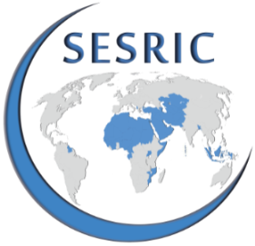
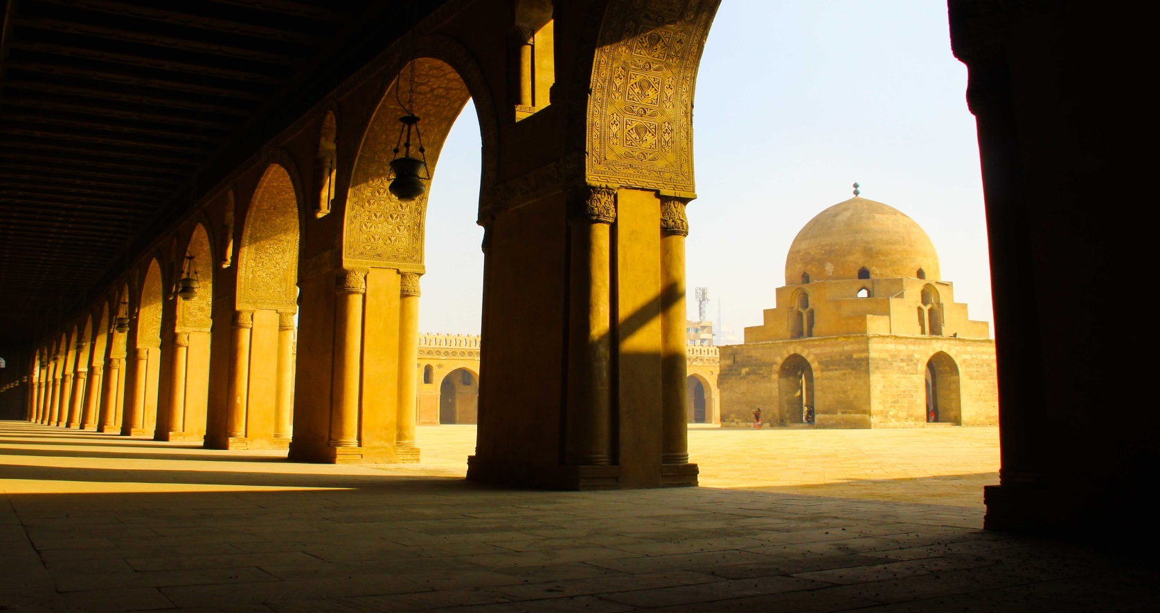
New Directions in the Tourism Sector:
Islamic Tourism in the OIC Countries
Maedeh Bon
9th Session of Islamic Conference of Tourism Ministers (ICTM), 21-23 December 2015
Niamey, Niger

Slide 2
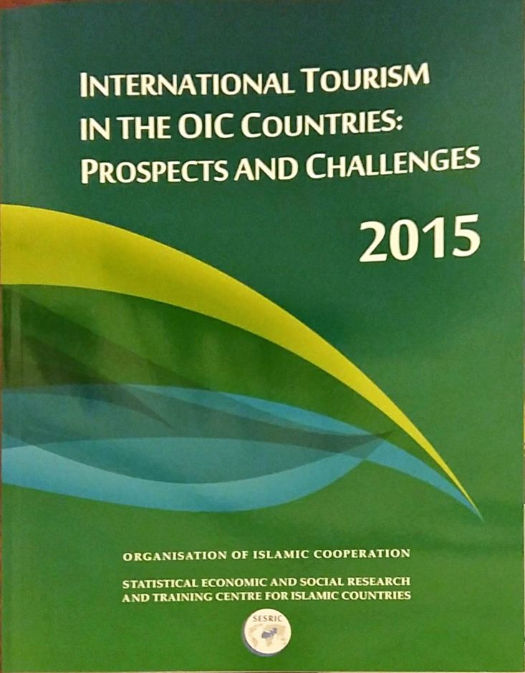
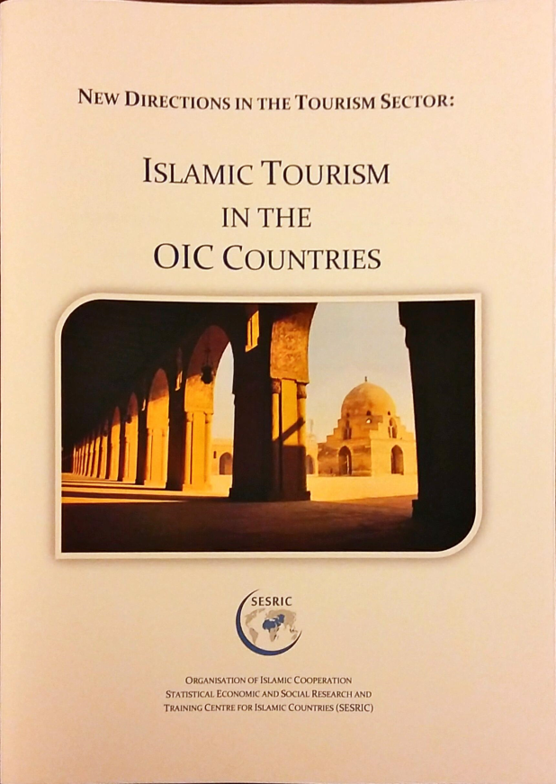
Outlines
Islamic Tourism and its Components
State of Islamic Tourism in the OIC Countries
Challenges and Opportunities for Islamic Tourism
Concluding Remarks and Policy Recommendations

Slide 3
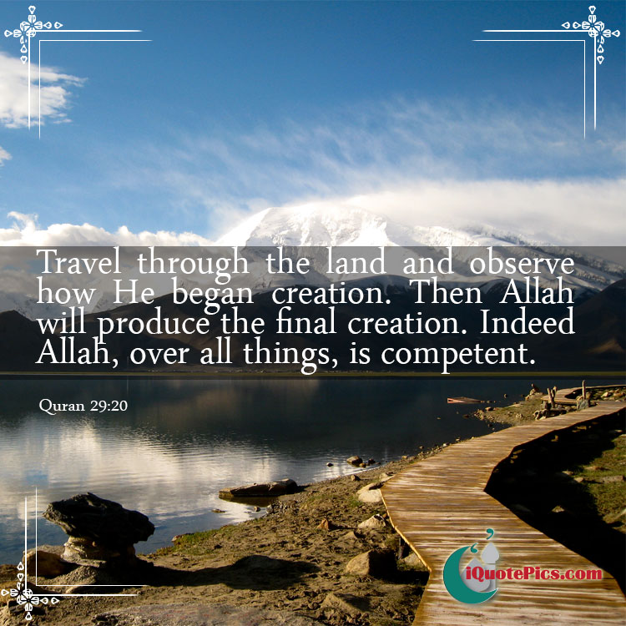

Islam and tourism

Slide 4
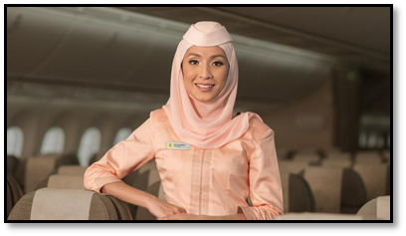
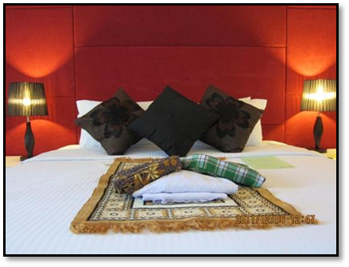
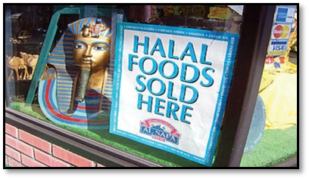
Islamic tourism and its components
Islamic tourism is mainly targeting people with Islamic beliefs
Islamic Tourism has been used with different names in the tourism theory and practice:
Halal Tourism/ Sharia’h Tourism /Muslim-Friendly Tourism
Major Components of Islamic Tourism
Halal Hotels
Halal Food Premises
Halal Tour Packages
Halal Transport (Airline)
Halal Finance

Slide 5
Factors Affecting the Decision of Muslim Tourists
Source: Dinar Standard and Crescent rating, 2015

Slide 6
State of Islamic Tourism in the OIC Countries
Muslim Tourism Market, 2014/15
Regional Distribution
Muslim tourism market (excluding the Hajj and Umrah) has increased from US$80 billion in 2006 to $145 billion in 2014, corresponding to an impressive increase of 81%
Despite growth, Islamic tourism remained as an emerging niche market with 108 million Muslim travellers, accounting for 10 to 12% of the global tourism sector
with an annual growth rate of 4.8%, Muslim tourism market is growing faster than the global tourism market, which recorded a growth rate of 3.8 per cent in 2013
Source: Thomson Reuters and Dinar Standard,2013-2015

Slide 7
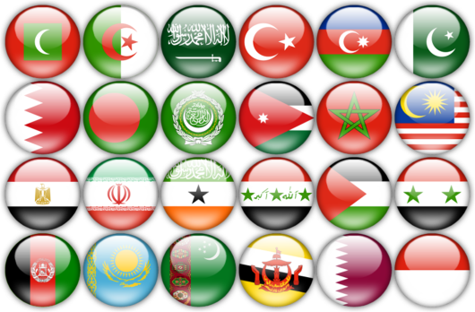
Major Source Markets for Islamic Tourism
Top-20 Muslim Tourist Source Markets, 2013/14
Rank | Country | Size |  | Rank | Country | Size
 |  | (US $ Billion) |  |  |  | (US $ Billion)
1 | Saudi Arabia | 17.8 |  | 11 | Germany | 3.6
2 | Iran | 14.3 |  | 12 | Egypt | 2.8
3 | United Arab Emirates | 11.2 |  | 13 | Azerbaijan | 2.4
4 | Qatar | 7.8 |  | 14 | United Kingdom | 2.4
5 | Kuwait | 7.7 |  | 15 | Singapore | 2.3
6 | Indonesia | 7.5 |  | 16 | France | 2.3
7 | Malaysia | 5.7 |  | 17 | Iraq | 2.2
8 | Russia | 5.4 |  | 18 | United States | 2
9 | Turkey | 4.5 |  | 19 | Morocco | 2
10 | Nigeria | 4.4 |  | 20 | Lebanon | 1.9
Source: Thomson Reuters and Dinar Standard

Slide 8
Major Islamic Tourism Destinations
Global Muslim Travel Index (GMTI):
Top 10 OIC and Non-OIC Islamic Tourism Destinations
Source: MasterCard and Crescent Rating, 2015

Slide 9
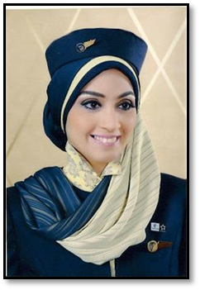
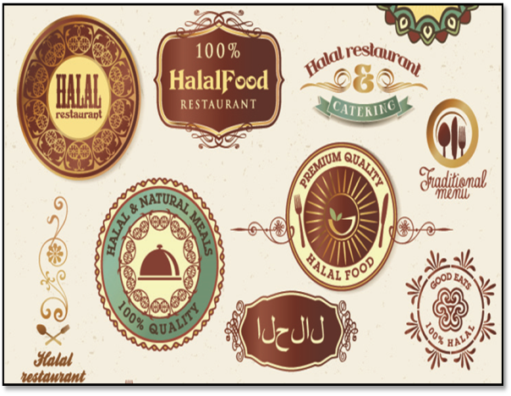

On-going Challenges
Lack of unified and global standards and certification
Financial Constraints for the Islamic tourism industry
Gender related issues: female employment in tourism sector
Differences in the influence of Islamic values and beliefs

Slide 10




Opportunities
Potential for economic growth
Innovative tourism products
Social media for marketing

Slide 11
Policy Recommendations:
At the National and the OIC Cooperation Level
Harmonization of policies and guidelines
At the Industry Level
Organizing Islamic tourism events
Utilizing the media
Designing long-term strategies and master plans
Sharing of expertise and experiences
Cooperation for making a positive image
Ensuring Halal
Training the staff
Facilitating the access
Paying attention to diversity
Proper accommodation management
Information about halal food
Offering gender specific facilities
Appropriate dress code for the staff
Suitable marketing strategies

Slide 12
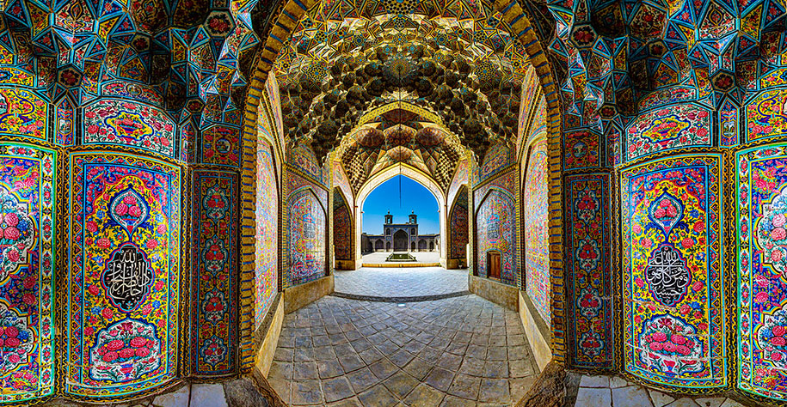
Thank you for your attention
Maedeh Bon
mbon@sesric.org

