Slide 1




Integration TQS into Azerbaijan Household Budget Survey
Azərbaycan Respublikasının Dövlət Statistika Komitəsi
Nail İmanov - Deputy Head of Department of Life Quality Statistics
Muharram Baghirlı - Advisor of Department of Life Quality Statistics

Slide 2
About poverty in the country
According to 2014 UNDP assessment in Human Development Index Azerbaijan ranked 78th among 188 countries. Since 1995 to 2014 this estimate has increased from 0.568 to 0.751, and is in the middle of the list of highly developed countries.
The crisis related to the price of oil in the world market is being reflected on the life of poor segments of population, who are firstly faced with decline in earnings.

Slide 3
Azerbaijan's economy is focused on the use of natural resources, and not on diversification of the economy. This factor led to the fact that the drop in oil prices led to a devaluation of the national currency, affected the strength and stability of human development. In this situation, the problem of poverty is one of the most important socio-economic problems of the Republic. To effectively solve this problem requires a number of conditions. One of them is the selection of the poverty assessment indicators that are sufficiently reliable, comparable in time and space, as well as available for measurement.

Slide 4
Collection, entry and processing of data of households’ sample survey
Method of households sampling is developed in 2000 based on the recommendations of the World Bank experts. Since 2014, the State Statistics Committee of Azerbaijan has approved the program of reforming of household surveys. In order to provide representativity (0.5%), the government decided to raise the number of interviewers from 125 to 255. The sample size is determined based on the principle of optimal combination of cost and accuracy of results. The scope of work of each interviewer is 40 households in one quarter on a regular basis. Visiting of the families and data collection is being started in accordance with the instructions, schedule and weekly division, provided by the State Statistics Committee.
At the end of the annual cycle all interviewers offered a present number of households not wishing for any reason or no opportunity to participate in the survey. The result is a natural rotation of 7-10 percent.

Slide 5
Sampling survey is conducted in all economic regions of the country by a selective method and based on the principles of voluntary participation of households.
Coverage: All households living in the Republic of Azerbaijan, with the exception of the collective.
Sample size: survey covers 10.2 thousand households (in which 40,200 members of the household) on a quarterly basis. Taking into account the requirements, the optimal size of the sample-more than 0, 5% -was calculated and adopted.
Compilation of the sample: Used territorial random sampling, based on the 1999 census data on the level of economic regions of the Azerbaijan Republic, urban and rural population.
Representativeness: The sample provides a representative survey on the results of economic regions and the whole country.
Interviewer’s burden: the burden per interviewer in urban and rural areas is 40 households.

Slide 6
DATA PROCESSING on clusters requires careful organization. The data processing is divided into 2 stages: primary and secondary data processing
PRIMARY DATA PROCESSING - obtaining reliable data files. Primary data processing involves the following steps:
- The introduction of questionnaires on the cluster in a data file;
- Verification of the data file structure;
- The re-introduction of data and the subsequent verification of the data file;
- Create a backup trusted and reconciled data file;
- The second level of editing the data file;
- make a copy of the edited or final data file.
SECONDARY DATA PROCESSING - is provision with analytical data files and the preparation of standard tables. Secondary data processing involves the following steps:
- Integration of all data files in the cluster by one data file;
- Export of data in SPSS system;
- Calculation of sample weights;
- Calculation of the index of well-being;
- Recoding variables to simplify analysis;
- Creation of tables required for data analysis;
- Archiving and dissemination of data files

Slide 7
The results of the survey are being developed in the whole Republic, by economic regions. The outcomes are microdata containing anonymized information for each household during the period of examination and aggregated data, developed in accordance with the official statistical methodology. In developing the budget survey the results of the statistical weights are applied, allowing to distribute the results of the survey on the general population. The main aggregates developed on the basis of the survey include: disposable resources of households; cash income of households; consumption expenditure of households; final consumption expenditure of households.
The findings allow to develop consumption indicators for grouping a large number of features that characterize the households and their members in various aspects.
Publication of the results of sample survey of household budgets is carried out by State Statistics Committee on a regular basis.

Slide 8
Integration TQS into Household Budget Survey
SESRIC organized a study visit on 'Integration of Tobacco Questions for Surveys (TQS): Module 1- Survey Design and Methodology' on 13-15 April 2015 in Baku with the participation of seven officials from Household Budget Survey and LSMS Department of the State Statistical Committee (SSC) of the Republic of Azerbaijan under the frame of the project initiated by SESRIC on the Integration of TQS into ongoing national surveys in Organization of Islamic Cooperation (OIC) Member States. The study visit was facilitated by Mr. Mehmet Günal, Expert from Health Statistics Department of Turk Stat.
The study visit focused on the following items:
-Global Adult Tobacco Survey Applications General Information (2008, 2012)
-Global Adult Tobacco Survey Applications 2012 Questionnaire
-Turkey Health Survey Applications General Information (2008, 2010, 2012, 2014)
-Turkey Health Survey Questionnaire 2008, 2010, 2012, 2014 – Tobacco Module
-Comparison: Global Adult Tobacco Survey, Turkey Health Survey (2008, 2010, 2012)

Slide 9
GATS Objectives
Global study of adult population about smoking is the world standard of the systematic monitoring of tobacco use among adults and monitoring of key indicators of tobacco control.
The study is a national representative survey that uses standart protocol in all countries of the world, including Azerbaijan.
GATS increases capacity of the country in the field of development, implementation and estimation of the program on tobacco control. This survey gives opportunity to the countries to fulfill their obligations in accordance with WHO World Framework Convention on Tobacco Control (FCTC) to gather comparable data inside of the country and across countries. WHO has developed a package of selected measures on reduction of demands.
-Monitorinn of tobacco consumption and prevention policies
-Protection of people from tobacco smoke
-Offering help in order to stop smoking
-Warning on hazards related with tobacco
-ban on distribution of advertising on selling and sponsorship by tobacco companies
-tax increasing on tobacco products

Slide 10
GATS Methodology
GATS uses a global standardized methodology which includes information on respondent, tobacco consumption (smoking and smokeless), stop tobacco use, passive cigarette smoke, economy, mass media, and knowledge, attitudes and aspects, related with tobacco use. GATS has been carried out in Azerbaijan in 2015, as households survey covering persons aged 15 years old and over, by assistance of Main Computing Center in cooperation with SESRIC. Multi-stage, geographically clustered sample design was used to obtain nationally representative data. Generally 5865 households were selected and one person from each household was randomly selected.
Interviews | 255
N household | 23
N people | 1
Total | 5865
Survey information is collected electronically using portable devices. Total
5783 interviews were conducted. The overall level of responses made 98.6%

Slide 11
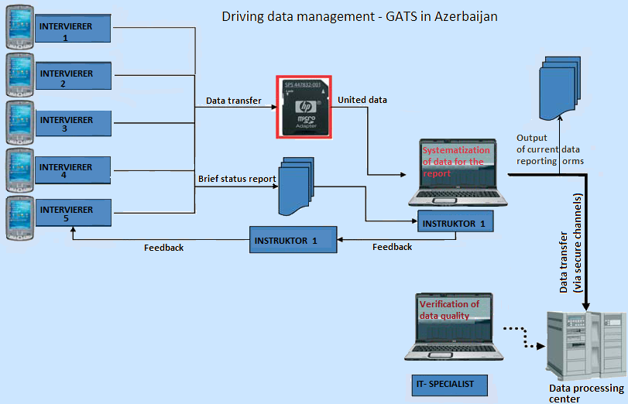
.

Slide 12
Total (ALL)
Total (ALL) | Sample | Cond. survey
 | 5865 | 5783
SEX
Male | 2762 | 2719
Female | 3103 | 3064
Adult
1 Member | 963 | 950
2 Member | 1123 | 1106
3 Member | 959 | 946
4 Member | 1181 | 1162
5 Member | 950 | 941
6+ Member | 689 | 678
Urb_Rur
Urban | 3105 | 3071
Rural | 2760 | 2712
EDUCAT
Doctor of Philosophy | 16 | 15
Master’s degree | 696 | 689
Bachelors | 343 | 339
College | 743 | 726
Technical School | 374 | 370
Secondary | 3033 | 2993
Basic | 573 | 566
Primary | 84 | 82
No education | 3 | 3

Slide 13
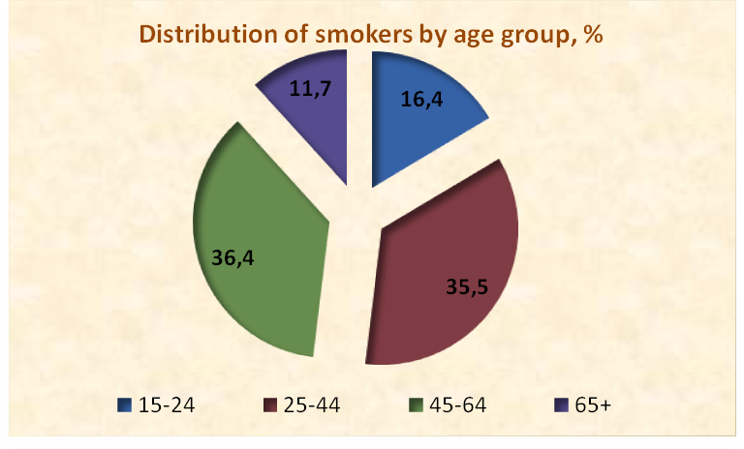
The following table shows the
distribution of adults by various demographic characteristics.
Countries may choose to reporting other demographic characteristics such as religion, race / ethnicity, employment status, wealth, marital status, literacy, or the geographic region and others
Total (ALL) | 5783
age_grup
15-24 | 950
25-44 | 2052
45-64 | 2103
65+ | 678

Slide 14
Detailed Smoking Status by Gender, %
Smoking Status | Over-all | Male | Female
Current tobacco smoker | 17,6 | 35,3 | 1,3
Daily smoker | 17,0 | 34,1 | 1,2
Occasional smoker | 0,6 | 1,2 | 0,1
Occasional smoker, formerly daily | 0,3 | 0,5 | -
Occasional smoker, never daily | 0,4 | 0,7 | 0,1
Current non-smoker | 82,4 | 64,7 | 98,7
Former smoker | 2,1 | 4,0 | 0,4
Former daily smoker | 0,8 | 1,6 | 0,2
Former occasional smoker | 1,3 | 2,4 | 0,3
Never smoker | 80,3 | 60,7 | 98,3

Slide 15
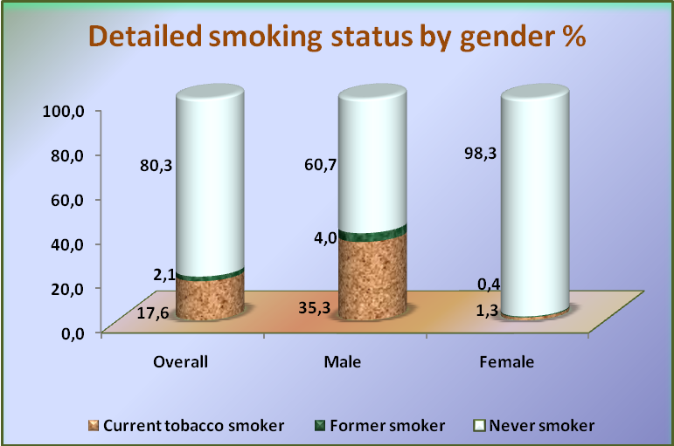

Slide 16
Current Smokers of Various Smoked Tobacco Products,
by Selected Demographic Characteristics, %
Demographic Characteristics | Type of Cigarette
 | Any smoked tobacco product | Any cigarette¹ | Manufac-tured | Hand-rolled | Other smoked tobacco²
Overall | 17,6 | 17,5 | 17,5 | 0,0 | 0,9
Gender
Male | 35,3 | 35,1 | 35,1 | 0,0 | 1,6
Female | 1,3 | 1,2 | 1,2 | - | 0,2
Age (years)
15-24 | 5,8 | 5,6 | 5,6 | - | 1,0
25-44 | 18,8 | 18,6 | 18,6 | - | 1,0
45-64 | 22,5 | 22,4 | 22,4 | - | 0,5
65+ | 16,9 | 16,8 | 16,8 | 0,1 | 1,1
Residence
Urban | 17,9 | 17,6 | 17,6 | - | 1,4
Rural | 17,3 | 17,3 | 17,3 | 0,0 | 0,3
Education Level³
Doctor of Philosophy PhD | 10,1 | 10,1 | 10,1 | - | -
Masters degree | 17,1 | 16,9 | 16,8 | - | 1,4
Bachelors degree | 12,9 | 12,9 | 12,9 | - | 1,2
College, technicum (vocational school) | 20,3 | 20,1 | 20,1 | - | 0,7
Technical school | 29,4 | 29,1 | 29,1 | - | 1,7
Secondary | 18,5 | 18,4 | 18,4 | - | 0,6
Basic | 7,9 | 7,4 | 7,4 | - | 1,1
Primary | 6,5 | 6,5 | 6,5 | 0,5 | 0,5
Note: Current use includes both daily and occasional (less than daily) use.
¹ Includes manufactured cigarettes, hand rolled cigarettes, and kreteks. only among respondents 15+ years old.
² Includes [describe products included in “other” category here].
³ Education level is reported only among respondents 15+ years old.

Slide 17
Cigarettes Smoked per Day Among Daily Cigarette Smokers, by Selected Demographic Characteristics, %
Demographic Characteristics | Number of cigarettes smoked on average per day
 | <5 | 5-9 | 10-14 | 15-24 | ≥ 25
Overall | 4,5 | 7,3 | 22,2 | 59,2 | 6,8
Gender
Male | 4,5 | 7,1 | 21,8 | 60,1 | 6,5
Female | 3,4 | 14,3 | 30,6 | 35,9 | 15,8
Age (years)
15-24 | - | 2,0 | 32,4 | 65,7 | -
25-44 | 4,4 | 8,5 | 28,4 | 53,4 | 5,3
45-64 | 5,2 | 7,3 | 17,2 | 62,1 | 8,1
65+ | 3,8 | 6,4 | 19,5 | 61,4 | 8,9
Residence
Urban | 5,1 | 9,9 | 25,7 | 52,2 | 7,1
Rural | 3,8 | 4,3 | 17,9 | 67,6 | 6,4
Education Level²
Doctor of Philosophy PhD | - | - | 44,9 | - | 55,1
Masters degree | 6,5 | 15,4 | 15,8 | 55,7 | 6,7
Bachelors degree | 3,2 | 4,2 | 26,5 | 50,5 | 15,6
College, technicum (vocational school) | 5,1 | 9,0 | 20,6 | 60,2 | 5,3
Technical school | 8,6 | 3,9 | 15,3 | 60,8 | 11,4
Secondary | 3,6 | 6,6 | 25,6 | 59,2 | 5,0
Basic | - | 1,4 | 13,0 | 71,7 | 14,0
Primary | - | - | 30,7 | 61,9 | 7,4

Slide 18
Exposure to Tobacco Smoke at Home, by Smoking status and Selected Demographic Characteristics , %
Demographic Characteristics | Respondents exposed to tobacco smoke at home¹
 | Overall | Non-smokers
Overall | 24,4 | 18,2
Gender
Male | 27,6 | 13,5
Female | 21,5 | 21,1
Age (years)
15-24 | 22,3 | 20,1
25-44 | 26,2 | 19,2
45-64 | 24,6 | 17,3
65+ | 22,2 | 15,1
Residence
Urban | 25,7 | 19,0
Rural | 22,9 | 17,2
Education Level²
Doctor of Philosophy PhD | 4,5 | -
Masters degree | 19,1 | 14,0
Bachelors degree | 19,7 | 14,2
College, technicum (vocational school) | 26,2 | 18,7
Technical school | 30,2 | 21,3
Secondary | 25,6 | 19,3
Basic | 23,2 | 18,9
Primary | 16,0 | 14,2
1 Respondents who reported that smoking inside the home occurs daily, weekly, or monthly. ² Education level is reported only among respondents 15+ years old.

Slide 19
Exposure to Tobacco Smoke at Indoor Work Areas, by Smoking Status and Selected Demographic Characteristics, %
Demographic Characteristics | Respondents exposed to tobacco smoke at work¹
 | Overall | Non-smokers
Overall | 45,1 | 42,1
Gender
Male | 54,3 | 53,2
Female | 33,0 | 33,0
Age (years)
15-24 | 48,1 | 47,6
25-44 | 47,8 | 45,0
45-64 | 41,9 | 38,1
65+ | 45,9 | 42,2
Residence
Urban | 45,8 | 43,1
Rural | 43,5 | 40,1
Education Level3
Doctor of Philosophy PhD | 50,7 | 50,7
Masters degree | 35,8 | 33,6
Bachelors degree | 44,0 | 44,4
College, technicum (vocational school) | 40,8 | 36,2
Technical school | 46,5 | 46,6
Secondary | 50,8 | 47,1
Basic | 59,9 | 56,4
Primary | 6,4 | 8,2
¹ In the past 30 days. Among those respondents who work outside of the home who usually work indoors or both indoors and outdoors. ^{\2} Education level is reported only among respondents 15+ years old

Slide 20
Current Smokers who Made a Quit Attempt and Received Health Care Provider Assistance in the Past 12 Months, by Selected Demographic Characteristics
Demographic Characteristics | Smoking cessation and health care seeking behavior
 | Made quit attempt¹ | Visited a HCP^{1,2} | Advised to quit by HCP^{2,3}
Overall | 42,8 | 26,8 | 74,2
Gender
Male | 42,7 | 27,1 | 74,7
Female | 44,4 | 19,2 | 56,4
Age (years)
15-24 | 35,8 | 13,7 | 82,9
25-44 | 44,8 | 27,2 | 78,0
45-64 | 42,8 | 26,3 | 69,9
65+ | 40,1 | 34,2 | 77,2
Residence
Urban | 41,9 | 21,2 | 86,3
Rural | 43,8 | 33,6 | 64,9
Education Level⁴
Doctor of Philosophy PhD | 55,1 | - | 83,5
Masters degree | 45,3 | 23,4 | 85,7
Bachelors degree | 52,0 | 34,7 | 87,9
College, technicum (vocational school) | 48,3 | 24,4 | 82,7
Technical school | 43,3 | 19,7 | 65,8
Secondary | 40,6 | 28,7 | 92,6
Basic | 31,2 | 26,4 | 81,2
Primary | 81,0 | 61,9 | -
¹ Among current smokers.
² HCP = health care provider.
³ Among current smokers who visited a HCP during the past 12 months.
⁴ Education level is reported only among respondents 15+ years old.

Slide 21
Noticing Anti-Cigarette Smoking Information During the Last 30 Days in Newspapers or Magazines and Television, by Smoking Status and Selected Demographic Characteristics , %
Places | Overall | Gender |  | Age (years) |  | Residence
 |  | Male | Female | 15-24 | ≥ 25 | Urban | Rural
Overall
In newspapers or in magazines | 43,2 | 48,4 | 38,3 | 43,9 | 43,0 | 42,6 | 43,9
On television | 66,3 | 71,7 | 61,4 | 66,9 | 66,2 | 65,3 | 67,5
Current smokers¹
In newspapers or in magazines | 49,2 | 49,0 | 52,8 | 56,2 | 48,8 | 47,9 | 50,7
On television | 75,6 | 76,3 | 57,0 | 69,3 | 76,0 | 73,7 | 77,9
Non-smokers²
In newspapers or in magazines | 41,9 | 48,1 | 38,2 | 43,1 | 41,6 | 41,4 | 42,4
On television | 64,3 | 69,1 | 61,4 | 66,8 | 63,7 | 63,5 | 65,3

Slide 22
Current Smokers who Noticed Health Warnings on Cigarette Packages and Considered Quitting Because of the Warnings During the Last 30 Days, by Selected Demographic Characteristics , %
 | Current smokers1 who…
 | Noticed health warnings on cigarette package2 | Thought about quitting because of warning label2
Overall | 87,6 | 48,3
Gender
Male | 88,3 | 48,9
Female | 70,1 | 33,0
Age (years)
15-24 | 84,1 | 39,5
25-44 | 89,6 | 52,4
45-64 | 87,1 | 45,5
65+ | 85,5 | 52,0
Residence
Urban | 84,3 | 48,6
Rural | 91,6 | 48,0
Education Level³
Doctor of Philosophy PhD | 100,0 | 55,1
Masters degree | 85,9 | 52,0
Bachelors degree | 83,8 | 53,0
College, technicum (vocational school) | 87,5 | 55,8
Technical school | 83,8 | 44,6
Secondary | 88,9 | 46,8
Basic | 87,4 | 34,6
Primary | 100,0 | 81,0
¹ Includes daily and occasional (less than daily) smokers.
² During the last 30 days.
³ Education level is reported only among respondents 15+ years old.

Slide 23
Noticing Cigarette Advertising During the Last 30 Days in Various Places, by Selected Demographic Characteristics, %
Places | Overall | Gender |  | Age (years) |  | Residence
 |  | Male | Female | 15-24 | ≥ 25 | Urban | Rural
Noticed advertisements in stores | 24,3 | 29,0 | 19,9 | 22,2 | 24,7 | 26,1 | 22,0
Noticed cigarette promotions | 13,8 | 17,4 | 10,5 | 11,8 | 14,2 | 18,3 | 8,5
Free samples | 1,9 | 3,0 | 0,9 | 2,0 | 1,9 | 2,5 | 1,2
Sale prices | 3,0 | 4,5 | 1,6 | 2,6 | 3,0 | 4,2 | 1,5
Coupons | 4,5 | 5,1 | 4,0 | 3,1 | 4,9 | 7,3 | 1,2
Free gifts/discounts on other products | 5,7 | 7,5 | 4,1 | 3,9 | 6,1 | 8,0 | 3,1
Clothing/item with brand name or logo | 5,7 | 6,9 | 4,6 | 6,1 | 5,6 | 6,9 | 4,2
Mail promoting cigarettes | 1,1 | 1,6 | 0,6 | 1,3 | 1,0 | 1,7 | 0,3

Slide 24
Average Amount Spent on a Pack of Cigarettes and Cost of 100 Packs of Cigarettes as a Percentage of Gross Domestic Product (GDP) per Capita
Local Currency, AZN
Average amount spent on 20 manufactured cigarettes | 1,4
 | Overall (%)
Cost of 100 packs of manufactured cigarettes as a percentage of per capita Gross Domestic Product (GDP) | 2,4
The table provides two economic indicators which are calculated among current smokers who smoke manufactured cigarettes at least once per week. Both of these estimates use a weighted average cost that is equivalent to the total expenditure on manufactured cigarettes per day across the target population divided by the total daily consumption of manufactured cigarettes.

Slide 25
Discussion Regulated by law, the fight against tobacco
The "tobacco or tobacco products" on the law are subject to fines for smoking in prohibited places. This is reflected in the Code of Administrative Offences. According to the Code places where smoking is prohibited by law, shall be fined 30 manat.
According to the Code enterprises, institutions, organizations and visible allocation of special places for smoking, the "No Smoking" sign warning letter or a failure to ensure that the officials in the amount of 400 manat (250 $), legal entities shall be fined in the amount of 1,000 manat (645 $ ).
"Tobacco or tobacco products" on the basis of law, education, health, health and cultural facilities, as well as sports competitions and other events in the halls, administrative buildings and private offices, excluding special places for smoking in the workplace, high-class restaurants, cafes, bars, except for the trade, public catering, household facilities, residential buildings and other indoor places of public use, transport distance, except for specially designated areas, smoking is prohibited in all forms of public transport.
Sale of tobacco and tobacco products is prohibited in the following cases:
1. In the absence of relevant certificates for each shipment of products;
2. marking with excise stamps and tobacco products;
3. nicotine, tar and carbon monoxide content of more than the upper limit;
4. tobacco box warning about the harmful effects of smoking on health are absent;
5. Making boxes of tobacco products and to maintain compliance with the requirements of the relevant regulatory documents;
6. The sale to persons under the age of 18;
7. sold through vending;
8. cigarettes, cigarettes and cigarillos sold piecemeal.
In addition, other paragraphs of the law where necessary is planned:
1. If necessary, buyers sellers of tobacco products shall have the right to request a document proving their age.
2. training, educational, health, medical and cultural facilities, as well as the sale of goods in the sale of tobacco products to children and adolescents is not allowed.
3. The harmful effects of smoking in places of trade in tobacco products, ban the sale of tobacco products to persons under the age of 18, as well as other articles that serve to restrict the use of tobacco products should be.

