Slide 1
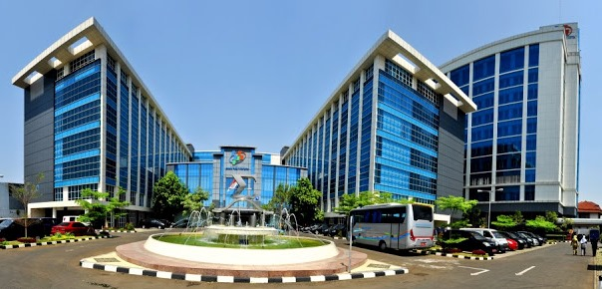
TOBACCO QUESTIONS IMPLEMENTATION INDONESIA EXPERIENCE By Team of BPS-Statistics Indonesia
Presented On Orientation Workshop
On Tobacco Questions for Survey (TQS)
Co-Organized by The SESRIC, WHO,CDC and Prevention, and CDC-Foundation
Ankara-Turkey, 3-4 May 2016

Slide 2
OUTLINE
Indonesia overview
Tobacco data collection
Tobacco data from Gats
Tobacco data from Susenas

Slide 3
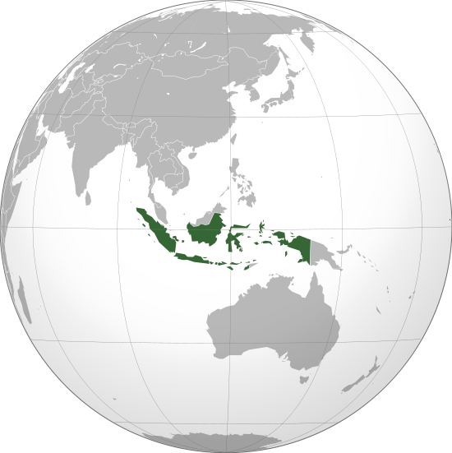
Indonesia Overview
Population: 237,641,326 people
Area: 1,910,931.32 km²
Source: BPS, 2010
Source: Ministry of Home Affairs, 2011
Sex Ratio: 101 men of 100 women
Smokers aged 15 years and over: 30.2%
vs
Non-smokers aged 15 years and over : 69.8%
Source: BPS, 2014
Source: BPS, 2015

Slide 4
Tobacco data collection

Slide 5
Tobacco Data Collection in BPS
GATS
GLOBAL ADULT TOBACCO SURVEY
Collected in 2011
Nationally representative household survey of person age 15 years and above
SUSENAS
NATIONAL SOCIO-ECONOMIC SURVEY
(CORE QUESTIONNAIRE)
Collected every year since 2015
Nationally representative household survey of persons age 5 years and above
.

Slide 6
Tobacco data from GATS

Slide 7
Indonesia Global Adult Tobacco Survey
Conducted in 2011;
Produce national and urban-rural and male-female estimates;
Target population are all non-institutionalized men and women, 15 years of age and over, who consider the country to be their usual place of residence;

Slide 8
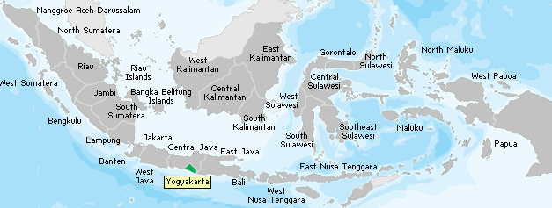
Country Residence Requirement for GATS
Residents of Indonesia :
citizens of and residing in Indonesia, or
non-citizens living in Indonesia, but who consider Indonesia to be their usual country of residence

Slide 9
Sampling design
First Stage; select n PSUs from N PSU in the sampling frame using Probability Proportional to Size (PPS) technique, that is number of ordinary households in each PSU resulting from 2010 Population Census.
Second Stage; select three census blocks (CBs) from the selected PSUs using PPS technique.
Before selecting the households, the list of households are first updated by field enumerator in each selected census block.
Third Stage; systematically select 30 households from the selected CBs

Slide 10
Number of sample
19 provinces
77 districts
9,000 HH
300 CB
100 PSU

Slide 11
Tobacco Smoking Prevalence Questions and Analysis Indicators
(for Monitoring)
Tobacco Topic | Indicator Name and Description
Q1. Current tobacco smoking status | Current Tobacco Smokers Percentage of respondents who currently smoke tobacco
 | Current Daily Tobacco Smokers Percentage of respondents who curently smoke tobacco daily
Q2a. Past daily smoking status (for current less than daily smokers) | Former Daily Tobacco Smokers (Among All Adults) Percentage of respondents who are ever daily tobacco smokers and currently do not smoke tobacco
Q2b. Past smoking status (for current non-smokers) | Former Daily Tobacco Smokers (Among Ever Daily Smokers) Percentage of ever daily tobacco smokers who currently do not smoke tobacco
Q3. Number of tobacco products smoked per day | Current (Product) Smokers Percentage of respondents who currently smoke (product)
 | Cigarettes Smoked per Day Average number of cigarettes smoked per day (of daily cigarette smokers)

Slide 12
Tobacco Smoking Prevalence Questions and Analysis Indicators
(for Monitoring)
Tobacco Topic | Indicator Name and Description
Q4. Current smokeless tobacco use | Current Smokeless Tobacco Users Percentage of respondents who currently use smokeless tobacco
 | Current Daily Smokeless Tobacco Users Percentage of respondents who currently use smokeless tobacco daily
Q5a. Past daily smokeless use (for current less than daily users) | Former Daily Smokelss Tobacco Users (Among All Adults) Percentage of respondents who are ever daily smokeless tobacco users and currently do not use smokeless tobacco
Q5b. Past smokeless use (for current non-users) | Former Daily Smokelss Tobacco Users (Among Ever Daily Users) Percentage of ever daily smokeless tobacco users who currently do not use smokeless tobacco

Slide 13
Tobacco Smoking Prevalence Questions and Analysis Indicators
(for Protecting)
Tobacco Topic | Indicator Name and Description
Q6. Frequency of anyone smoking at home | Exposure to Secondhand Smoke at Home Percentage of respondents who report that smoking occurs inside their home
Q7. Currently work outside home | Exposure to Secondhand Smoke at Work Percentage of indoor workers who were exposed to tobacco smoke at work in the past 30 days
Q8. Work indoor/outdoor
Q9. Anyone smoke at work during the past 30 days

Slide 14
Tobacco Smoking Prevalence Questions and Analysis Indicators
(for Offering)
Tobacco Topic | Indicator Name and Description
Q10. Tried to quit in past 12 months | Smoking Quit Attempt in the Past 12 Months Percentage of current tobacco smokers who tried to quit during the past 12 months
Q11. Visiting a doctor in past 12 months | Health Care Provider’s Advice to Quit Smoking Tobacco Percentage of current tobacco smokers who visited a doctor or health care provider during the past 12 months and were advised to quit smoking tobacco
Q12. Receiving advice to quit smoking from doctor

Slide 15
Tobacco Smoking Prevalence Questions and Analysis Indicators
(for Warning)
Tobacco Topic | Indicator Name and Description
Q13. Noticing anti-cigarette information in newspapers or magazines | Awerness of anti-Cigarette information in Newspapers/Magazines Percentage of respondents who have noticed information about the dangers of smoking cigarettes or that encourages quitting in neswpapers or magazines in the last 30 days
Q14. Noticing anti-cigarette information on television | Awerness of anti-Cigarette information onTelevision Percentage of respondents who have noticed information about the dangers of smoking cigarettes or that encourages quitting on television in the last 30 days
Q15. Noticing health warnings on cigarette packs | Noticing Health Warning Labels on Cigarette Packages Percentage of current smokers who noticed health warnngs on cigarette packages in the last 30 days
Q16. Thingking about quitting because of health warnings | Thingking of Quitting Because of Health Warning Labels on Cigarette Packages Percentage of current tobacco smokers who reported thingking about quitting smoking in the last 30 days because of the warning labels on cigarette packages

Slide 16
Tobacco Smoking Prevalence Questions and Analysis Indicators
(for Enforce)
Tobacco Topic | Indicator Name and Description
Q17. Noticing cigarette advertisements in stores | Awereness of Cigarette Advertasing in Stores Percentage of respondents who have noticed any advertisements or signs promoting cigarettes in stores where cigarettes are sold in the last 30 days
Q18. Noticing cigarette promotiong | Awareness of Specific Types of Cigarette Promotion Percentage of respondents who noticed (free sanples of cigarettes, cigarettes at sales prices, coupons for cigarettes, free gifts or discounts on other products when buying cigarettes, clothing or other items with a cigarette brand name or logo, cigarette promotionin the mail) in the last 30 days

Slide 17
Tobacco Smoking Prevalence Questions and Analysis Indicators
(for Raise)
Tobacco Topic | Indicator Name and Description
Q19. Last cigarette purchase – quantity | Cost of Manufactured Cigarettes Average amount spent on a pack of manufactured cigarettes (in local currency)
Q20. Last cigarette purchase – cost | Cigarette Affordability Average cost of 100 packs of manufactured cigarettes as a percentage of Gross Domestic Product (GD) per capita

Slide 18
Tobacco data from Susenas
Natio Socio-Economic Survey

Slide 19
Coverage
Susenas Core (2015 and 2016, March)
Conducted every year
Sample size = 300,000 HHs
Susenas Housing and Health Module
(2016, September)
Conducted every three year
Sample size = 75,000 HHs

Slide 20
Methodology of Susenas 2015 - 2016
300.000 CBs
(Result of Mapping 2010 Census Population)
with PPS
154.557 PSU
(Group of CBs)
30.000 PSU
Susenas Core (March)
with Wealth Index
30.000 CBs
Rural
Modul– Sept. = 7.500 CBs
Urban
n CBs
n CBs
Urban
Rural
10 HH/CBs
10 HH/CBs
n CBs
n CBs
300.000 HH
10 HH/CBs
10 HH/CBs
75.000 HH

Slide 21
Sampling method
(Susenas 2015-2016)
Stratification
Based on Population Census 2010, about 720 thousand CB stratified by household welfare level using wealth index as well as urban/rural areas
Implicit stratification by household head level of education

Slide 22
Sampling method
(Susenas 2015-2016)
- 2 -
Sampling frame
Master sampling frame of Susenas is selected approximately 180 thousand census blocks (25% of the total census block) which are selected by Proportional Population to Size (PPS) with the number of households from the 2010 Population Census

Slide 23
Sampling method
(Susenas 2015-2016)
- 3-
March Samples
September Samples
34 provinces
511 districts
30,000 CBs
300,000 HHs
Estimates district level
34 provinces
511 districts
7,500 CBs
75,000 HHs
Estimates province level
34 provinces
511 districts
7,500 CB
75,000 HH
Estimates province level

Slide 24
Tobacco questions in Susenas core 2015 and 2016
No. | Name of Household Member | ….. | Household Member Aged 5 Years and Over
 |  |  | In the last month, do you currently smoke tobacco? Yes, daily ➔ 809 Yes, less than daily 5. Not at all ➔ 810 8. Don’t know  other HH member | If 807 = 2, Have you smoked tobacco daily in the pass? 1. Yes 5. No 8. Don’t know | In the last month, how many cigarettes on average per week? (cigarette) (continue to other HH member) | If 807 = 5, In the past, have you smoked tobacco? Yes, daily Yes, less than daily 5. Not at all 8. Don’t know  other HH member
801 | 802 | ..... | 807 | 808 | 809 | 810
1 |  | ….. |  |  |  | 
2 |  | ….. |  |  |  | 
3 |  | ….. |  |  |  | 

Slide 25
Result

Slide 26
Number of Household Sample, Selected Respondent, and Tobacco Prevalence
Tobacco Survey | Number of Household Sample | Selected Respondent | Tobacco Prevalence
 |  |  | Men | Women | Total
GATS Indonesia 2011 | 9,000 | Only one HH member aged 15 years and over | 67.0 | 2.7 | 34.8
Susenas Housing and Health Module 2013 | 75,000 | All HH members aged 15 years and over | 62.7 | 1.4 | 32.0
 |  | All HH members aged 10 years and over | 55.2 | 1.3 | 28.3
Susenas Core 2015 | 300,000 | All HH members aged 15 years and over | 59.3 | 1.3 | 30.2
 |  | All HH members aged 10 years and over | 52.4 | 1.2 | 26.8
 |  | All HH members aged 5 years and over | 46.7 | 1.0 | 23.9

Slide 27
Tobacco use - GATS Indonesia 2011
Current tobacco smokers by sex
Age 15 and over
67.0% 2.7%
.
Male Current Tobacco Smokers by Age
Female Current Tobacco Smokers by Age
15-24 | 51.7%
18-24 | 73.3%
45-64 | 72.4%
65+ | 61.2%
15-24 | 0.1%
18-24 | 1.7%
45-64 | 5.8%
65+ | 6.7%

Slide 28
Tobacco use - GATS Indonesia 2011 -2-
Average number cigarettes smoked per day
13.0 8.1
.
Average age at daily smoking initiation
17,6 *
*the data for women are not reported due to small sample size

Slide 29
Tobacco use – Susenas Core 2015
Current tobacco smokers by sex
Age 15 and over
59.3% 1.3%
.
Male Current Tobacco Smokers by Age
Female Current Tobacco Smokers by Age
15-24 | 38.4%
18-24 | 50.5%
45-64 | 63.4%
65+ | 48.3%
15-24 | 0.6%
18-24 | 0.7%
45-64 | 2.0%
65+ | 2.5%

Slide 30
Tobacco use – Susenas Core 2015 -2-
Average number cigarettes smoked per day
11.3 8.3
.
Average age at daily smoking initiation
* *
*data for age at daily smoking initiation not collected

Slide 31
Tobacco prevalence of people aged 15 years and over
Tobacco smokers | 2011 ¹⁾ |  |  | 2013 ²⁾ |  |  | 2015 ³⁾
 | Men | Women | Overall | Men | Women | Overall | Men | Women | Overall
Current tobbaco smokers | 67.0 | 2.7 | 34.8 | 62.7 | 1.4 | 32.0 | 59.3 | 1.3 | 30.2
Daily tobbaco smokers | 56.7 | 1.8 | 29.2 | 52.9 | 1.0 | 26.9 | 53.8 | 1.1 | 27.4
Occasional tobbaco smokers | 10.3 | 0.9 | 5.6 | 9.8 | 0.4 | 5.1 | 5.5 | 0.2 | 2.8
Current non smoker | 33.0 | 97.3 | 65.2 | 37.3 | 98.6 | 68.0 | 40.7 | 98.7 | 69.8
Former smokers | 6.0 | 0.6 | 3.3 | 8.1 | 0.4 | 4.3 | 3.1 | 0.3 | 1.6
Never smokers | 27.0 | 96.7 | 61.9 | 29.2 | 98.2 | 63.7 | 37.6 | 98.4 | 68.1
Note: ¹⁾ Indonesia Global Adult Tobacco Survey 2011
²⁾ Susenas Housing and Health Module ,2013
³⁾ Susenas Core, 2015

Slide 32
Percentage of food expenditure per month per capita of three highest commodity expenditure
Year | Urban |  |  | Rural |  |  | Urban + Rural
 | Prepared food and beverages | Cereals | Tobacco and betel | Prepared food and beverages | Cereals | Tobacco and betel | Prepared food and beverages | Cereals | Tobacco and betel
2010 | 30.6 | 13.4 | 9.4 | 17.8 | 22.1 | 11.2 | 24.9 | 17.3 | 10.2
2011 | 33.6 | 12.1 | 9.5 | 20.3 | 19.1 | 11.6 | 27.8 | 15.1 | 10.4
2012 | 30.0 | 14.6 | 11.2 | 17.9 | 22.4 | 13.2 | 24.9 | 17.9 | 12.1
2013 | 31.5 | 12.9 | 11.2 | 18.2 | 20.9 | 13.8 | 25.9 | 16.3 | 12.3
2014 | 32.5 | 12.3 | 11.4 | 19.2 | 19.7 | 14.3 | 26.7 | 15.5 | 12.6
2015 | 31.8 | 12.8 | 11.2 | 20.2 | 20.5 | 14.1 | 26.7 | 16.2 | 12.5

Slide 33
THANK YOU
TERIMA KASIH

