Slide 1
Morocco: Opportunities to Integrate Tobacco Questions for Survey
Dr Elkhansa Mahdaoui,MD,MPH
Non Communicable Diseases Department
Moroccan Ministry of Health

Slide 2
Morocco: Current Conditions
Smoking is a public health issue:
The current tobacco smoking rate (age 18 and over) is 32.0% for men and 0.2% for women.
The SimSmoke model projects more than 3,370,000 premature deaths of smokers alive (more than 3,350,000 male and 17,000 female deaths) in 2010 (Levy DT and Al. Application of the Abridged SimSmoke model to four Eastern Mediterranean countries, 2015).
The proportion of deaths attributable to tobacco is 8% for age 30 and over (WHO Global Report: Mortality attributable to tobacco 2012).

Slide 3
Age-standardised prevalence estimates for tobacco smoking among all persons aged 15 years and over in Morocco

Slide 4
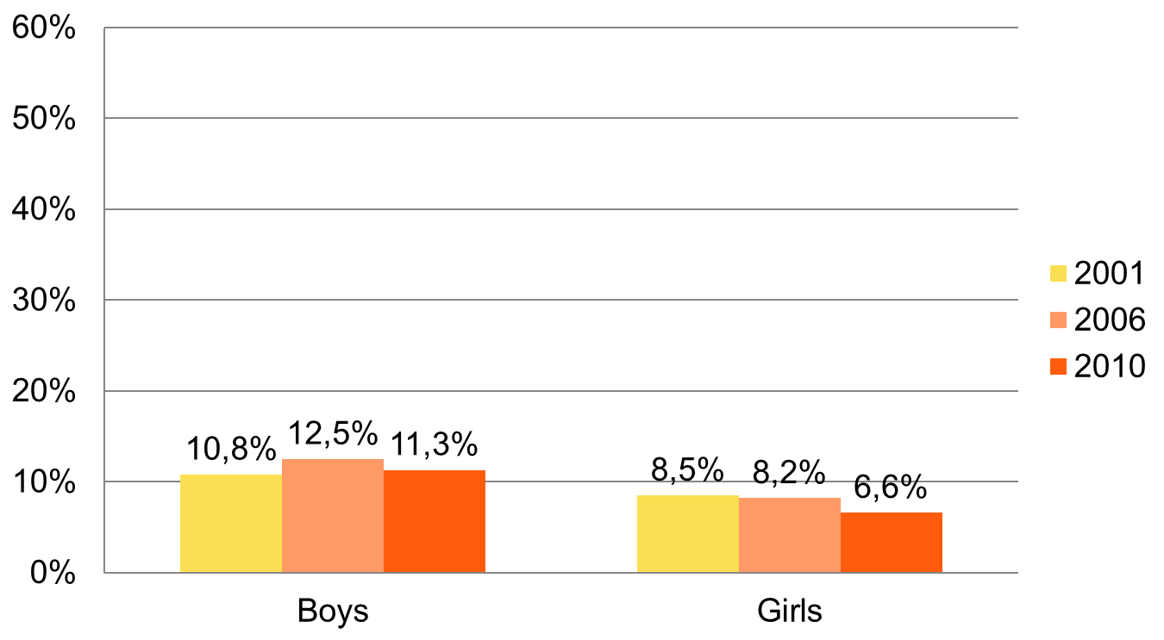
Currently use any tobacco products among 13-15 years old students in Morocco “over time”
Global Youth Tobacco Survey data , Fact sheets Morocco; 2001, 2006, and 2010 .

Slide 5
Currently smoking cigarettes among 13-15 years old students in Morocco “over time”

Slide 6
Key recommended policy
To monitor the epidemic through systematic and regular surveys, covering all population, youth and adults.
Monitoring can provide policy-makers and public health authorities with essential information to fight this epidemic.
Tobacco Questions can be embedded in existing population-based surveys or censuses.

Slide 7
WHO STEPwise approach(1)
Non communicable diseases are responsible for 75% of all deaths in Morocco.
The STEPwise approach is a the WHO’s recommended tool for surveillance of chronic diseases and their risk factors.
Currently, Morocco is preparing to implement the stepwise investigation.

Slide 8
WHO STEPwise approach(2)
STEPwise approach= a good opportunity to use TQS in Morocco.
Using the TQS in the STEPwise survey is a standard set of tobacco questions in surveys.
TQS will help Morocco to improve comparability at the national and international levels.

Slide 9
Methodology
Population targeted: 18 years and over
Sample size: 6050 covering the 12 regions in Morocco
Response rate: 80%
Exclusion criteria:
- poeple who have not given their consent to participate in the investigation and / or those who have been issued two (02) unsuccessful visits .
- Individuals unable to answer questions ( people with special needs : Needs, deaf, dumb , blind).

Slide 10
Others opportunities
The High Commission for Planning (HCP), the main producer of official statistics in Morocco will conduct:
surveys on the living standards of households (2017)
survey on family (every 5 years).

