Slide 1

GATS
GLOBAL ADULT TOBACCO SURVEY
المسح العالمي لاستهلاك التبغ بين البالغين
قـطــر 2013
QATAR 2013

Slide 2
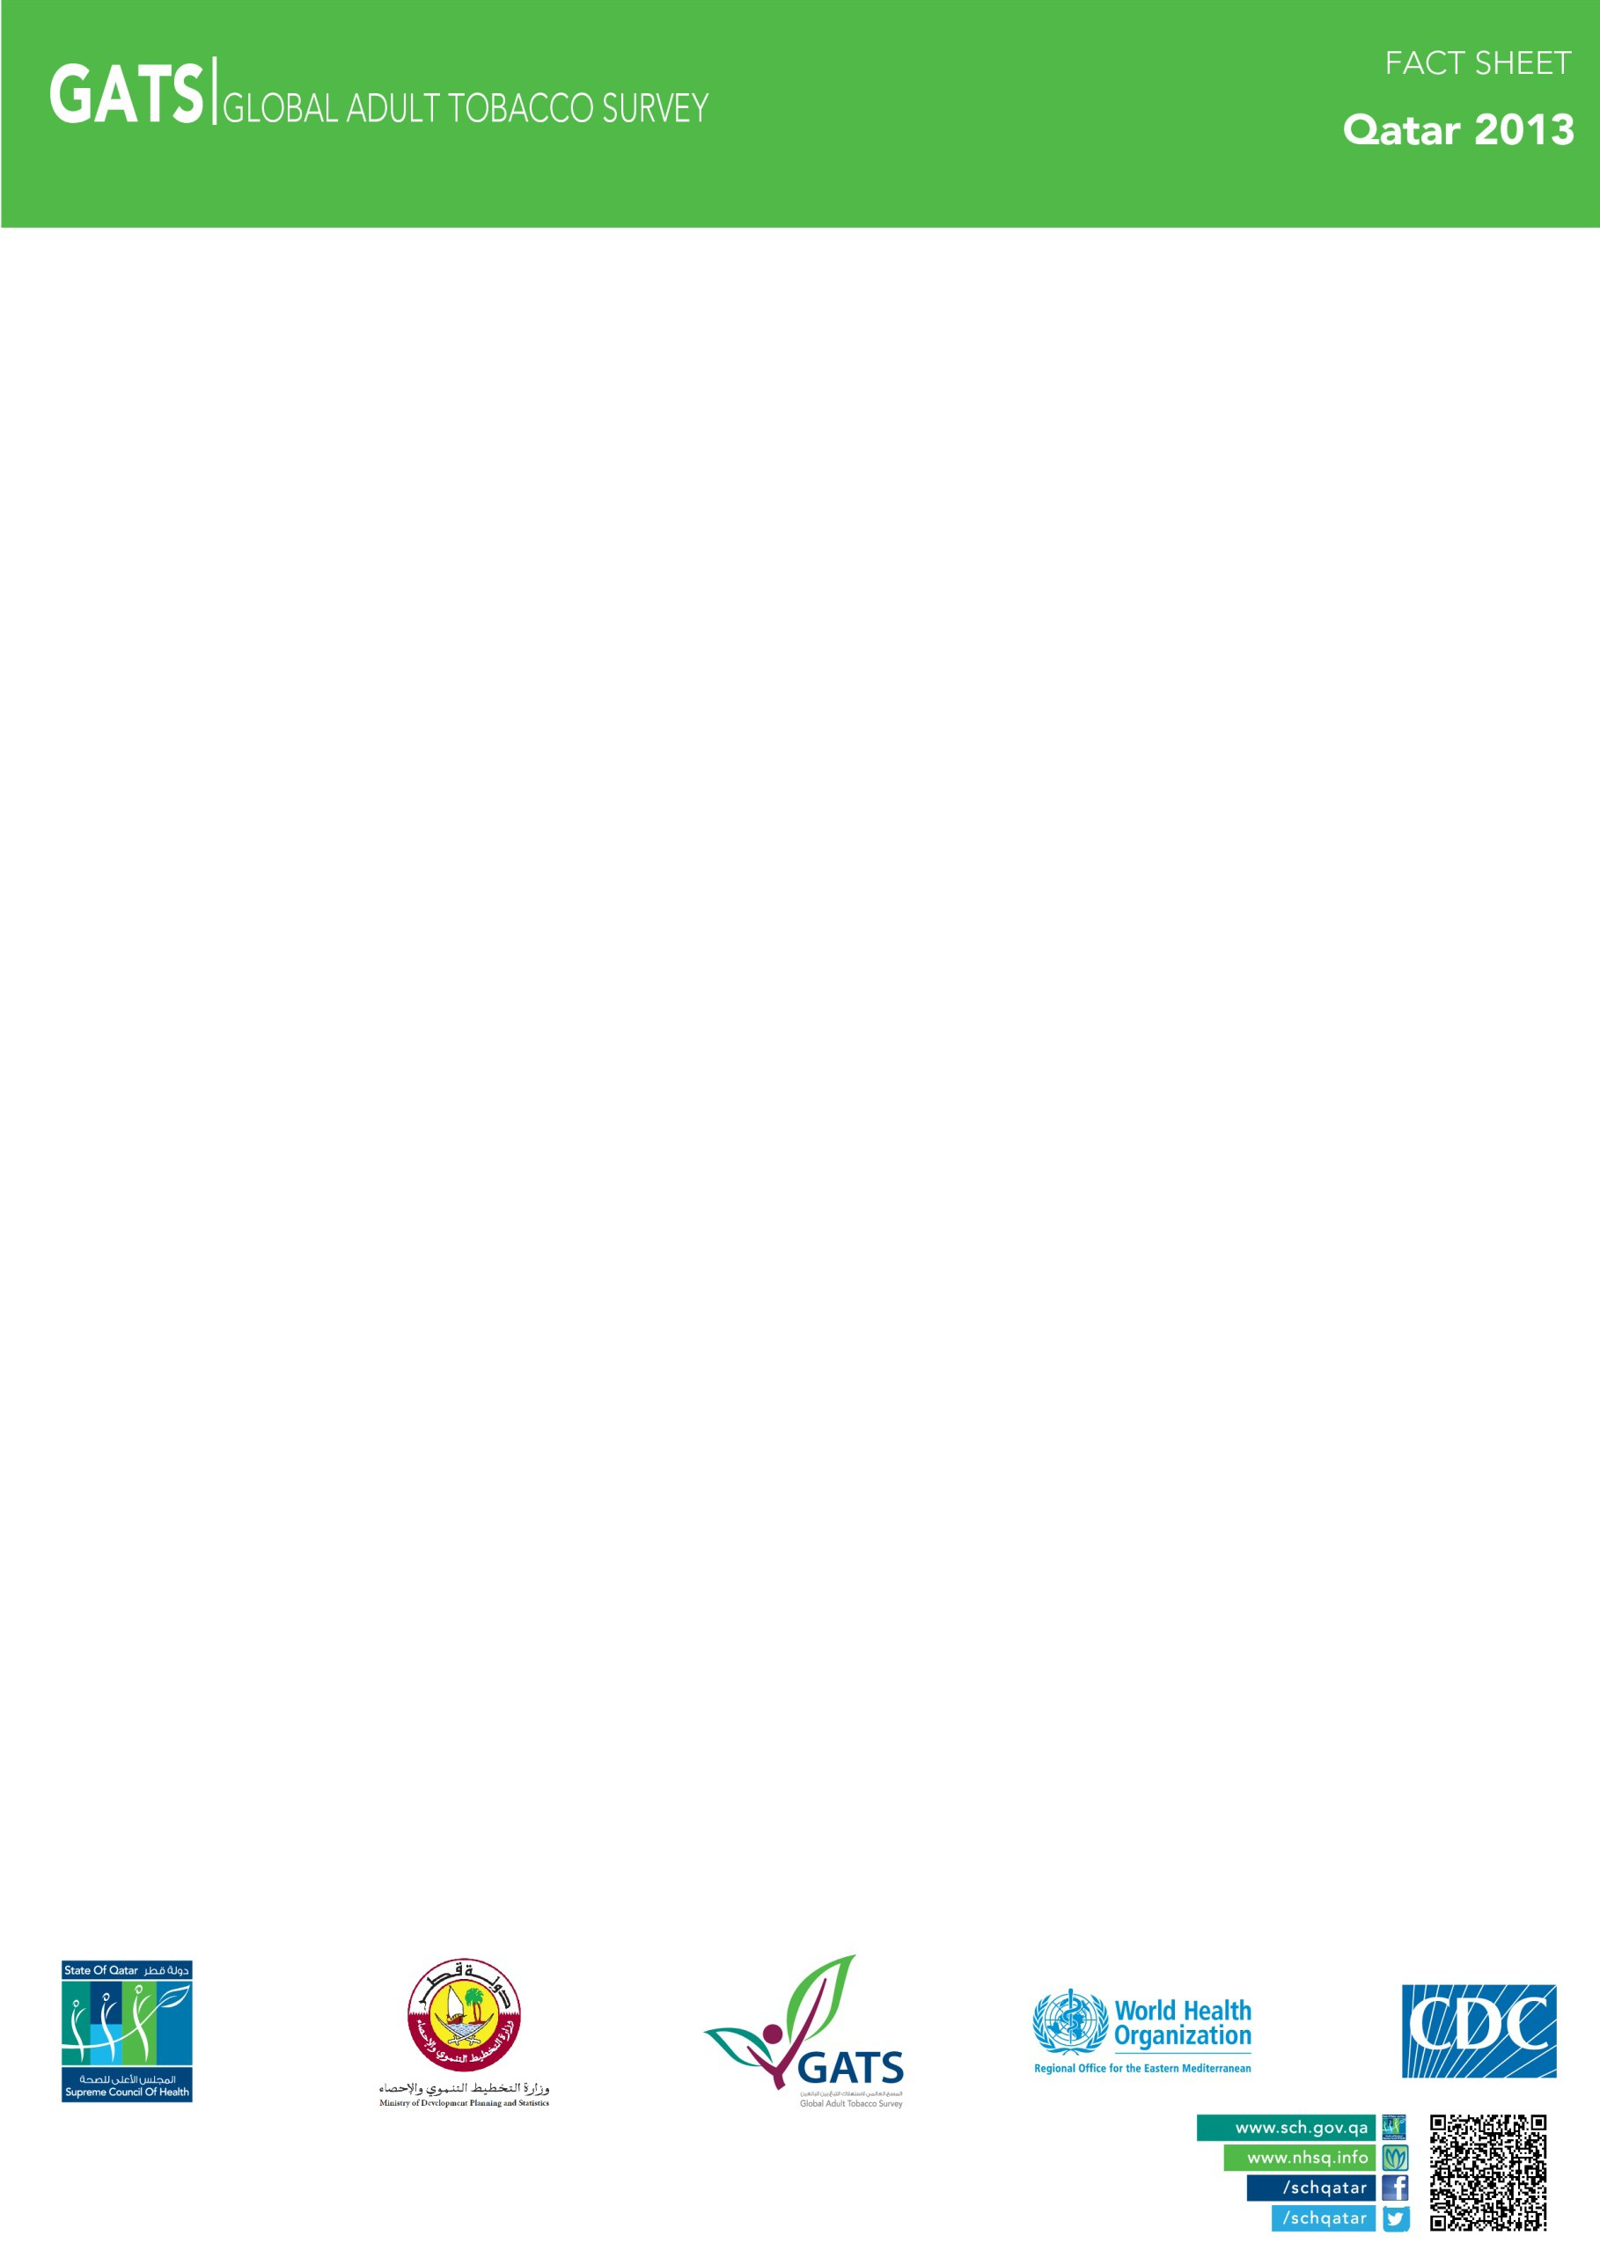
GATS Objectives:
The Global Adult Tobacco survey (GATS) is a global standard for systematically monitoring adult tobacco use (smoking and smokeless) and tracking key tobacco control indicators.
GATS are a nationally representative survey, using a consistent and standard protocol across countries including Qatar. GATS enhance countries capacity to design, implement and evaluate tobacco control programs. It will also assist countries to fulfill their obligations under the World Health Organization (WHO) Framework Convention on Tobacco Control (FCTC) to generate comparable data .within and across countries

Slide 3
WHO has developed MPOWER, a package of selected demand reduction measures contained in the WHO FCTC:
MPOWER
Monitor tobacco use & prevention policies.
Protect people from tobacco smoke.
Offer help to quit tobacco use.
Warn about the dangers of tobacco.
Enforce bans on tobacco advertising, promotion, & sponsorship.
Raise taxes on tobacco.

Slide 4
GATS Methodology
GATS use a global standardized methodology. It includes information on respondents’ background characteristics, tobacco use (smoking and smokeless), cessation, secondhand smoke, economics, media, and knowledge, attitudes and perceptions towards tobacco use. In Qatar, GATS was conducted in 2013 as a household survey of persons 15 years of age and older by the Supreme Council of Health (SCH) in collaboration with the Ministry of Development Planning and Statistics (MDPS). A multi-stage, geographically clustered sample

Slide 5

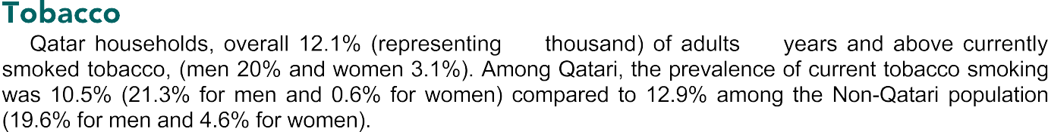


Slide 6
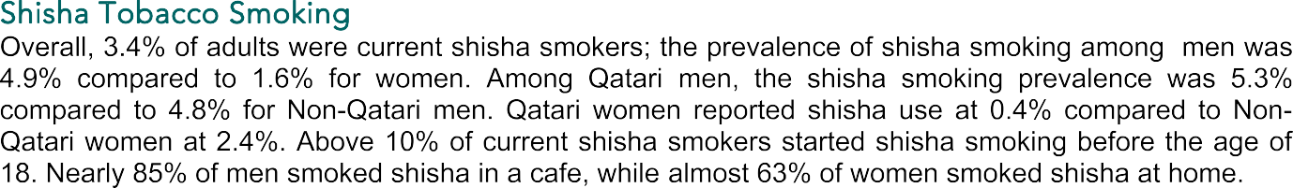


Slide 7
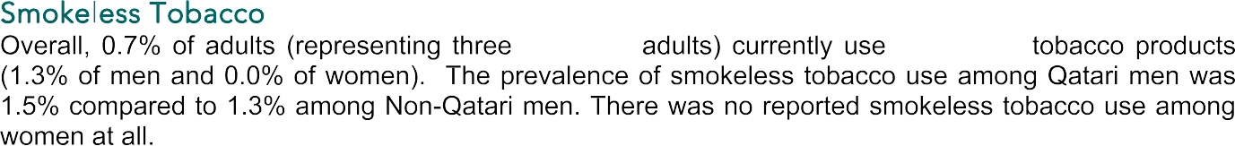

Slide 8
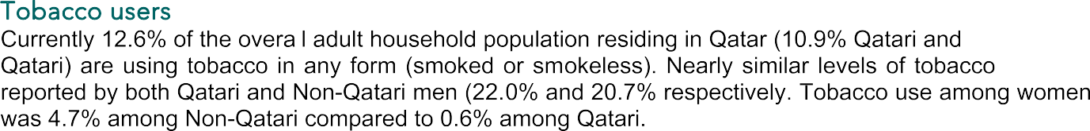

Slide 10
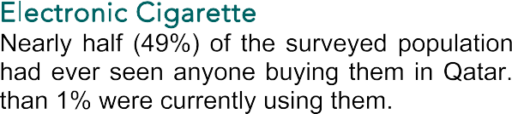

Slide 11
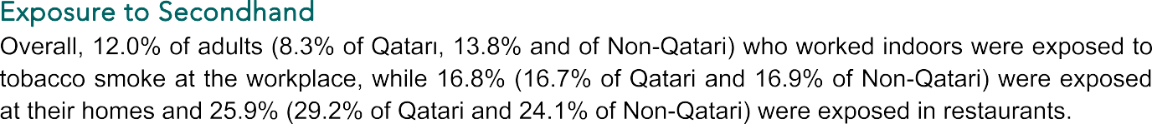

Slide 12

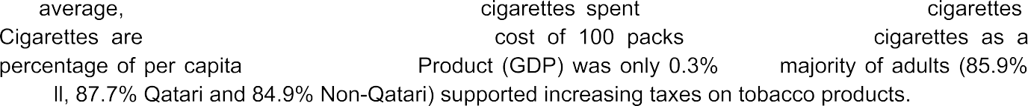




Slide 13
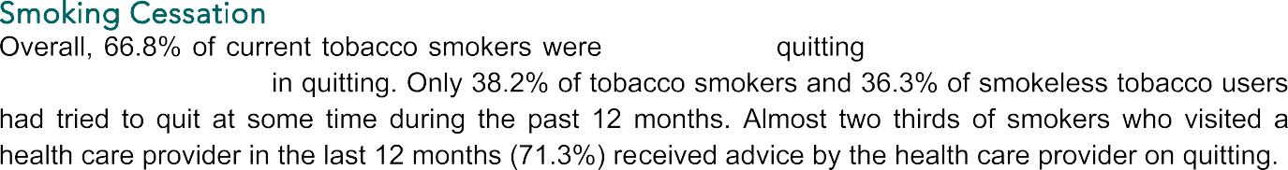


Slide 14
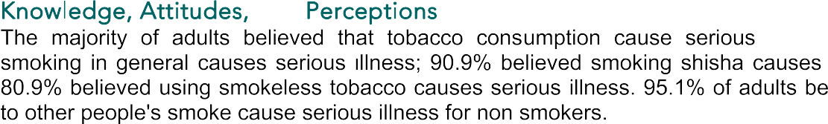


Slide 15


