Slide 1
STATISTICS AND INFORMATION DEPARTMENT
TOBACCO QUESTIONS
FOR SURVEYS

Slide 2
BACKGROUND
2007
Developed Tobacco Free OIC in response to the spread of tobacco epidemic in the OIC MCs.
2008
Participated in the 3rd Session of the Conference of the Parties to the WHO Framework Convention on Tobacco Control.
2010
SESRIC collaborated with Regional Office for the Framework Convention Alliance for Tobacco Control for the Eastern Mediterranean (FCA)
Notes:
2007: SESRIC presented a report on “Tobacco Control in OIC Member Countries” as a reference study to the First Islamic Conference of Health Ministers held on 12-15 June in Kuala Lumpur, Malaysia. Consequently, SESRIC developed Tobacco Free OIC in response to the spread of tobacco epidemic in the OIC MCs.
2008: The importance of the Conference of the Parties derives from the fact that the WHO Framework Convention on Tobacco Control (WHO FCTC) is the first treaty negotiated under the auspices of the World Health Organization and represents a paradigm shift in developing a regulatory strategy to address addictive substances by formulating demand reduction strategies as well as supply issues.
2010: with an aim to promote cooperation in providing assistance regarding the development of policies and legislation as well as the capacity building programmes related to tobacco control in the OIC MCs.

Slide 3
BACKGROUND
2012
Delegation from CDC visited SESRIC, discussed cooperation possibilities in the field of tobacco control.
2012
In collaboration with the Tobacco Market Regulatory Authority (TAPDK) of Turkey, SESRIC organised study visit to Smoke Cessation Centre in Erzurum, Turkey.
2012
Delegation from Bloomberg Foundation and WHO National Tobacco Control Programme Office visited SESRIC.
Notes:
2012: The delegation comprised of Dr. Samira Asma, Chief of Global Tobacco Control, US Centers for Disease Control and Prevention (CDC), Mr. William C. Parra, Chief Operating Officer of the Bloomberg Global Initiative to Reduce Tobacco Use, CDC Foundation and Dr. Toker Ergüder, National Tobacco Control Programme Officer, World Health Organization.
2012: in order to share the practices and exchange expertise on tobacco control issues on 20-21 June 2012 in Erzurum, Republic of Turkey. Delegation visited Smoke Cessation Centre and was informed on the system and techniques that are being used for smoke cessation.
2012: Dr. Kelly J. Henning Director, International Health Programs Bloomberg Foundation New York, Dr. Toker Ergüder, National Tobacco Control Programme Officer, World Health Organization (WHO) visited Dr. Savas Alpay, Director General of SESRIC, in his office on 26 June 2012. Dr. Henning shared that The Bloomberg Initiative to Reduce Tobacco Use is committed to reducing tobacco use in 15 large countries that account for two-thirds of the world’s smokers. She also informed the success stories and challenges of the 5 OIC Member Countries that Bloomberg Initiative has been focused on; Bangladesh, Egypt, Indonesia Pakistan and Turkey. She also stated that collaboration with SESRIC in tobacco control activities will enhance the effectiveness of their studies in OIC Member Countries.

Slide 4
BACKGROUND
2013
Participated in ‘The First Regional Training Workshop on Tobacco Control Trade’ in Cairo, Egypt. Organised by WHO.
2013
Attended ‘Tobacco Questions for Surveys (TQS)’ Conference in Geneva, Switzerland. Organised by WHO and CDC.
2013
Attended the 4th Islamic Conference of Health Ministers in Jakarta, Indonesia.
Notes:
2013: The workshop intended to prepare Member States in the Eastern Mediterranean Region to better understand the common issues between tobacco control and trade. Throughout the workshop, the participants had the chance to understand the linkages between trade and tobacco control in light of international agreements such as the WHO Framework Convention for Tobacco Control (WHO FCTC), to understand the controversial issues between tobacco control and trade and how to develop joint goals for health and to discuss on how to enable both the trade and health sectors to work together to form a joint vision to achieve common goals on tobacco control.
2013: Prof. Savaş Alpay, Director General of SESRIC, attended the conference and gave a presentation on “The Current Status of Tobacco Use and Tobacco Control Measures in OIC Member Countries”.
2013: adopted three resolutions on tobacco control in OIC Member States:
Urges the OIC Member States to take steps on speedy ratification of WHO Framework Convention on Tobacco Control (FCTC), if not done so, and improve the implementation of all MPOWER measures;
Invites the Member States to sign and ratify the WHO Protocol to Eliminate Illicit Trade in Tobacco Products and better coordinate their efforts in fighting illicit trade in tobacco products and also encourage Member States not to host tobacco trade fairs;
Calls upon the OIC Member States and relevant national and OIC institutions and civil society organizations to actively cooperate with and participate in the capacity building activities and programmes of SESRIC Tobacco Free OIC initiative.

Slide 5
BACKGROUND
Integration of the Tobacco Questions for Surveys (TQS) into the National Surveys in OIC Member Countries
12 September 2014
MoA was signed between National Foundation for the Centers for Disease Control and Prevention, Inc. and SESRIC.
The integration of TQS into the framework of on-going surveys in OIC MCs will serve as a mechanism to harmonize and standardize the monitoring of key tobacco control indicators regularly and promote sustainability and integration with other risk factors surveillance initiatives.
15 OIC MCs were selected for a pilot study.

Slide 6
TQS INTEGRATION PROJECT
15 Selected Pilot Study Countries
IndonesiaMalaysia
Egypt
Jordan
Morocco
Tunisia
Albania
Azerbaijan Kazakhstan
Tajikistan
Cameroon
Mauritania
Senegal
Sudan
Uganda
Azerbaijan, Cameroon, Egypt, Indonesia, Mauritania, Senegal, & Tajikistan
SEARO
EURO
EMRO
AFRO
Declared Commitment
Notes:
*From 15 OIC MC which have been selected for a pilot study, 7 countries have declared their commitment.
*Suspended countries: Albania, Jordan, Kazakhstan, Malaysia, Morocco, Sudan, Tunisia, Uganda

Slide 7
TQS INTEGRATION PROJECT
Azerbaijan
National Household & Budget Survey
Cameroon
National Demographic and Health Survey (DHS)
Egypt
National Labour Force Survey
Indonesia
National Socio-Economic Survey (SUSENAS)
COMPLETED
ON-GOING
COMPLETED
COMPLETED
Mauritania
Multiple Indicators Cluster Surveys (MICS)
Senegal
Continuous Demographic and Health Survey
(C-DHS)
Tajikistan
Household Survey on Standard of Living
COMPLETED
COMPLETED
ON-GOING

Slide 8
TQS INTEGRATION PROJECT
Additional Countries Declared Commitment
In-Progress
Cote d’Ivoire
Gambia
Mali
Qatar*
Afghanistan
Chad
Guinea
Guinea-Bissau
Iraq
Lebanon
Mozambique
Sierra Leone
Niger

Slide 9
TQS INTEGRATION PROJECT
3
Trainings on ‘TQS’
1
Training Course on ‘Tobacco Control’ in Collaboration with TAPDK of Turkey
2
Study Visits

Slide 10
TQS INTEGRATION PROJECT
http://www.oicstatcom.org/tqs.php

Slide 11
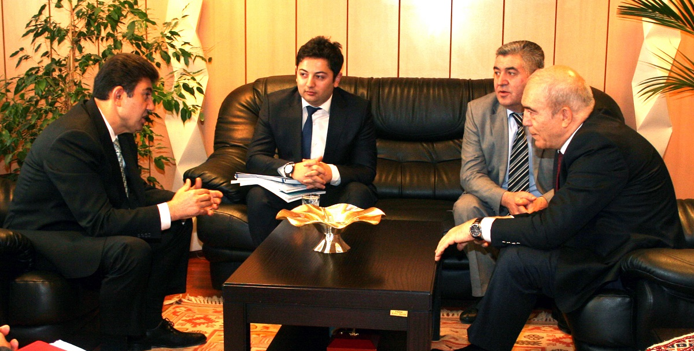
TQS INTEGRATION PROJECT
Study Visit on ‘Integration of TQS’
SSC of Azerbaijan Visited TurkStat of Turkey
Turkey, 21 November 2014
Notes:
The experts of TurkStat on the following items:
* Global Adult Tobacco Survey for the period 2008-2012,
* Turkey Health Survey- 2012 and prior applications for the implementation,
* Turkey's Health Survey and the Global Adult Tobacco Survey: Computing and sample sizes

Slide 12
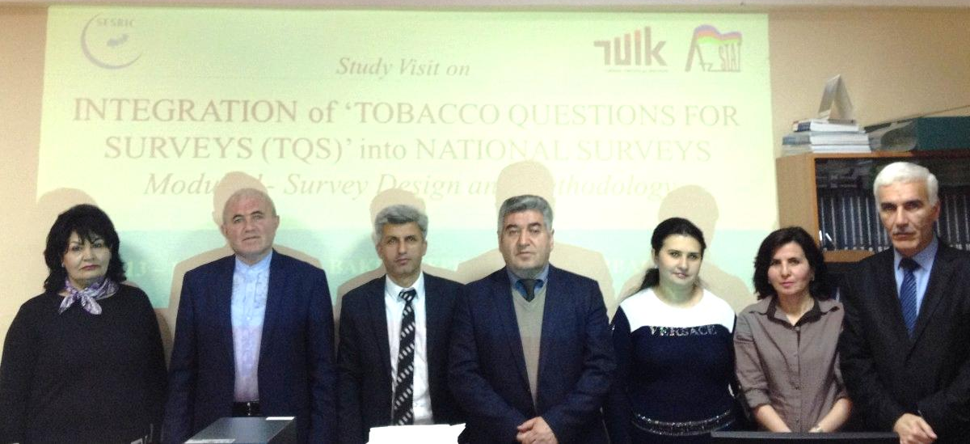
TQS INTEGRATION PROJECT
Training on ‘Integration of Tobacco Questions for Surveys (TQS):
Module 1 – Survey Design and Methodology’
Azerbaijan, 13-15 April 2015
Notes:
The study visit focused on the following items:
* Global Adult Tobacco Survey Applications General Information (2008, 2012)
* Global Adult Tobacco Survey Applications 2012 Questionnaire
* Turkey Health Survey Applications General Information (2008, 2010, 2012, 2014)
* Turkey Health Survey Questionnaire 2008, 2010, 2012, 2014 – Tobacco Module*
* Comparison: Global Adult Tobacco Survey, Turkey Health Survey (2008, 2010, 2012)

Slide 13
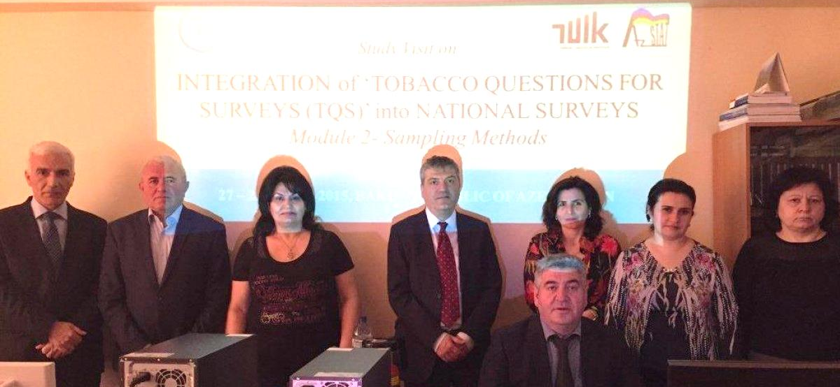
TQS INTEGRATION PROJECT
Training on ‘Integration of Tobacco Questions for Surveys (TQS):
Module 2 – Sampling Methods’
Azerbaijan, 27-29 April 2015
Notes:
The study visit focused on the following items:
* Global Adult Tobacco Survey (GATS) Sampling Design (2008- 2012)
* Global Adult Tobacco Survey Nonresponse Forms (household, individual)
* Turkey Health Survey Sampling Design (2008-2014)
* Turkey Health Survey Nonresponse Forms (household, individual)

Slide 14
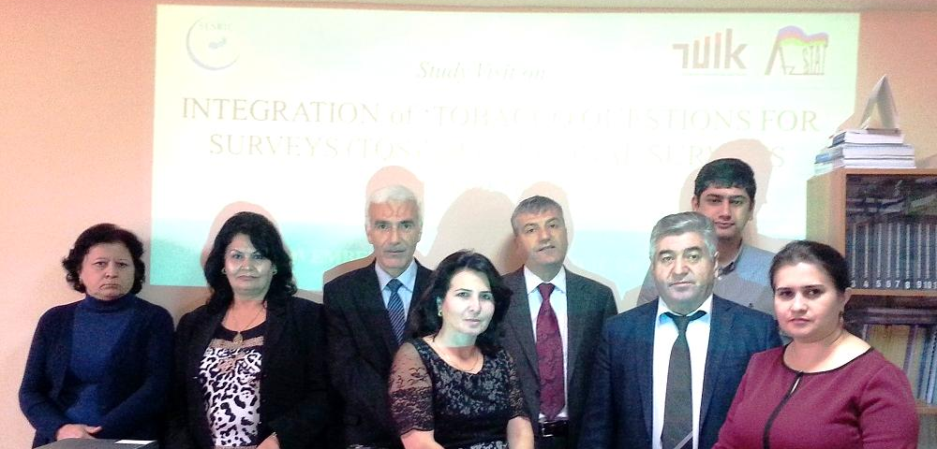
TQS INTEGRATION PROJECT
Training on ‘Integration of Tobacco Questions for Surveys (TQS)
– Sampling Methods’
Azerbaijan, 10-13 November 2015
Notes:
The study visit covered on the following items:
* Weighting and non-response forms (household, individual)
* General controls on data with all steps
* Calculating weights
* Calculating base weights (household and individual)
* Non response adjustment, out of scopes
* Creating projected population tables and using them in calibrations

Slide 15
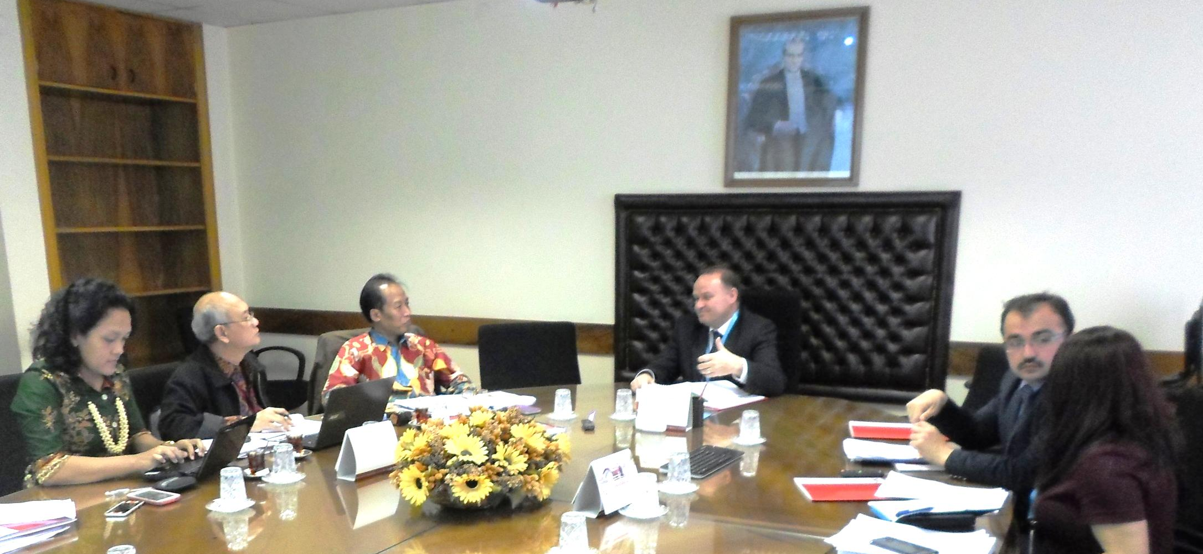
TQS INTEGRATION PROJECT
Study Visit on ‘Integration of Tobacco Questions for Surveys (TQS)’
BPS-Statistics Indonesia Visited TurkStat of Turkey
Turkey, 25-26 April 2016
Notes:
The study visit covered the following items:
* Global Adult Tobacco Survey, 2008 and 2012
* Turkish Health Survey, 2010, 2012, and 2014
* Data Processing in Surveys
* Sampling Methodology in Surveys

Slide 16
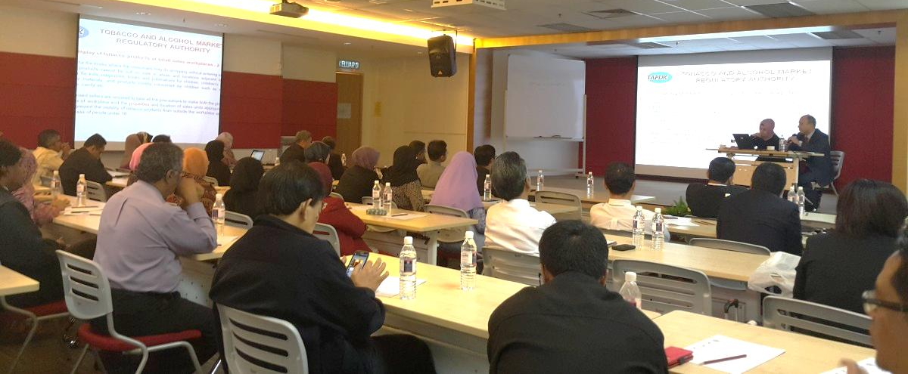
TQS INTEGRATION PROJECT
Training Course on ‘Tobacco Control’
Malaysia, 1-2 April 2015
In cooperation with the Tobacco and Alcohol Market Regulatory Authority
of Turkey (TAPDK)
Notes:
The training course on “Tobacco Control” focussed on the following topics:
* WHO FCTC
* Packaging and labelling & pictorial warnings
* Selling to minors
* Protecting second-hand smokers & tobacco use in public places

Slide 17
“Cooperation for Development”
THANK YOU
Website : www.sesric.org www.oicstatcom.org
Email : oicankara@sesric.org statistics@sesric.org
Twitter : @sesric @oicstatcom

