Slide 1
The Global Burden of Tobacco: Monitoring Non-Communicable Disease (NCD) Targets and Tracking the Tobacco Epidemic
E Tursan d’Espaignet and A Commar
Comprehensive Information Systems on Tobacco Control
WHO, Geneva

Slide 2
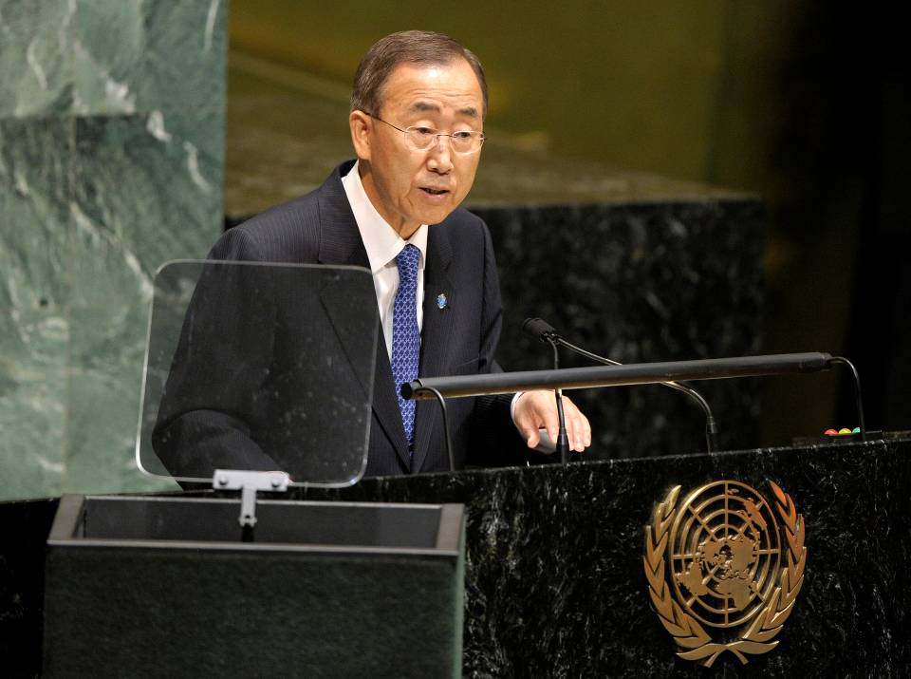
From the UN meeting on NCDs to SDGs
19 September 2011
High-level Meeting on NCDs
New-York
Notes:
Most low- and middle-income countries are now facing a double burden of communicable and non-communicable diseases. In recognition of this global threat, the UN General Assembly arranged a High-level Meeting on NCDs in September 2011, at which Heads of State and government officials participated and adopted a wide-ranging agenda for the prevention and control of NCDs.
The Political Declaration adopted by the General Assembly acknowledged that NCDs constitute one of the major challenges for development in the 21st century and requested WHO to lead and coordinate global action against NCDs.
Following from that meeting, a meeting of UN agencies was convened in December 2011 to agree on next steps for the UN. At that meeting, it was agreed that UN agencies could enter into joint work-plans with WHO to focus on the NCD agenda. WHO and ITU, the UN health and telecoms agencies, have decided to come together in a groundbreaking new partnership, with governments, NGOs and the private sector to focus on mobile technology for NCDs.
27/04/2016
2

Slide 3
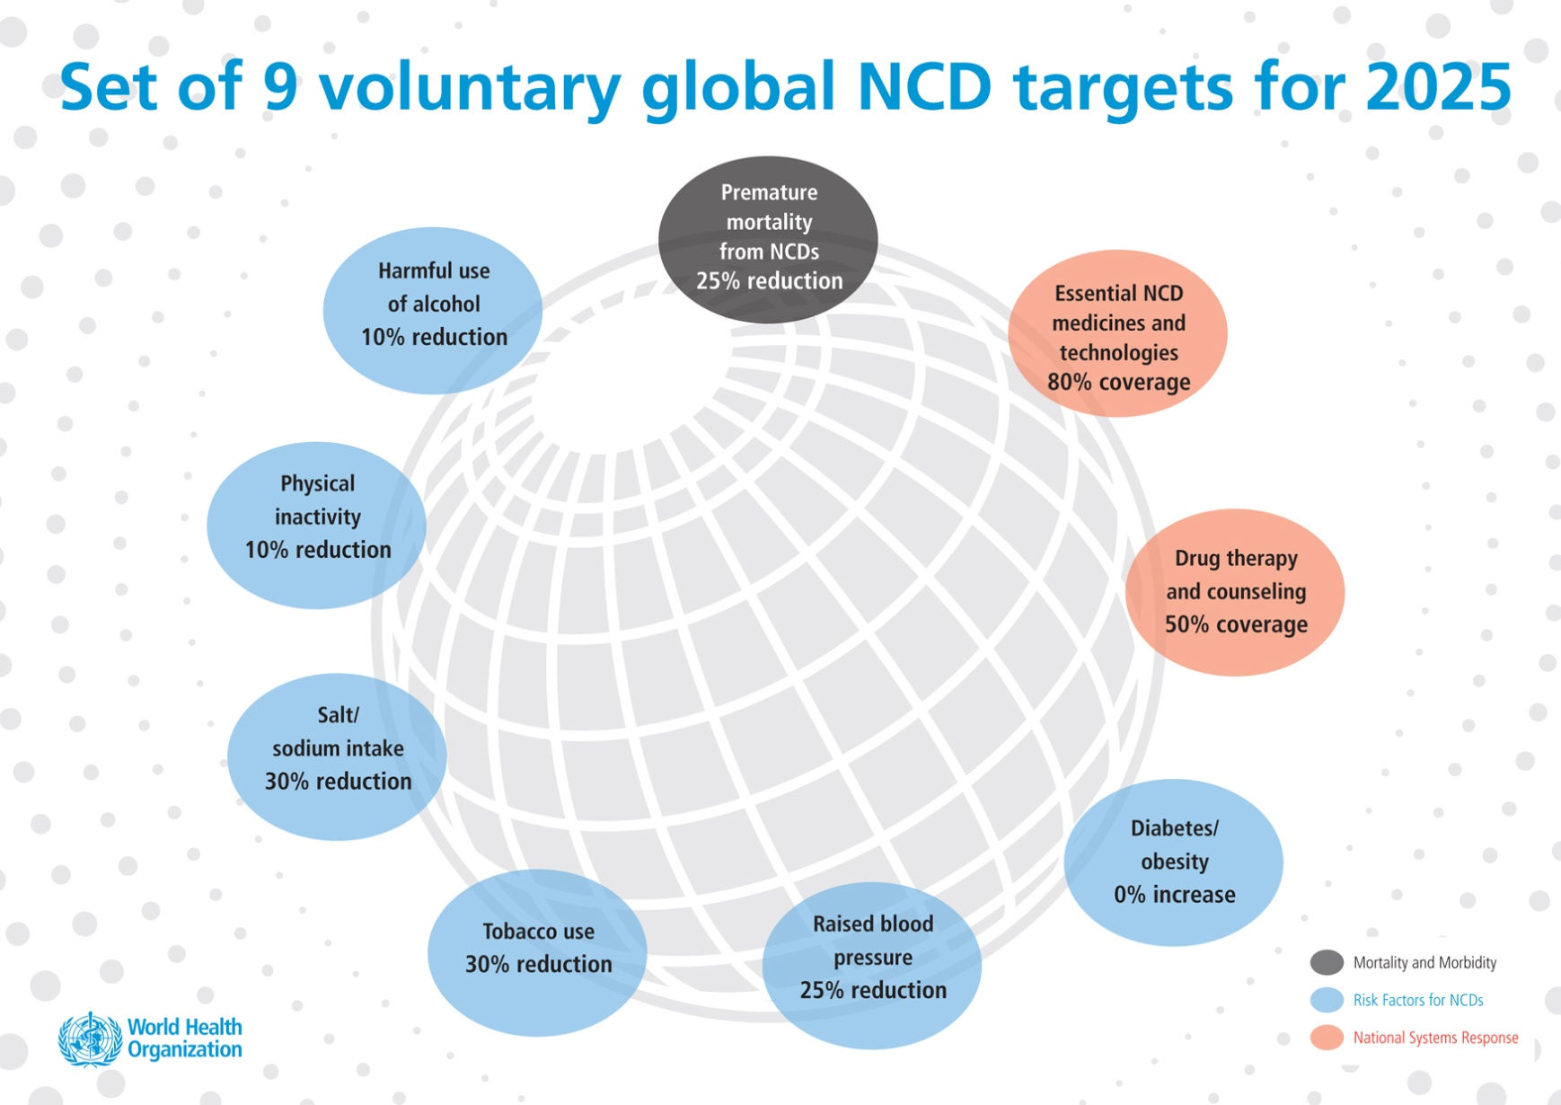
Working towards targets

Slide 4

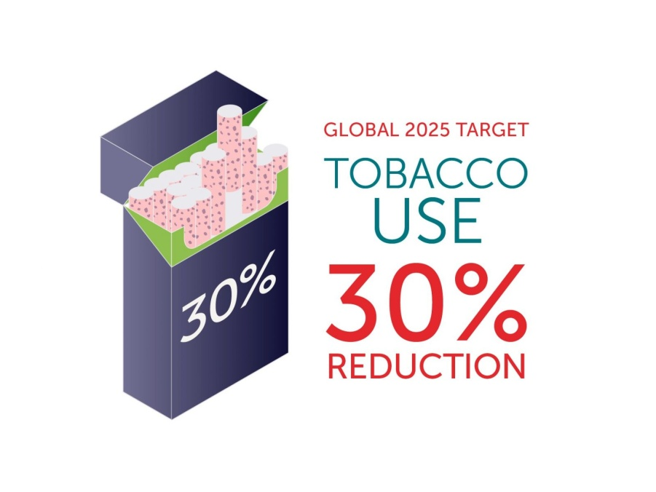
Tobacco use prevalence target
    NCD Global Monitoring Framework

Slide 5

How fast is the epidemic going and can we stop it?
And in its wake ….
6 million deaths every year or
1 death every 6 seconds

Slide 6
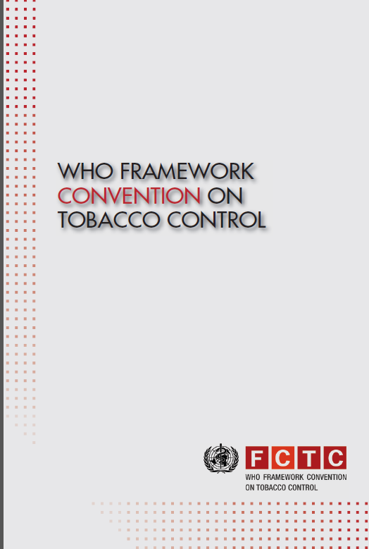

Antidote to the tobacco epidemic
The WHO FCTC
NCD target to be achieved mostly through the demand reduction measures of the WHO FCTC (badged under the acronym MPOWER)
The SDG target to be achieved through full implementation of the WHO FCTC (3.a)

Slide 7
Article 20 calls on Parties to
… establish, as appropriate, programmes for national, regional and global surveillance of the magnitude, patterns, determinants and consequences of tobacco consumption and exposure to tobacco smoke.
Towards this end, the Parties should integrate tobacco surveillance programmes into national, regional and global health surveillance programmes so that data are comparable and can be analysed at the regional and international levels, as appropriate.

Slide 8
Monitoring the magnitude and speed of the epidemic
WHO in collaboration with CDC set up the Global Tobacco Surveillance System to undertake with countries standardised and harmonised:
Global Youth Tobacco Surveys
Global Adult Tobacco Surveys
Tobacco Questions for Surveys (for incorporation in multi-risk factor NCD surveys or other surveys such as household expenditure surveys, census, …)

Slide 9

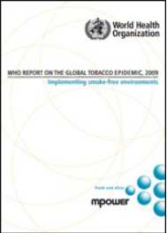
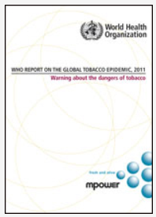
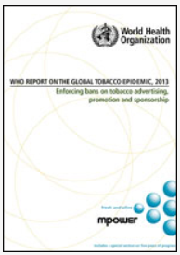
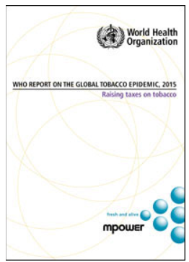
Monitoring implementation of selected demand reduction measures of the FCTC
2008: Focused on all measures
2009: Protection against SHS
2011: Warning on dangers
2013: Enforcement
2015: Taxation
2017: Monitoring

Slide 10
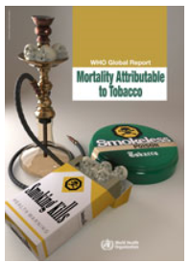
Monitoring mortality attributable to tobacco
First published by WHO in 2012
2004 mortality information for most countries: by cause of death, by age and sex for almost all countries
Updated publication in Nov 2016: Comparative data for 2000 and 2012

Slide 11
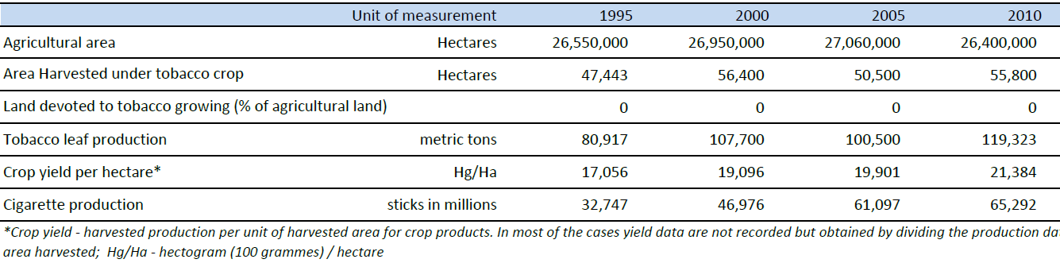
Other: Agriculture and Trade data

Slide 12
Monitoring trends in tobacco use (smoking)
Based on survey data collected in countries since 1990
Where data not sufficient, borrows data from neighbouring countries (but excludes countries that have done nil or only one survey
Fits a regression line using a mix of negative binomial and logistic functions and provides trend from 2000 and projection to 2025
Information available for about 140 countries first published in 2015. Being currently updated and will be published by July 2016

Slide 13
Produces trends information on four indicators of smoking
CURRENT TOBACCO SMOKING | CURRENT CIGARETTE SMOKING
DAILY TOBACCO SMOKING | DAILY CIGARETTE SMOKING

Slide 14
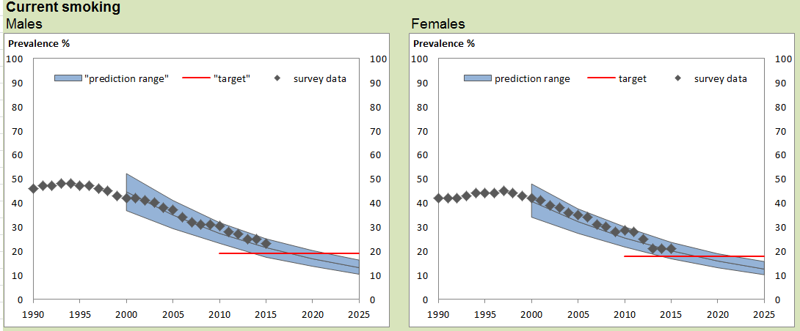
Example of a country with good surveillance data

Slide 15
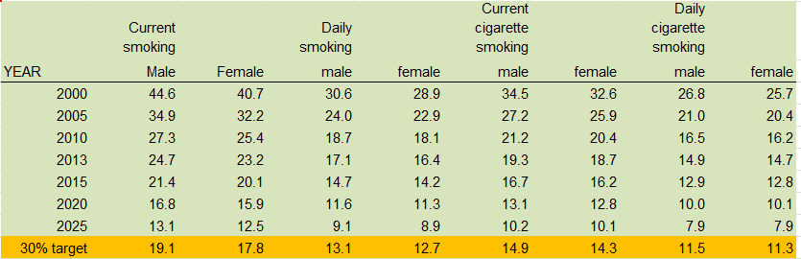
Example of a country with excellent surveillance data

Slide 16
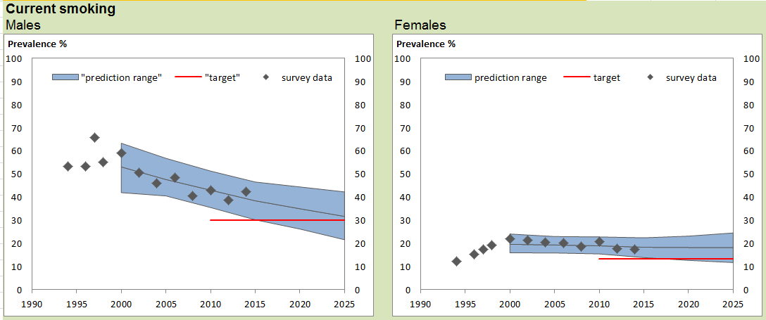
Another example: very good surveillance

Slide 17
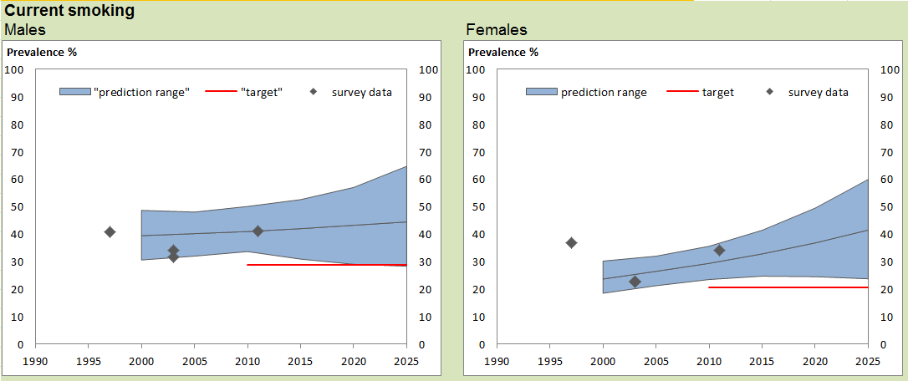
Country C

Slide 18
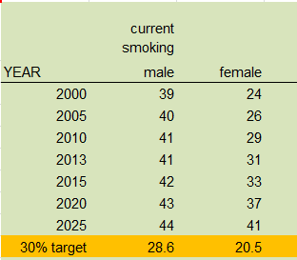
Country C

Slide 19
Trends by WHO Region, males, 2000-2025

Slide 20
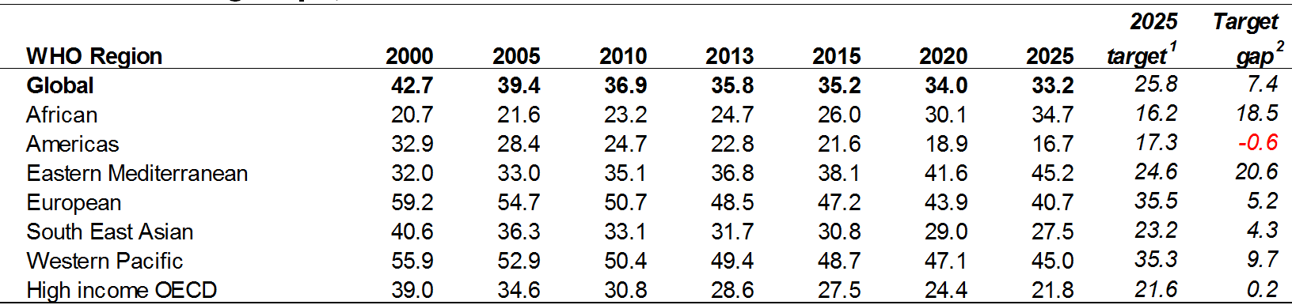
Trends by WHO Region, males, 2000-2025

Slide 21
Trends by WHO Region, females, 2000-2025

Slide 22
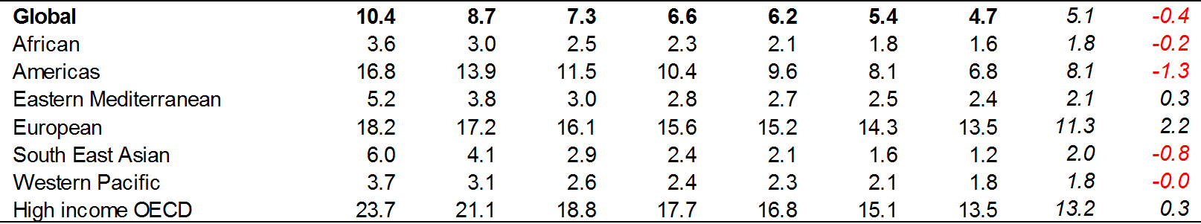
Trends by WHO Region, females, 2000-2025

Slide 23
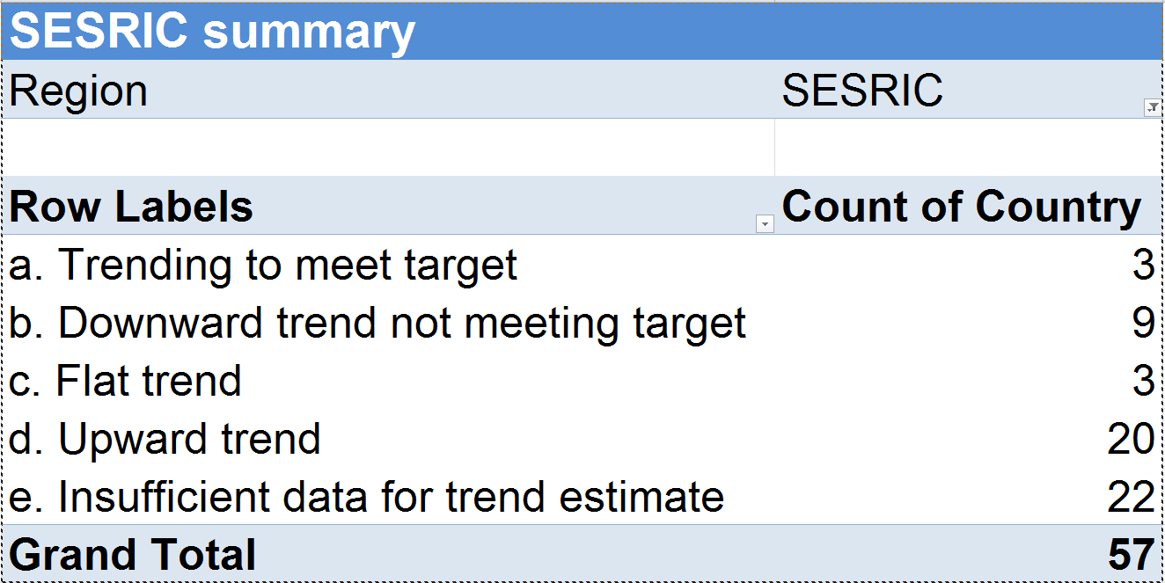

Slide 24
Thank you for your attention

