Slide 1
Dissemination and Data to Action
Dr Heba Fouad
WHO, EMRO

Slide 2
Surveillance
Ongoing, systematic collection, analysis, & interpretation of data essential to planning, implementation, & evaluation of public health practice, integrated with timely dissemination to those responsible for prevention & control.
Timely, useful evidence to empower public & policy makers to lead & manage effectively. That’s where public health begins.
Notes:
I would like to start with the definition on Surveillance
We are all play very important role in production of data , we invest in implementing national level representative surveys based on robust methodology to make data available , which is by itself is important to reflect real picture of current situation, however, there is an important part of the definition , which is related to dissemination and use of data that we still missing
This is the focus of this presentation

Slide 3
GTSS Topics: Indicators
GTSS Monitor exposure and exposure determinants
Tobacco Use
Knowledge and Attitudes
Secondhand Smoke Exposure
Pro- and Anti-tobacco Media and Advertising Exposure
Cessation
Access and Availability of Tobacco
Tobacco economics
3
Notes:
As it was mentioned yesterday , GTSS provides a wide range of information and indicators on tobacco epidemic and related policies needed to reduce demand for tobacco what we call demand reduction measures recommended by WHO and is part of FCTC
GATS or TQS , both provides similar indicators information in each of the following domain or area
GATS is the full survey
TQS which is the focus of this meeting is subset of questions that cover the whole range of main indicators on MPOWER

Slide 4
MPOWER Polices to Reverse the Global Tobacco Epidemic
Monitor tobacco use and prevention policies
Protect people from tobacco smoke
Offer help to quit tobacco use
Warn about the dangers of tobacco
Enforce bans on tobacco advertising, promotion and sponsorship
Raise taxes on tobacco
Notes:
4
All indicators measured through GTSS; GATS or integrated TQS into national level surveys provides information on the status of policy implementation , it evaluates the effectiveness of implemented policies and intervention so far made for tobacco control.

Slide 5
Global Tobacco Surveillance System is a Dynamic system
Analysis
Workshop
Determine key messages,
Identify key audiences, and key partners
Policy & Program
Workshop
Conducted in country with key partners to plan for data release and post press conference follow-up activities (e.g. National action planning workshop)
Survey Workshop
Introduce guidance and expectations for results dissemination, com. and advocacy
Conduct
Survey
Report Data
Evaluate and
Modify Programs
Tobacco Control
Program
Health Communication and Advocacy
Programs
Repeat
Every ? Years
Implement
Programs
Notes:
5
The GTSS when designed, by WHO and CDC in late 1999, was made with the objective to build capacity in monitoring and evaluation of tobacco use , to enable program planning, design and evaluation and to assist countries to fulfill their obligation towards implementing FCTC. Survey information feeds in different reports , at national and global level to monitor the tobacco epidemic

Slide 6

Data dissemination
GATS /TQS
GATS: 2008-2016
  Completed in 28 countries
  30 country fact ( with repeats)
  24 country reports
  24 public use data sets
TQS: 2009-2016
  Completed in 63 countries (3-22 questions)
  TQS available in 7 languages
Notes:
,

Slide 7

How data dissemination is done?
Fact sheets
Executive Summaries
Country Reports
Research Publications
Data 2 Action (D2A) Workshops
GATS Atlas
WHO Report on the Global Tobacco epidemic; GTCR, available at: http://www.who.int/tobacco/global_report/2015/report/en
WHO , MOHs, NSO, and CDC …webistes
Notes:
GTSS has a standard data dissemination protocol including
Facts sheets, country report and availability of data sets in public domain

Slide 8
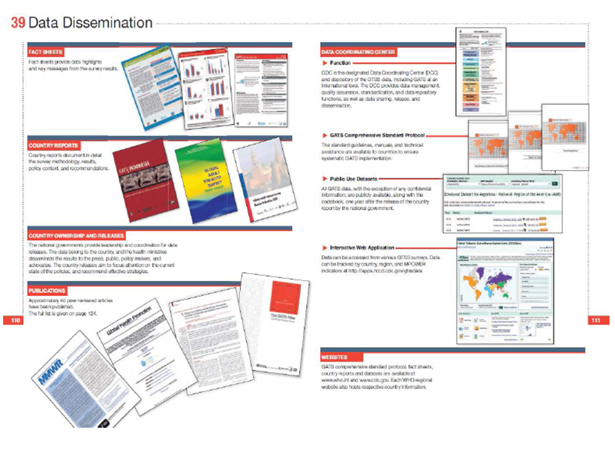
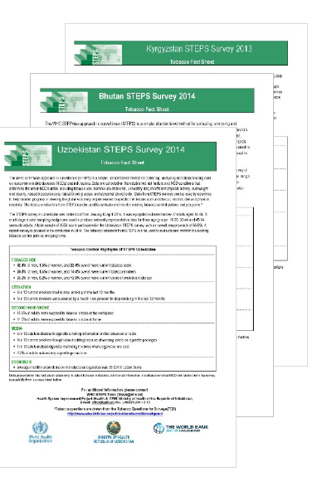
Data dissemination
Notes:
WHO and CDC in collaboration with MOHs, NSO ..post GTSS data in different formats on their websites, moreover, CDC collaborated with WHO on integration of full TQS into risk factors survey (STEP survey) to harmonize indicators and to allow data comparability

Slide 9
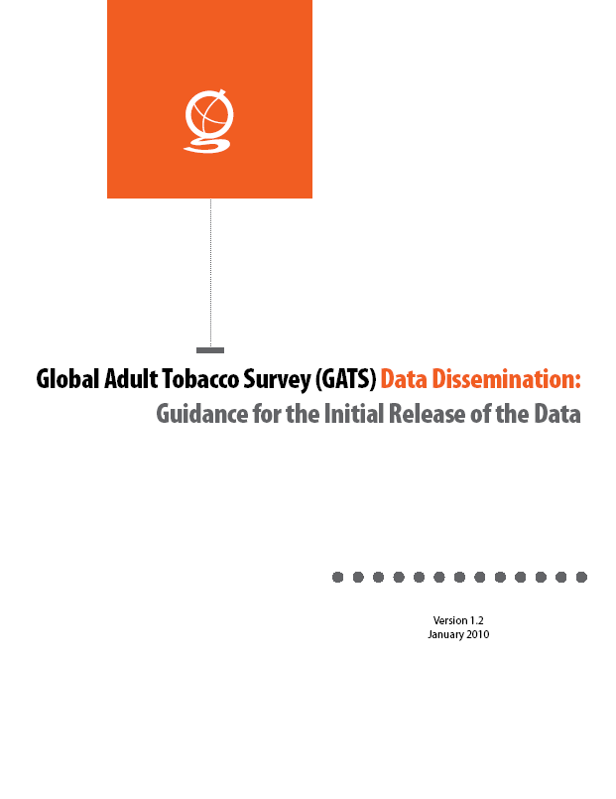
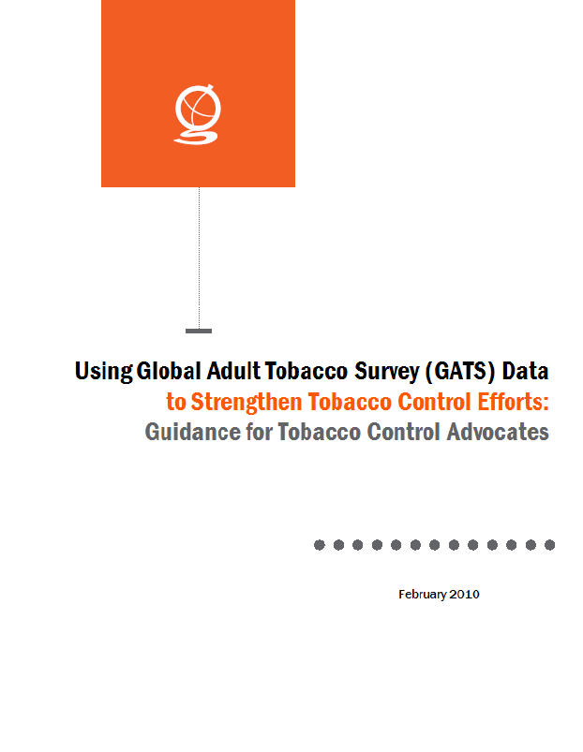
Guides and Resources

Slide 10
Use of data
“Power of data”
To demonstrate seriousness of tobacco as a health and social problem
To identify major determinants of demand for tobacco
To plan and design programs and intervention based on evidence
To promote and Inform Policy Change and to build the case and advocate for policies that work
To evaluate existing policies
To monitor change overtime especially on achieving target (30% reduction of tobacco use among adults by 2025)
Generate cross sectional estimates for global level picture and status of the tobacco epidemic
Notes:
What are possible uses of data

Slide 11
Using Data For Policy Change
“TELL the STORY”
It requires a clear understanding of the data, as well as the policy context, and the relationship between the findings and key policy issues:
  Understand the data and policy context
  Identify target audiences
  Develop partnerships for use
  Agree on key messages
  Package the data
  Release and Disseminate
Notes:
Using Data to advocate for strong Tobacco Control Policies
It requires a clear understanding of the data, as well as the policy context, and the relationship between the findings and key policy issues
Messages should be:
Clear and concise
Increase the target audiences understanding of the problem
Clearly link the problem to evidence based solutions
Motivate the audience to take action
Package the data
Data must be presented in simple, easy to use format
Country reports provide full report
Fact sheets and presentations provide short synthesis of key data

Slide 12
Target Audiences
Policy makers
Non-government organisations and civil societies
General public
Advocacy groups
Media outlets

Slide 13
TELL the STORY
Develop the key Messages :
  Clear and concise
  Increase the target audiences understanding of the problem
  Motivate the audience on action needed
Package the data :
  Information must be presented in simple, easy to use format, especially for media and policy makers
  Country reports provide full report
  Fact sheets and graphical presentations provide picture on key data

Slide 14
Releasing the Data
  Release event (press conference, high level meeting)
  Make data available in easy to use format (fact sheet, briefs)
  key messages
  Promote action based on data findings
  Actively recruit relevant stakeholders and key decision makers as well as the media to attend

Slide 15
Examples of Data to Action/use
Turkey
Enhanced smoke-free law and increased enforcement
Mexico
Raised Tobacco Taxes
India
Raised profile of smokeless tobacco problem,
Implemented stronger health warnings on all tobacco packaging

Slide 16
Way forward
Collaboration between Statistical office and MOH; the end user of information
Data communication strategy should be part of the survey protocol plan
Multisectoral collaboration is required at different levels between data production and usage (NGOs, MOHs, NSOs, academia,.. etc)
Data to action workshops should be part of dissemination plan
Data use and communication should be an ongoing process to raise awareness and to push for policy making: Create team charged with use of the data
Notes:
M&E is a dynamic process
We need to think beyond table shells and beyond country report and fact sheets, how we get the message out using innovative ideas of communication to keep tobacco on the top of the political agenda and to keep conversation ongoing on the epidemic and status of control

Slide 17
What Gets Measured Gets Done

Slide 18

Thank you for your attention

