Slide 1
Social Security Systems in Bangladesh
Mohammad Kazi Foysal
Senior Assistant Secretary
Ministry of Social Welfare, Bangladesh
Government of the People’s Republic of Bangladesh

Slide 2
Where is Bangladesh
Government of the People’s Republic of Bangladesh

Slide 3
Bangladesh - Snapshot
Government of the People’s Republic of Bangladesh

Slide 4
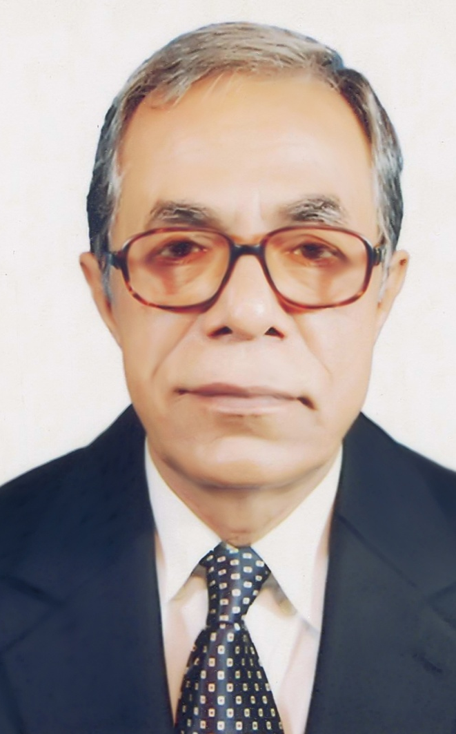
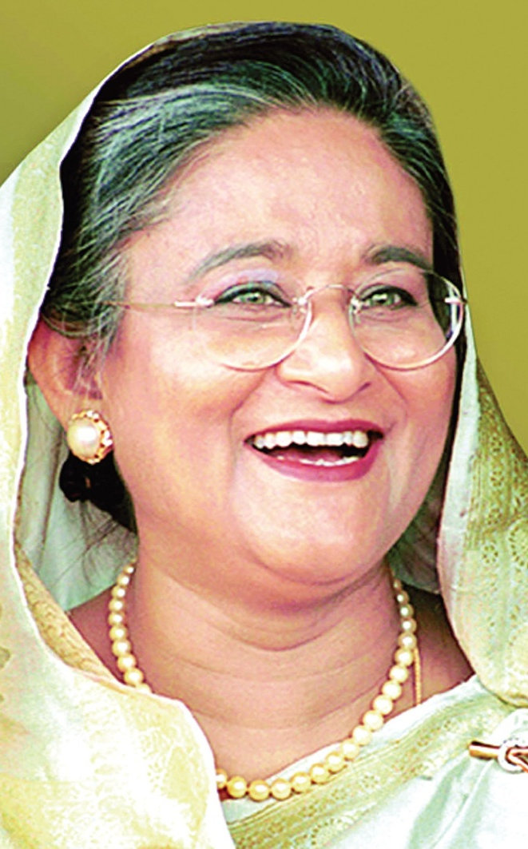
Bangladesh - Leaders
Father of the National H’ble President of Bangladesh H’ble PM of Bangladesh
Government of the People’s Republic of Bangladesh

Slide 5
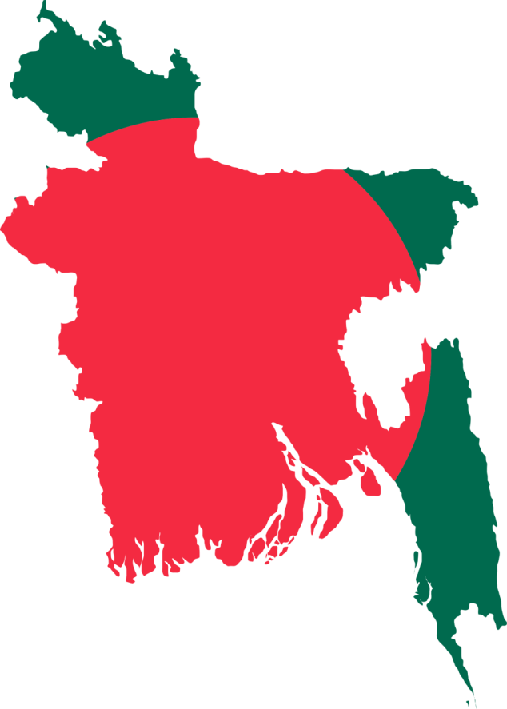
Bangladesh - Snapshot
Bangladesh – Snapshot
People's Republic of Bangladesh
Capital City
Dhaka
Mother Language
Bangla
2nd Language
English
Currency
Taka (BDT)
Government of the People’s Republic of Bangladesh

Slide 6
Bangladesh - Snapshot
Bangladesh - Snapshot
Land (91%)
River (9%)
Total
133,910 sq. km
13,660 sq. km
147,570 sq. km
Government of the People’s Republic of Bangladesh

Slide 7
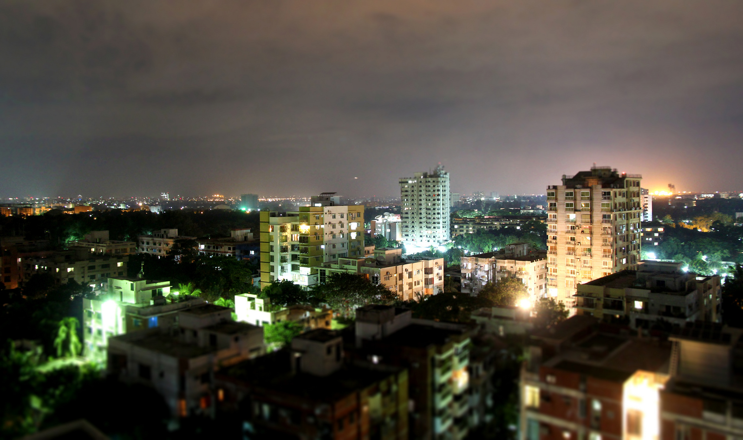
Bangladesh - Snapshot
Bangladesh - Snapshot
“
Dhaka
Capital of Bangladesh
”
Government of the People’s Republic of Bangladesh

Slide 8
Interesting Facts
Interesting Facts
“
Keokradong (1,230 m)
”
highest point
Government of the People’s Republic of Bangladesh

Slide 9
Interesting Facts
“
World’s longest sea beach
”
125 km
Government of the People’s Republic of Bangladesh

Slide 10
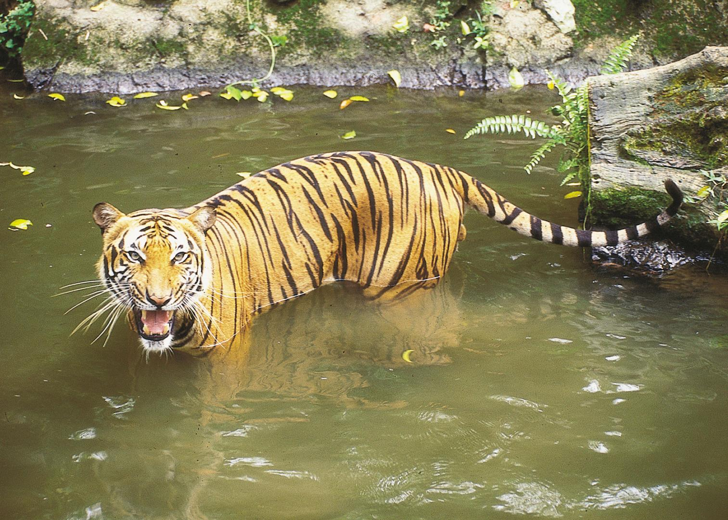
Bangladesh - Snapshot
“
Home of Royal Bengal Tiger
”
Government of the People’s Republic of Bangladesh

Slide 11
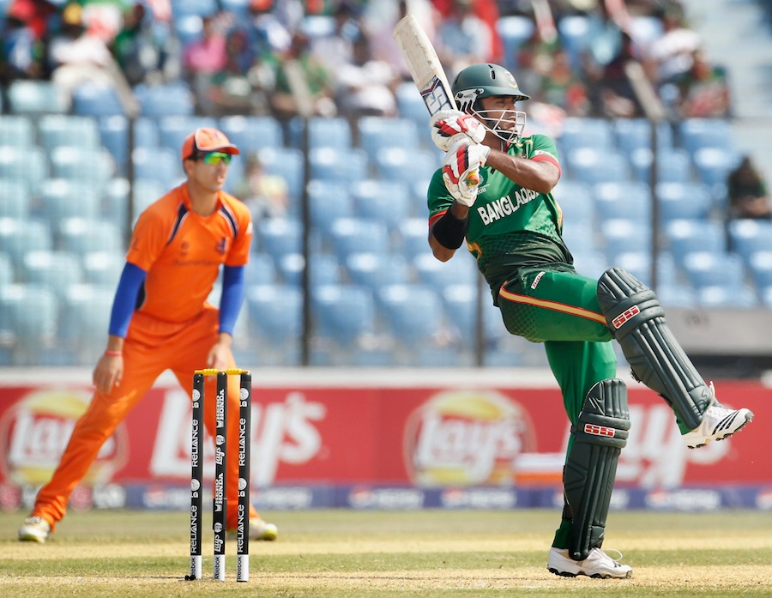
Bangladesh - Snapshot
“
Cricket
”
Government of the People’s Republic of Bangladesh

Slide 12
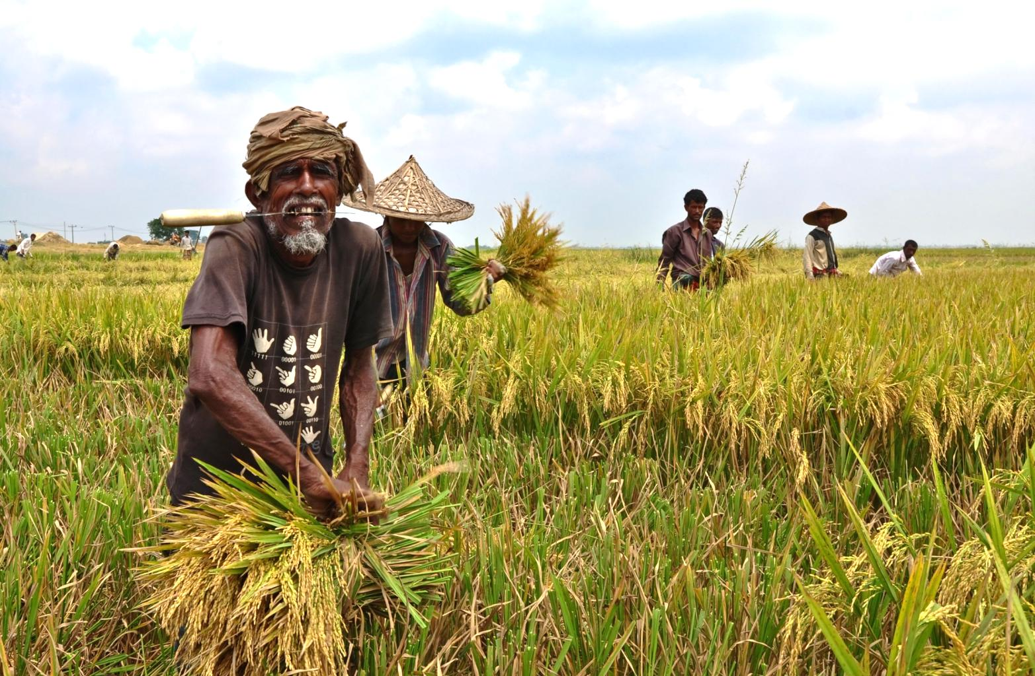
Bangladesh - Snapshot
“
Half of the population
are farmers
”
Government of the People’s Republic of Bangladesh

Slide 13
Bangladesh - Snapshot
“
Garments – export powerhouse
”
$ 19 billion industry
Government of the People’s Republic of Bangladesh

Slide 14
Bangladesh - Snapshot
“
80% alluvial plain land
”
hilly
in
southeast
mostly flat alluvial plain
Government of the People’s Republic of Bangladesh

Slide 15
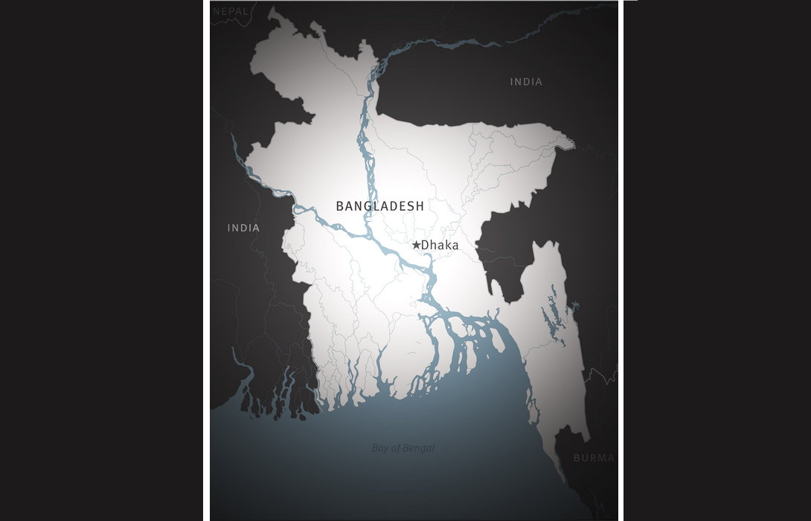
Bangladesh - Snapshot
land of rivers
hilly
in
southeast
Padma
Meghna
Jamuna
Bhramaputra
mostly flat alluvial plain
Government of the People’s Republic of Bangladesh

Slide 16
Bangladesh - Snapshot
Population: 163 million
Literacy rate: 61.5%
HDI: 142 out of 188 countries
Child mortality rate: 38 (2015), 47 (2011)
Maternal mortality rate: 176 (2015), 228 (2011)
Government of the People’s Republic of Bangladesh

Slide 17
Working Ministries
Ministry of Social Welfare
Ministry of Land
Ministry of Health
Ministry of Disaster Management
Government of the People’s Republic of Bangladesh

Slide 18
Ministry of Social Welfare
“3 Million Seniors,,
Government of the People’s Republic of Bangladesh

Slide 19
Ministry of Social Welfare
“1 Million Widows,,
Government of the People’s Republic of Bangladesh

Slide 20
Ministry of Social Welfare
“0.4 Million Special Needs Persons”
Government of the People’s Republic of Bangladesh

Slide 21
Ministry of Social Welfare
“1 Million Special Needs Children”
Government of the People’s Republic of Bangladesh

Slide 22
Ministry of Social Welfare
“1500 Acid Victims Rehabilitation”
Government of the People’s Republic of Bangladesh

Slide 23
Ministry of Social Welfare
“20,000 Orphans in GoB-run Orphanages”
Government of the People’s Republic of Bangladesh

Slide 24
Ministry of Social Welfare
“Grants for 80,000 Orphans”
Government of the People’s Republic of Bangladesh

Slide 25
Ministry of Social Welfare
“Livelihood Improvement Program for 4,000 hermaphrodite people”
Government of the People’s Republic of Bangladesh

Slide 26
Ministry of Social Welfare
“Livelihood Improvement Program for 20,000 gypsies”
Government of the People’s Republic of Bangladesh

Slide 27
Ministry of Social Welfare
Rehabilitation for beggars
Livelihood tea-labors
Grants for cancer and biopsy patients
Government of the People’s Republic of Bangladesh

Slide 28
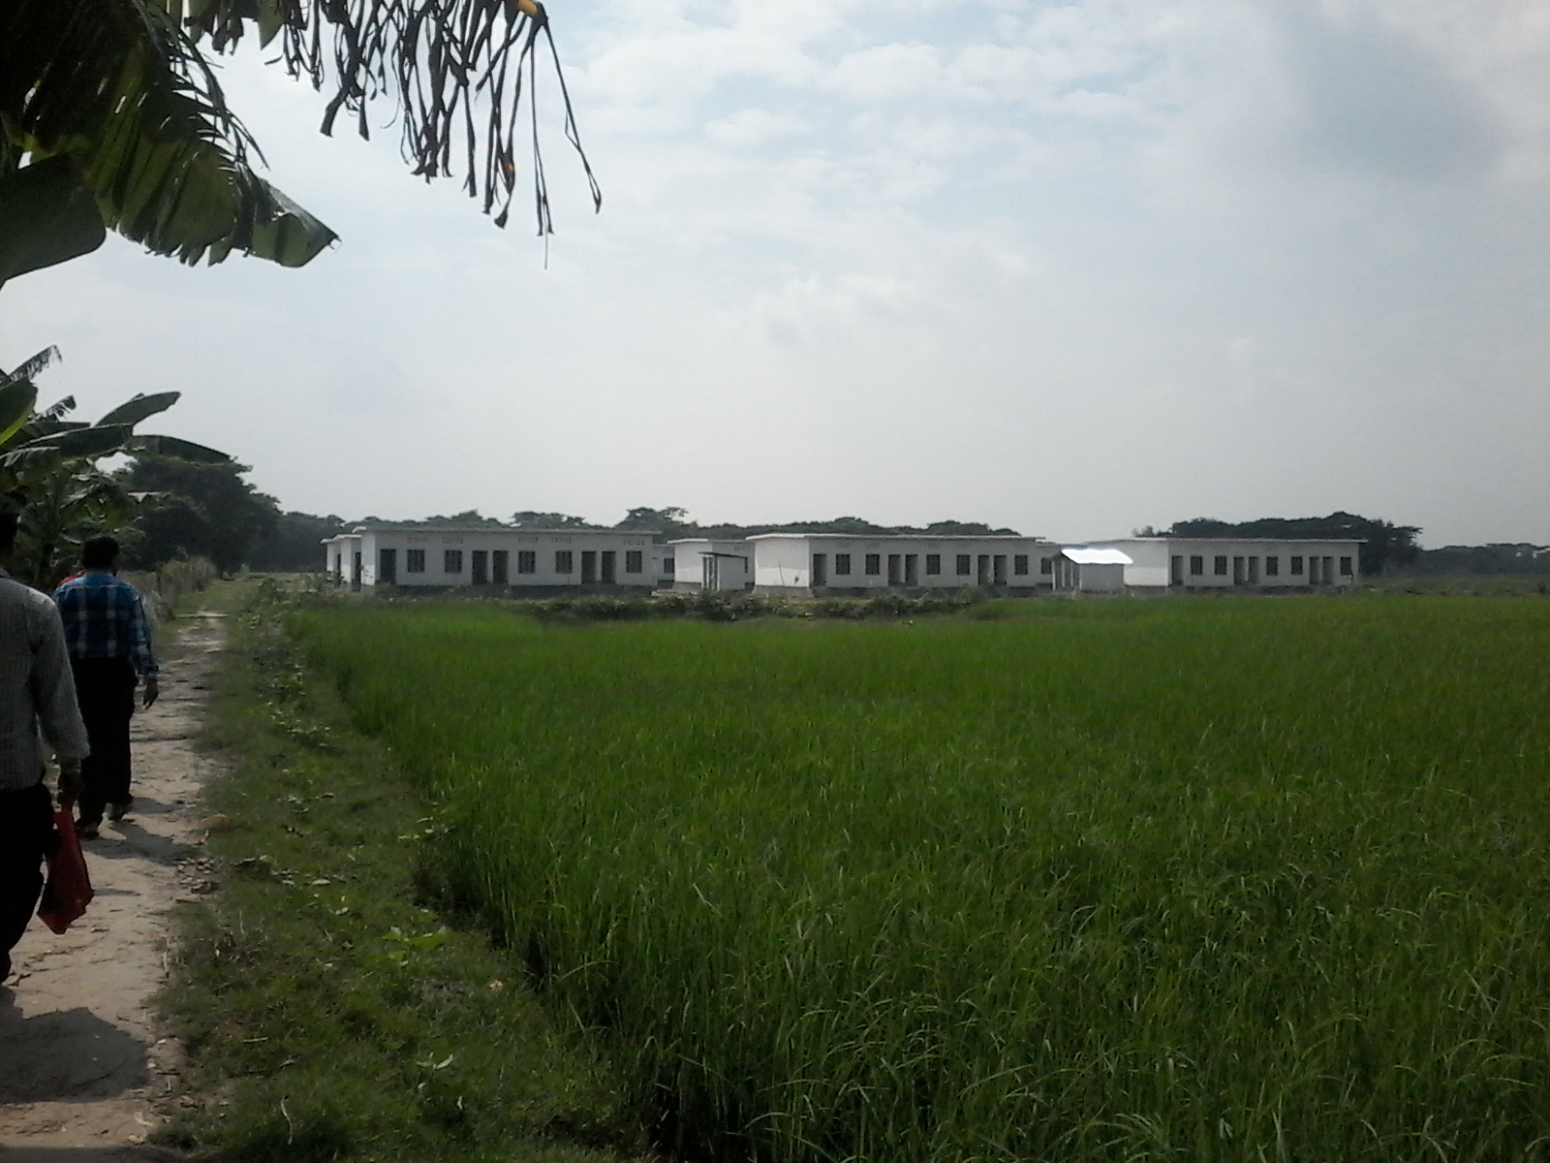
Ministry of Land
Land to 50,000 landless families in 2015
Home to 10,000 homeless families in 2015
Government of the People’s Republic of Bangladesh

Slide 29
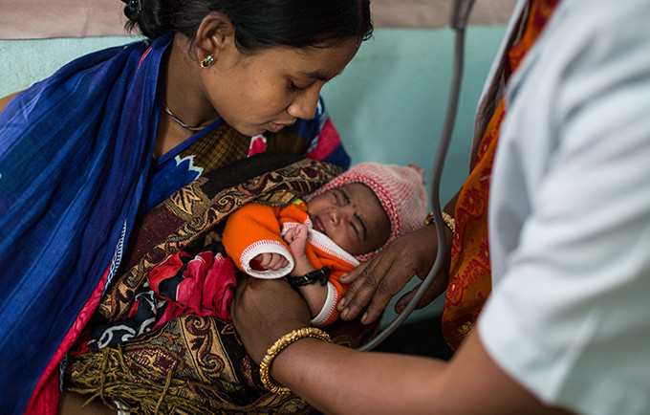
Ministry of Health
“18,000 Community Clinics”
“Each Serves 6,000 People”
Government of the People’s Republic of Bangladesh

Slide 30
Ministry of Dis. Management
Created work opportunity for 5 million people for 40 days in 2015
Government of the People’s Republic of Bangladesh

Slide 31
Any Question
Government of the People’s Republic of Bangladesh

Slide 32
Government of the People’s Republic of Bangladesh

