Slide 1
Islamic Republic of Afghanistan
Ministry of Lobar, Social Affairs, Martyrs & Disabled
(MoLSAMD)
Employment of Persons with Disabilities
Mujahid Wali Zazai
October 2016

Slide 2
Contents:
Over View
Disable Rights and Concession Law
Disables Employment System
Challenges
Recommendations

Slide 3
Over View:
Disable:
Any person who has a physical or mental impairment that substantially limits one or more their major life activities

Slide 4
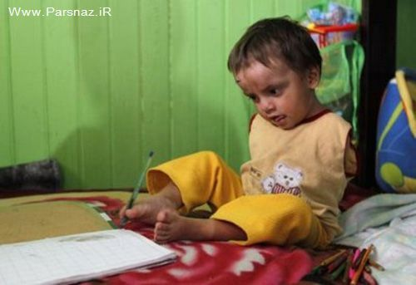
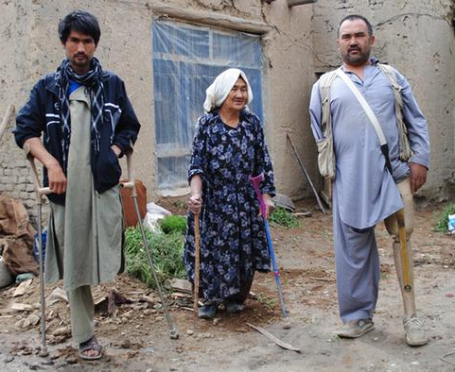
Over View…
Disability caused by birth
Types of Disabilities:
Disability caused by an accident or external factors

Slide 5
Over View…
The most recent statistics on Disability Survey jointly conducted by the Government of Afghanistan & Handicap International
The survey found a general prevalence rate of 2.7% for severe disabilities and 4.7% for less severe disabilities.
It means that over 850,000 people suffers from various forms of disability.

Slide 6
Over View…
One in five households is estimated to have a person with disability.
Around the three-quarters of persons with disabilities, most are illiterate, unemployed or lack access to health services, education and other opportunities (N.D.S).

Slide 7
Disable Rights and Concession Law:
The Government of Islamic Republic of Afghanistan has taken a number of legislative and policy steps that indicate commitment to advising the rights of persons with disabilities.
Passed on 20 Dec 2009.
The Law contains three session and forty Articles.

Slide 8
Disables Employment System:
Disable Rights and Concession Law:(2nd Season , 22nd Article):
The Government has considered the 3% of the total government positions for the interested and eligible disabled persons.
Current Population of Afghanistan | 33.6 Million Over
Government Civil Employees | 480,000 Persons
Number of Disable Employees in Government | 14,400 Persons
Number of Disabled Females in Government | 2 % of 14,400
Number of Disabled Males in Government | 98 % of 14,400

Slide 9
Challenges:
Main problems disabled people face:
Relevant field experience
Education
Physical abilities
Lack of interest
Assistant

Slide 10
Challenges…
Main problems disabled people face in society
Verbal and Physical abuse
Lack of access to dedication and live-hood opportunities
Lack of Social opportunities (Marriage, Family Life, etc..)
Lack of appropriate health care and treatment Services
Loss of respect within family and community

Slide 11
Recommendations:
Conducting programs for disabled persons for their capacity building
Providing facilities for better education
Making Artificial body parts for disables
Public information campaigns, specially presenting the abilities of persons with disabilities
Improving their physical accessibility to public places such as Mosques (Masjid), Government buildings, offices & schools

Slide 12
Recommendations:
Creation incentives for employers to hire disabled people
Creation of a network or peer groups for disable people
Improving peoples’ knowledge about causes, and treatment of disabilities through mass media. Religious leaders, modern and traditional health practitioners

Slide 13
Thank you!
?

