Slide 1


OUTBOUND TOURISM STATISTICS
Statistical, Economic and Social Research and Training
Centre for Islamic Countries Statistical Capacity Building
Programme
Akhmad Tantowi
BPS-Statistics Indonesia
Paramaribo, 9 – 11 August 2016

Slide 2
Outline
What is outbound tourism?
Measuring flow and characteristics of outbound visitors
Indonesia Outbound Tourism Statistics

Slide 3
Type of visitors
International
Domestic
country of residence different from country visited
country of residence the same as country visited
Inbound visitors
Outbound visitors

Slide 4
International tourism
Inbound tourist
Outbound tourist

Slide 5
What is Outbound Tourism?
Outbound tourism comprises the activities of a resident visitor outside the country of reference, either as part of an outbound trip or as part of a domestic trip;
Outbound visitor is a traveler taking a trip to a country outside his/her usual environment, for less than a year, for any main purpose (business, leisure or other personal purpose) other than to be employed by a resident entity in the country visited.

Slide 6
Classification of outbound travellers
Busness & professional
outbound Travellers
Holiday, leisure
& recreation
Visiting friends
and relatives
outbound
Visitors
Other outbound Travellers
Education &
training
Tourists
(Overnight Visitors)
Same-day visitors
(Excursionists)
Health &
medical care
Main purpose of tourism trip
Religion/
pilgrimages
National residing abroad
Other non-residents
(foreigners)
Shopping
Transit
Other
Border workers
Seasonal workers
Other short-term workers
Long-term workers
Nomads and refugees
Other travellers deemed not to enter the economic territory (Diplomats, military, armed forces on maneuver
long-term students and patients and their family joining them
Persons entering the country to establish there their cor
Crews on public modes
of transport
Transit pass not entering the eco and legal territory

Slide 7
Relationship between international arrivals and different categories of visitors and other travellers
International arrivals
Arrining non-residents
Returning residents
Others
Visitors
Other travellers
Visitors
Other travellers
Nomads, refugees
Business & prof
Holiday, leisure & rec
Visiting friends & rel
etc
Border workers
Crew of public trans
Frequend border crossers
etc
Business & prof
Holiday, leisure & rec
Visiting friends & rel
etc
Border workers
Crew of public trans
Frequend border crossers
etc

Slide 8
Measuring flow and characteristics of outbound visitors
Countries often leave the observation of outbound tourism in general to a later stage, than that for inbound and domestic tourism.
This is because its impact on the local economy is felt as a “loss” (an import), since the corresponding economic transactions occur between a resident visitor and a non-resident service provider.
However, if, within a tourism promotion policy, national travellers are to be encouraged to select domestic destinations, the reasons for their choice of foreign travel need to be understood

Slide 9
Measuring flow and characteristics of outbound visitors (1)
any country setting out to develop a system of data collection on international tourism should first identify all available relevant administrative records.
In the case of outbound tourism, the main sources of information will be:
  administrative data collected by the border protection authorities;
    This data identifies all travellers – both visitors and non-visitors – although in some countries very frequent border crossers, e.g. people crossing the border on a daily basis for work purposes, may not be recorded.
  special surveys designed to collect supplementary information, at or near the border, or using household survey
    The survey usually to collect data such as the demographics of the visitors, activities while in the country, places visited, how much spent while in the country, etc.

Slide 10
Measuring flow and characteristics of outbound visitors (2)
Beyond NTAs and NSOs, Central Banks, who are usually in charge of compiling and providing BoP data, might also be interested in participating in decisions concerning the frequency with which international tourism flows and expenditure by inbound and outbound visitors are measured
they could be valuable partners in the development of tourism statistics.

Slide 11
Statistics of outbound visitors
Port of departure
  useful for stratification of universe
Demography (sex, age, civil status, occupation)
Main purpose of the trip
  Essential for identifying types of visitors’ trips

Slide 12
Statistics of outbound visitors (1)
Mode of transport used
Type of accommodation
  needs to be confirmed
Length of stay
  Very useful as initial indication as to actual length of stay; needs to be confirmed
Expenditure

Slide 13
Indonesia Outbound Tourism Statistics
Officially, BPS/MoT has not released the number of outbound visitors
Central Bank has used outbound visitors data in compiling BoP
Main source in compiling the flow of outbound visitors arrivals is monthly report of immigration offices throughout Indonesia
The data of number of Indonesian working abroad have been obtained from BNP2TKI
The expenditure of outbound visitors have been established through questions on the Outbound Survey conducted by MoT

Slide 14
Immigration Reports
Immigration offices compile the monthly reports from immigration office branches reports at international port of departure leave Indonesia
Indonesia has more than 130 international ports of entry
Immigration reports descript the outflow Indonesian and foreigners

Slide 15
BNP2TKI Reports
Outbound visitors from immigration report:
  Indonesian authority give specific regulation for Indonesian want to work in abroad

Slide 16
Outbound Survey
Outbound Survey has been conducted by the Ministry of Tourism
BPS has assisted the MoT related methodology and questionnaire
Central Bank has been involved in the survey as a user using the data
MoT also has coordinated with many institution such as immigration authority and port of entry authorities

Slide 17
Outbound Survey (1)
Outbound Survey has been conducted by face to face interview
Outbound Survey has been conducted in several main port of entries
Respondents of each port or country are calculated based on number of Indonesian outbound a year before
Respondent criteria: age ≥ 15 years, Indonesian, individual trip
The survey has been conducted every two years

Slide 18
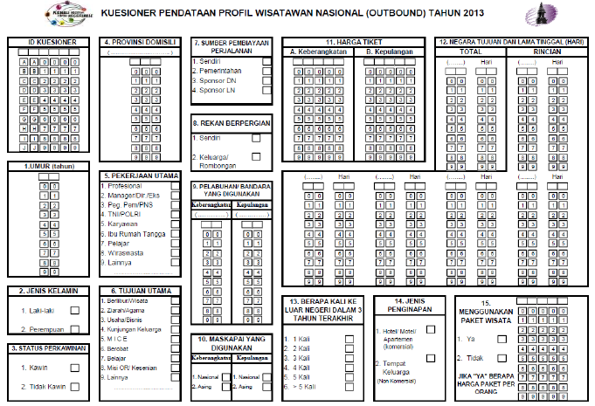
Questionnaire Outbound Survey

Slide 19
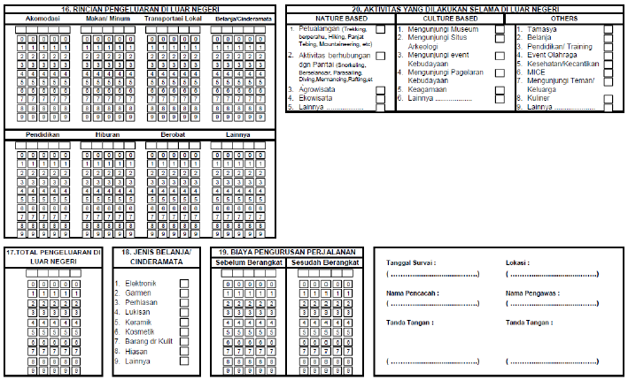
Questionnaire Outbound Survey (1)

Slide 20
Number of Indonesian Outbound, 2011-2015

Slide 21
Number of Indonesian Outbound by Destination, 2013 vs 2011

Slide 22
Characteristics of Indonesian Outbound, 2013

Slide 23
Average Expenditure and LoS per Visit of Indonesian Outbound, 2010-2013

Slide 24
THANK YOU
Terima Kasih
MATUR NUWUN

Slide 25
Slide Title
Make Effective Presentations
Using Awesome Backgrounds
Engage your Audience
Capture Audience Attention

Slide 26

Slide Title
Make Effective Presentations
Using Awesome Backgrounds
Engage your Audience
Capture Audience Attention

Slide 27
Slide Title
Product A
Product B
Feature 1
Feature 2
Feature 3
Feature 1
Feature 2
Feature 3

