Slide 1
INBOUND TOURISM STATISTICS
Statistical, Economic and Social Research and Training
Centre for Islamic Countries Statistical Capacity Building
Programme
Akhmad Tantowi
BPS-Statistics Indonesia
Paramaribo, 9 – 11 August 2016

Slide 2
Outline
Who is visitors?
What is inbound visitor?
Measuring flow and characteristics of inbound visitors
Indonesia Inbound Tourism Statistics

Slide 3
Who is visitor?
A visitor is a traveler taking a trip to a main destination outside his/her usual environment, for less than a year, for any main purpose (business, leisure or other personal purpose) other than to be employed by a resident entity in the country or place visited.
Tourism refers to the activity of visitors

Slide 4
Type of visitors
International
Domestic
country of residence different from country visited
country of residence the same as country visited
Inbound visitors
Outbound visitors

Slide 5
International tourism
Inbound tourist
Outbound tourist

Slide 6
Internal tourism
Inbound tourist
Domestic tourist

Slide 7
Forms of tourism
Inbound tourism, which comprises the activities of a non-resident visitor within the country of reference on an inbound trip;
Outbound tourism, which comprises the activities of a resident visitor outside the country of reference, either as part of an outbound trip or as part of a domestic trip.
Domestic tourism, which comprises the activities of a resident visitor within the country of reference either as part of a domestic trip or part of an outbound trip;

Slide 8
What is Inbound Tourism?
Inbound tourism comprises the activities of a non-resident visitor within the country of reference on an inbound trip;
Inbound visitor is a traveler taking a trip to a country outside his/her usual environment, for less than a year, for any main purpose (business, leisure or other personal purpose) other than to be employed by a resident entity in the country visited.

Slide 9
Classification of inbound travellers
Busness & professional
Inbound Travellers
Holiday, leisure
& recreation
Visiting friends
and relatives
Inbound
Visitors
Other Inbound Travellers
Education &
training
Tourists
(Overnight Visitors)
Same-day visitors
(Excursionists)
Health &
medical care
Main purpose of tourism trip
Religion/
pilgrimages
National residing abroad
Other non-residents
(foreigners)
Shopping
Transit
Other
Border workers
Seasonal workers
Other short-term workers
Long-term workers
Nomads and refugees
Other travellers deemed not to enter the economic territory (Diplomats, military, armed forces on maneuver
long-term students and patients and their family joining them
Persons entering the country to establish there their cor
Crews on public modes
of transport
Transit pass not entering the eco and legal territory

Slide 10
Relationship between international arrivals and different categories of visitors and other travellers
International arrivals
Arrining non-residents
Returning residents
Others
Visitors
Other travellers
Visitors
Other travellers
Nomads, refugees
Business & prof
Holiday, leisure & rec
Visiting friends & rel
etc
Border workers
Crew of public trans
Frequend border crossers
etc
Business & prof
Holiday, leisure & rec
Visiting friends & rel
etc
Border workers
Crew of public trans
Frequend border crossers
etc

Slide 11
Measuring flow and characteristics of inbound visitors
any country setting out to develop a system of data collection on international tourism should first identify all available relevant administrative records.
In the case of inbound tourism, the main sources of information will be:
administrative data collected by the border protection authorities;
This data identifies all travellers – both visitors and non-visitors – although in some countries very frequent border crossers, e.g. people crossing the border on a daily basis for work purposes, may not be recorded.
E/D cards were the most common mechanism for estimating arrivals and that all countries reporting their use also combined them with other administrative records (entry controls, the use of passports or visas, etc.).

Slide 12
Measuring flow and characteristics of inbound visitors (1)
special surveys designed to collect supplementary information, at or near the border, at tourism attractions, and at accommodation establishments
The survey usually to collect data such as the demographics of the visitors, activities while in the country, places visited, how much spent while in the country, etc.

Slide 13
Measuring flow and characteristics of inbound visitors (2)
Beyond NTAs and NSOs, Central Banks, who are usually in charge of compiling and providing BoP data, might also be interested in participating in decisions concerning the frequency with which international tourism flows and expenditure by inbound and outbound visitors are measured
they could be valuable partners in the development of tourism statistics.

Slide 14
Statistics of inbound visitors
Port of entry
useful for stratification of universe
Demography (sex, age, civil status, occupation)
very useful for marketing purposes
Nationality
Useful for designing and stratifying surveys; useful in conjunction with “Current country of residence”
Country of residence
Essential for identifying person as a visitor, and data on countries of origin;

Slide 15
Statistics of inbound visitors (1)
Main purpose of the trip
Essential for identifying types of visitors’ trips
Mode of transport used
useful for marketing purposes and for stratification of universe
Type of accommodation
Of some use as initial indication as to actual accommodation; needs to be confirmed
Length of stay
Very useful as initial indication as to actual length of stay; needs to be confirmed
Expenditure

Slide 16
Indonesia Inbound Tourism Statistics
Statistics Indonesia (BPS) releases the number of inbound visitors arrivals monthly
Main source in compiling the flow of inbound visitors arrivals is monthly report of immigration offices throughout Indonesia
Before 2015, the characteristics of inbound trips and visitors were established through questions on the entry/departure cards
Since 2015 the characteristics of inbound trips and visitors have been established through questions on the Passenger Exit Survey conducted by Ministry of Tourism

Slide 17
Indonesia Tourism Statistics (1)
The expenditure of inbound visitors have been established through questions on the Passenger Exit Survey conducted by Ministry of Tourism

Slide 18
Immigration Reports
Immigration offices compile the monthly reports from immigration office branches reports at international port of entry to Indonesia
Indonesia has more than 130 international ports of entry
Immigration reports descript the inflow and outflow Indonesian and foreigners by citizenship, passport (Indonesian) and visa

Slide 19
Immigration Reports (1)
Inbound visitors from immigration report:
For Indonesian: Indonesians live abroad are estimated based on Indonesia lived abroad survey in 2009
For foreigner: foreigners are excluded from inbound visitors if their country of residence is Indonesia or they visit Indonesia and have main purpose work in Indonesia
Indonesian authority give specific visa for foreigner want to stay in Indonesia more a year or work in Indonesia

Slide 20
Passenger Exit Survey
PES has been conducted every year by the Ministry of Tourism
BPS has assisted the MoT related methodology and questionnaire
Central Bank has been involved in the survey as a user using the data
MoT also has coordinated with many institution such as immigration authority and port of entry authorities

Slide 21
Passenger Exit Survey (1)
PES has been conducted by face to face interview
PES has been conducted in main port of entries (2016: 13 port of entries)
Respondents of each port or country are calculated based on visitor arrivals a year before (2016: number of sample: 25.000).
Respondent criteria: age ≥ 15 years, not Indonesian, individual trip
The survey has been conducted two times in a year: low season (April-Mei) and peak season (July-August)

Slide 22
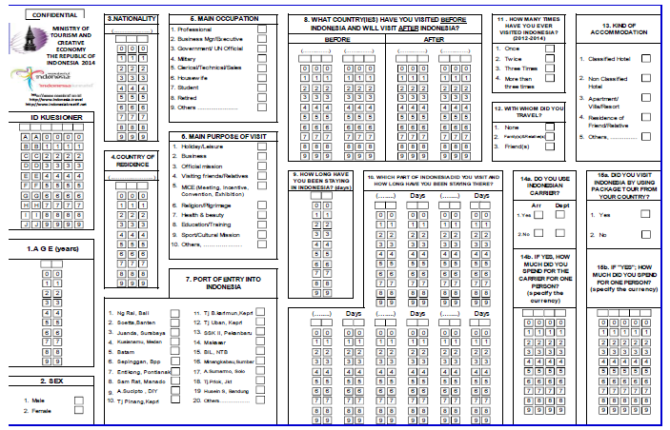
PES Questionnaire

Slide 23
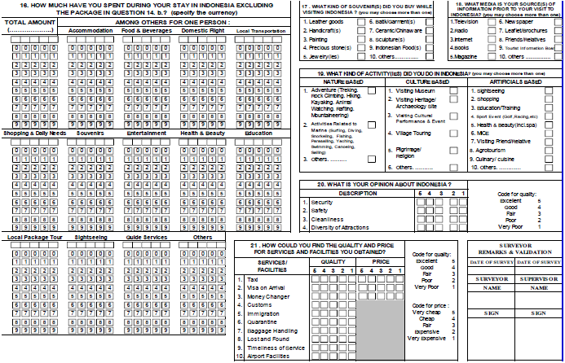
PES Questionnaire(1)

Slide 24
Visitor Arrivals to Indonesia, 2011-2015

Slide 25
Visitor Arrivals to Indonesia by Main Markets, 2014-2015

Slide 26
Characteristics of Visitor Arrivals to Indonesia, 2014

Slide 27
Average Expenditure and LoS per Visit of Visitor Arrivals to Indonesia, 2010-2014

Slide 28
THANK YOU
Terima Kasih
MATUR NUWUN

