Slide 1
ACCOMMODATION STATISTICS
Statistical, Economic and Social Research and Training
Centre for Islamic Countries Statistical Capacity Building
Programme
Akhmad Tantowi
BPS-Statistics Indonesia
Paramaribo, 9 – 11 August 2016

Slide 2
Outline
Background
Compiling accommodation statistics
Indonesia Accommodation Statistics

Slide 3
Background
In order to attract visitors, goods and services must be available in the form and in the quantity that visitors might demand.
Tourism supply is understood as the direct provision to visitors of the goods and services that make up tourism expenditure.
The analysis of tourism supply consists:
in showing how the conditions are created that enable producers to provide goods and services to visitors
in describing the processes, the production costs and the economic performance of the suppliers in the tourism industries

Slide 4
Compiling accommodation satatistics
To begin, it is important to determine the type of statistical unit for which information is sought and data compiled.
In tourism, many producing entities operate on very small scale in a single location as unincorporated enterprises, family businesses or even as informal units of production, with only one establishment in activities such as food and beverage serving services, hotels and other personal services.
Compilers should be particularly aware of the existence of these types of units, which might behave differently from the big formal units that often are the focus of statistical procedures and official registers.

Slide 5
Compiling … (1)
Because they spend a night outside their usual environment, tourists will need a specific place to stay overnight
Short-term accommodation services are considered so important for tourism that many countries consider the establishments providing them
The services provided on a commercial basis and the establishments providing them must be appropriately classified in order to obtain the information required for analysing different segments of demand and the producers servicing those segments which may vary in forms of organization, size and range of services offered.

Slide 6
Compiling … (2)
Data collection on accommodation services from the supply side offers the opportunity to cross-classify with information on the types of destinations where the accommodation establishments are located.
There is already a long tradition of using non-monetary indicators collected from the supply side to monitor the capacities and use of the accommodation establishments and to depict the flows of both domestic and inbound tourism.
It is an important source of information not only for the accommodation industry but also for tourism policy, administration and promotion.

Slide 7
Accommodation Survey
For many countries, surveys of accommodation establishments are the most important short-term information source on supply as they are in general.
To depict tourism flows, the number of arrivals and nights spent are the most used indicators.
Nights spent are more appropriate to reflect the performance of the accommodation industry and the impact of the tourists stay for the place visited.
Dividing the number of nights spent by the number of arrivals provides the average length of stay, which can be used as an analytical indicator to offer additional information on the kind of tourism in a country or region.

Slide 8
Data of Accommodation
The following variables are most frequently used to describe the accommodation capacities:
Months operating in the year;
Number of rooms or accommodation units;
Number of bed places;
Occupancy rates by rooms or accommodation units (an indicator to be associated with revenue per room);
Occupancy rates by bed places (an indicator to be associated with flows of visitors);
Revenue per available room.

Slide 9
Indonesia Accommodation Statistics
Statistics Indonesia (BPS) has conducted two surveys in collecting accommodation data:
VHTS (monthly survey)
VHTL (annual survey)

Slide 10
VHTS (Monthly Survey)
Coverage:
Throughout Indonesia territory : 34 provinces
Star hotels : census
Non star hotels : sample
Some variables are collected in the survey:
occupancy rates by rooms
occupancy rates of bed places
average length of stay
number of guests (Indonesian and foreigner)
Output:
Press Release: star hotels, 27 provinces, monthly, occupancy rates by rooms and average length of stay
Publication: all hotels and provinces, annually

Slide 11
Flow of VHTS Survey
Census
Star Hotels
Entry
E-mail
BPS
BPS
Regency/Mun
BPS
Province
VHTS
Nonstar
Hotels
Sample

Slide 12
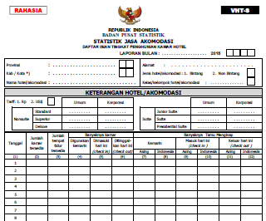
VHTS Questionnaire

Slide 13
VHTL (Annual Survey)
Coverage: all scale short-term accommodation establishment throughout Indonesia territory
Some variables are collected in the survey:
Number of accommodation establishments
Number of rooms and room rates
Number of workers by education level, job status and sex
Hotel facilities
Spending and revenue\
etc
Output:
Publication: annually

Slide 14
Flow of VHTL Survey
Entry
Star
Hotels
BPS
Regency/Mun
BPS
Province
BPS
VHTL
VHTL
Nonstar
Hotels

Slide 15
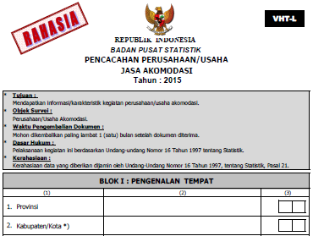
VHTL Questionnaire

Slide 16
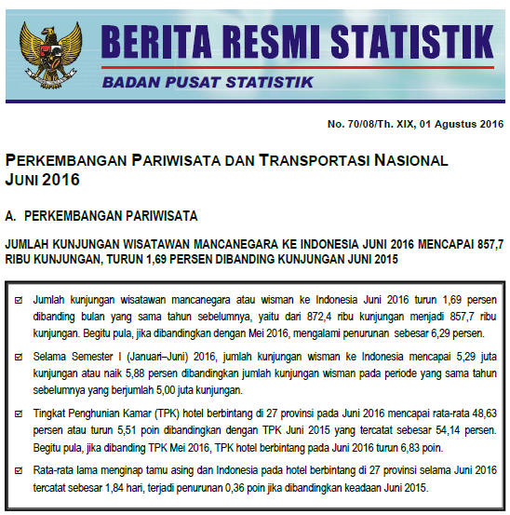
Monthly Press Release

Slide 17
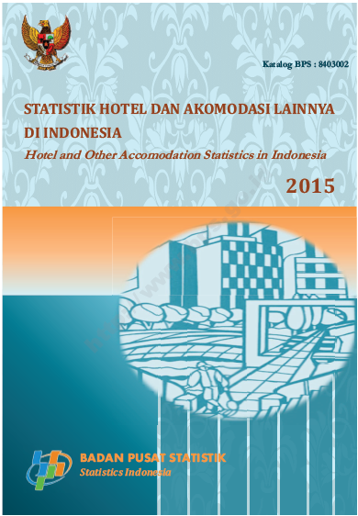
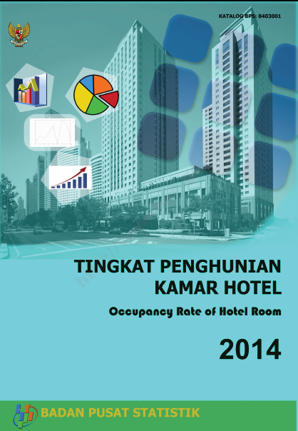
Annual Publications
https://www.bps.go.id/index.php/Publikasi/

Slide 18
Figure 1. Number of Short-stay Acc Est by Clas, 2014-2015

Slide 19
Figure 2. Distribution of rooms of acc est by province, 2015

Slide 20
Figure 3. Number of Workers of Acc Est by Education Level, 2015

Slide 21
Figure 4. Occupancy Rate of Hotel Room in Star Hotels, 2013-2014

Slide 22
Figure 5. Occupancy Rate of Hotel Room in Non Star Hotels, 2013-2014

Slide 23
THANK YOU
Terima Kasih
MATUR NUWUN

