Slide 1
STATISTICAL, ECONOMIC AND SOCIAL RESEARCH AND TRAINING CENTRE FOR ISLAMIC COUNTRIES |  | CENTRE DE RECHERCHES STASTISTIQUES ECONOMIQUES ET SOCIALES ET DE FORMATION POUR LES PAYS ISLAMIQUES
مركز الأبحاث الإحصائية والاقتصادية والاجتماعية والتدريب للدول الإسلامية (مركز أنقرة)
Tourism Statistics Training
Gambia
Statistics Capacity Building (StatCaB) Programme
Under the Sponsorship of
Statistical , Economic and social Research and Training Center for Islamic Countries
Arrivals and Departures statistics
Koire Yunus Lugya
(M. Demo, B.Statistics Makerere University)
Uganda Bureau of Statistics
22nd August 2016
31-Aug-16
Uganda Bureau of Statistics ¤ Plot 9 Colville Street, Kampala Uganda ¤ Website: www.ubos.org
Tel: +256(0)-41-4706000 ¤ E-mail: ubos@ubos.org
1
Notes:
1

Slide 2
Contents
Background
Arrivals and Departure declaration form
Indicator definition
Scope of coverage
Data sources
The compilation methodology
Best practises
Challenges and Recommendations
31-Aug-16
Uganda Bureau of Statistics ¤ Plot 9 Colville Street, Kampala Uganda ¤ Website: www.ubos.org
Tel: +256(0)-41-4706000 ¤ E-mail: ubos@ubos.org
2
Notes:
2

Slide 3
Background
T
The relevance of statistics in tourism development
The objective of national statistical system is to provide:
relevant,
comprehensive ,
accurate
and objective statistical information
Generally, statistics are invaluable for monitoring the country’s economic and social conditions, the planning and private sector programmes and investment, policy debates and advocacy

Slide 4
Why tourism statistics?
Essentials
Official decision making , policy formulation
Policy analysis and research
Academic , business , industrials and other research
Development of tourism research
Measurement of the contribution of tourism to the country’s economy
Business planning and monitoring progress
Strategic marketing
Guide investment promotion
Facilitates comparison across countries
Citizen/residents being informed about the performance of their govt.

Slide 5
Definitions
Visitors include
Tourists
cruise ship passengers and non-residents who stay in the country for less than a day, other those who do not leave the airport
Transit passenger is one who stops over in country for flight connections to other destination
Transit 1: passengers who do not leave the transit area of the airport or harbour.
Transit 2: passengers who leave the airport or harbour and stay in the country for more than 24 hrs only for flight connections purpose (transit 2 are included in definition of tourists

Slide 6
Definitions (Cont’d)
Same- day visitor (Excursionist)
Are non resident visitors other than those who do not leave the airport, they stay in a country for less than 24 hours
Because the IRTS ,2008 already provides basic conceptual consistency with other statistical frameworks (IRTS 2008, para. 1.31) such as the System of National Accounts 2008 (SNA 2008) and the Balance
of Payments and International Investment Position Manual (BPM6), the Tourism Satellite Account: Recommended Methodological Framework 2008 (TSA: RMF 2008)

Slide 7
Definitions (Cont’d)
Builds upon this consistency and provides an additional resource to link tourism statistics to the standard tables of the SNA 2008.

Slide 8
The Arrival declaration form

Slide 9
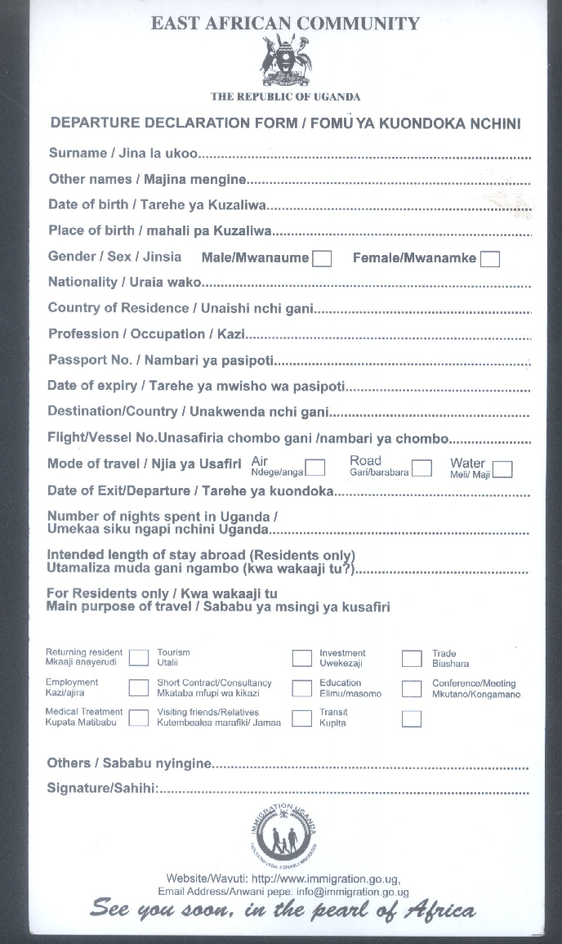
The Departure declaration form
Data
source

Slide 10
Purpose of visit
Holidays, leisure and recreation. This category includes, for example, Sightseeing, visiting natural or man-made sites, attending sporting or cultural events, practicing a sport activity; using beaches, attending summer camps for youngsters,, etc. .
Visiting friends and relatives. This category includes, for example, attending weddings, funerals or any other family event; short-term caring for the sick or old, etc.
Education and training. Taking short-term courses; following particular programmes of study (formal or informal) or acquiring specific skills through formal courses, university, etc.

Slide 11
Purpose of visit (Cont’d)
Health and medical care. Receiving services from hospitals, clinics, convalescent homes and, more generally, health and social institutions, etc. This category includes only short-term treatments because long-term treatments requiring stays of one year or more are not part of tourism.
Religion/pilgrimage. Attending religious meetings and events, pilgrimages, etc.
Shopping. Purchasing consumer goods for own personal use or as gifts except for resale or for use in a future productive process, (in which case the purpose would be business and professional), etc.
Transit. stopping at a place without any specific purpose other than being en route to another destination.

Slide 12
Purpose of visit (Cont’d)
Other. volunteer work (not included elsewhere), investigative work and migration possibilities; undertaking any other temporary non-remunerated activities not included elsewhere, etc.
Business and professional. This category includes the activities of the self-employed and employees as long as they do not correspond to an implicit or explicit employer employee relationship with a resident producer in the country or place visited, those of investors, businessmen, etc. It also includes, for example, attending meetings, conferences or congresses, trade fairs and exhibitions; giving lectures, concerts, shows

Slide 13
Border post analysis
Share of visitor arrivals by entry point
Border posts | No. of visitor arrivals | %age share
Border post 1
Border post 2
Border post 3
Border post 4
Border post 5
Border post 6
Border post n
Total

Slide 14
Purpose of visit analysis
Tourist arrivals by Purpose of visit
Purpose of visit | January |  | Year
 | 2015 | 2016 | 2014 | 2013 | 2012
Returning Resident
Prospective Resident
Seeking employment
Temporary Employment
Visiting Friends/Relatives
Holiday
Business/Conference
Transit
Medical Treatment
Tourism
Short Contract/Consultancy
Investment
Education
Trade
31-Aug-16
Uganda Bureau of Statistics ¤ Plot 9 Colville Street, Kampala Uganda ¤ Website: www.ubos.org
Tel: +256(0)-41-4706000 ¤ E-mail: ubos@ubos.org
14
Notes:
14

Slide 15
Mode of travel analysis
Mode of travel
Water
Road
Air
railway

Slide 16
Variables on the A&D Declaration form
Name of traveler
Date of birth
Place of birth
Sex
Nationality
Country of residence
Profession/occupation
Passport number
Date of expiry

Slide 17
Variables on the A&D Declaration form (Cont’d)
Mode of travel
Date o f exit/Departure
Number of nights spend a country
Intended length of stay (abroad) ( for resident departing)
Main purpose of travel (visit) (for residents departing)

Slide 18
Variables on the A&D Declaration form (Cont’d)
Purpose of travel
Returning Resident
Prospective Resident (seeking permanent residency status)
Seeking employment
Temporary Employment
Visiting Friends/Relatives
Holiday
Business/Conference
Transit
Medical Treatment

Slide 19
Variables on the A&D Declaration form (Cont’d)
Purpose of travel
Tourism
Short Contract/Consultancy
Investment
Education
Trade

Slide 20
Outputs
Total arrivals and tourist arrivals by mode of travel (Numbers, percentage)
Total arrivals and tourist arrivals by country of residence (Numbers, percentage)
Regional Analysis
Total arrivals and tourist arrivals by main purpose of travel residence (Numbers, percentage)
Total arrivals and tourist arrivals by length of stay (Numbers, percentage)

Slide 21
Data capture processes
Statistics offices need to develop electronic system to capture data from arrivals and departures declaration forms on a daily basis.
Sharing mechanism should be setup, The system should deposit data onto a central server housed at the statistical office.
(i) Access space and
(ii) Access back up facility
Connectivity – preference is a fibre link
We need to bring on board National fibric network, so that we tap their services
The system should be piloted for a period of 6 months before its extended to other entry/exit points.
31-Aug-16
Uganda Bureau of Statistics ¤ Plot 9 Colville Street, Kampala Uganda ¤ Website: www.ubos.org
Tel: +256(0)-41-4706000 ¤ E-mail: ubos@ubos.org
21
Notes:
21

Slide 22
Data capture process – data capture fields
All variables on the A&D declaration form will be captured;
The system will include the name and passport number of the traveller
This implies that the A&D declaration form will be re-designed (without altering the content – to make it suitable for scanning technology)

Slide 23
System development and acquisition
The GBOS team will develop a concept note/proposal for development of the A&D declaration form processing system. The proposal shall define all the functional specifications of the system.
It is proposed that the funding entity will procure a Business Solutions firm to develop the system using the RFP approach.
The Bureau, together with the other stakeholders will take lead in the development of the system, participate in the selection and evaluation process of the business firm.

Slide 24
Issues to Consider
Sustainability
Management of Satellite offices
Establishment Costs
Supervision of the Data Entrants.
Data Transfer
Connectivity

Slide 25
Challenges and Recommendation
Budget constraints
Irregular use of arrivals and departure declaration form by Immigration, hence inconsistency in A&D data.
Untimely data, incase the A&D declaration forms are not processed electronically.
Addressing challenges requires coordination of key stakeholders in the industry both private and public.
Improve communication among key stakeholders by forming national statistical committees (NSC) includes NSBs, immigration departments, Central Bank, Tourism boards/authorities, MDA, wildlife departments.

Slide 26
Thank you

Slide 27
Visitor to tourism attraction Place/Sites
Definitions
Tourism attraction sites :Any place of interest where tourists visit typically for its exhibited man-made, natural or cultural value or its historical significance.
A Visitors to tourism attraction Place/Sites; Persons who undertake a leisure, educational, research tour in the tourism attraction Place/Sites. These visitor can be categorized as:
National parks: An area of international and national importance because of its biological diversity, landscape or national heritage and in which the following activities may be permitted: Biodiversity conservation; Recreation; scenic viewing; scientific research; and any other tourism related economic activities.

Slide 28
Visitor to tourism attraction Place/Sites
Game/natural reserves: Areas controlled by government often set aside for conservation of fauna and flora with controlled wildlife activities.
Historical Sites: Protected sites by national historic significance where pieces of political, military, cultural history have been preserved for education, enjoyment etc.
Historical Buildings: Historical buildings registered/ recognized by regulatory Authority.

Slide 29
Visitor to tourism attraction Place/Sites
Museum: is a nonprofit making permanent institution, in the service of society and its development, and open to the public, which acquires, conserves researches, communicates and exhibits for the purpose of study, education and enjoyment of material evidence about man and his environment.

Slide 30
Analysis of tourism attraction Place/Sites
The administrative details of tourists attraction sites:
Region, district , sub county, parish and village.
Type of tourists attraction sites/places

Slide 31
Analysis of tourism attraction Place/Sites
A Visitors to tourism attraction Place/Sites can be categorized as:
Foreign Non Resident (excluding ECOWAS PSs citizens)
National residents excluding citizens of the ECOWAS PSs visiting National Parks and Game Reserves.
Foreign Residents (Excludes ECOWAS PSs citizens)
These are non-citizens of the ECOWAS Partner States residing in the Partner State of reference visiting National Parks and Game Reserves.
Nationals and other ECOWAS PSs Citizens
Number of nationals and other ECOWAS Citizens visiting National Parks and Game Reserves.

Slide 32
Tourism attraction Place/Sites
Abuko nature reserve
National museum
Kunta kinta island
Stone circle at wassu and kerr batch
CFAO building
Fort bilian
Katchaly poll
Arch 22
Mongo park memorial at karantaba
Monkey park

Slide 33
Tourism attraction Place/Sites
Albert market
Kiang west national park
Bar bolong reserve
Tendaba
Janjanburck
War memorial and fountain at 22nd July square
St matty tomb cape point.

Slide 34
Methodology
Visitors to the tourism sites (national parks/games reserves, beaches, tourist sites/building, islands etc

