Slide 1
The General Directorate
on the Status of Women
Best Practices on National Mechanisms For Empowering Women :
Promoting Women’s Employment in Turkey
04.10.2016
ANKARA

Slide 2
Current Situation
in Women’s Employment

Slide 3
Current Situation
in Women’s Employment

Slide 4
Current Situation
in Women’s Employment

Slide 5
The Objectives Set with regard to Women’s Employment
10th . Development Plan
Reaching a %34,9 labor force participation rate and %31 employment rate for women by 2018
National Employment Strategy
Reaching a %41 labor force participation rate for women by 2023
Reducing the rate of informal women employment to 30% by 2023

Slide 6
Government Program
Review of the legislation regarding women requesting opinions of the relevant stakeholders to strengthen women’s position further and promote efficiency of the practices available
Sustainability of incentives introduced for employment of women
Develop and implement a Women’s Entrepreneurship Program and facilitate women’s participation in business life
Multiply the awareness-raising programs to consolidate the perspective of equal opportunities for men and women among the employees and employers
Implement the policies for reconciliation of work and family life

Slide 7
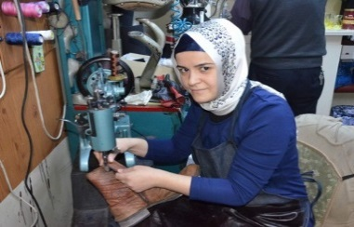
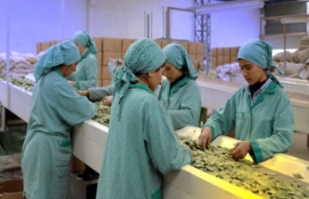
Examples of Best Practices
Incentive For Women’s Employment
Insurance premiums of women who started to work over the age of 18, are paid from the Unemployment Insurance Fund of employer’s share depending on certain conditions for a period of 12 and 54 months.

Slide 8
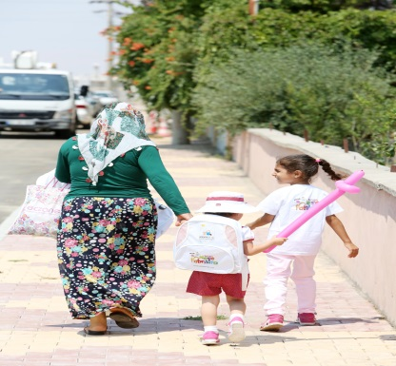
Examples of Best Practices
Open kindergartens in a total of 10 organized industrial zones until the end of 2019.

Slide 9
Examples of Best Practices

Slide 10
Examples of Best Practices
The support programs provide women entrepreneurs with financial support 10 percent greater than men.

Slide 11
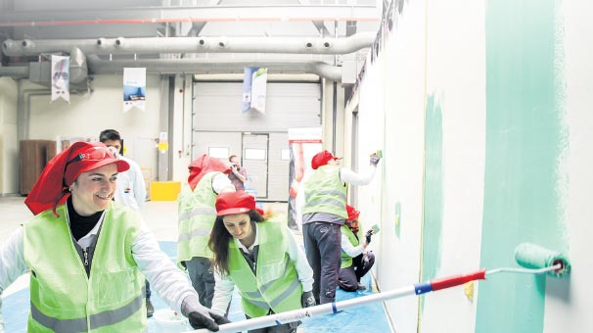
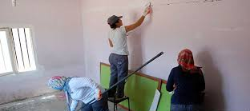
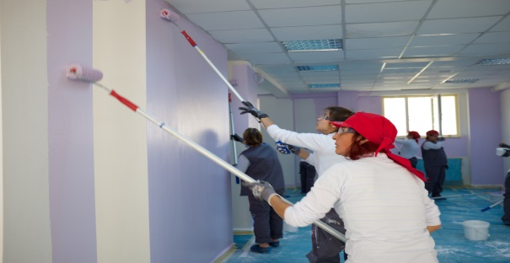
Examples of Best Practices
Filli Painter Forewomen Project

Slide 12
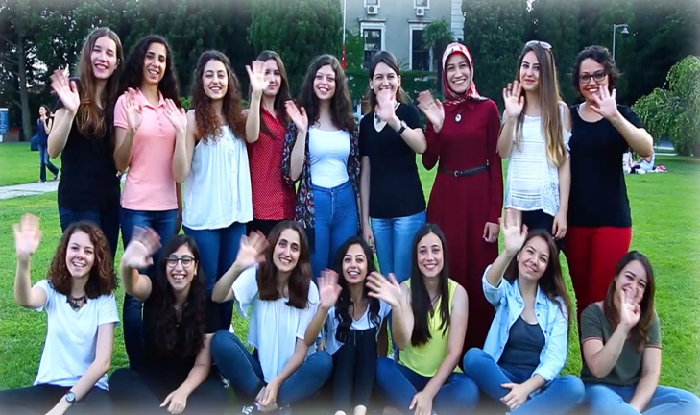
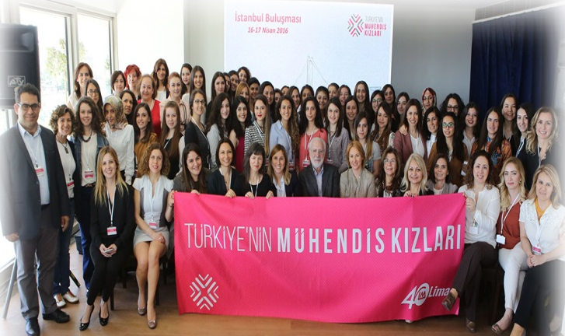
Examples of Best Practices
Turkey's Engineer Girls Project (2016-2020

Slide 13
The General Directorate
On The Status Of Women
Thank you for your attention…
Akın YUMUŞ
Family and Social Policy Expert
akin.yumus@aile.gov.tr

