Slide 1
STATISTICAL, ECONOMIC AND SOCIAL RESEARCH AND TRAINING CENTRE FOR ISLAMIC COUNTRIES
ORGANISATION OF ISLAMIC COOPERATION
Street Living and Street Working
Children in OIC Member Countries
25 January 2019
Presented by Kaan Namli, Researcher at SESRIC

Slide 2
Outline
Introduction
Overview of Children’s Situation in OIC Countries
Who are Street Children?
Street Children in Numbers
Major Causes
Risks Street Children Face
Way Forward
STATISTICAL, ECONOMIC AND SOCIAL RESEARCH AND TRAINING CENTRE FOR ISLAMIC COUNTRIES
ORGANISATION OF ISLAMIC COOPERATION

Slide 3
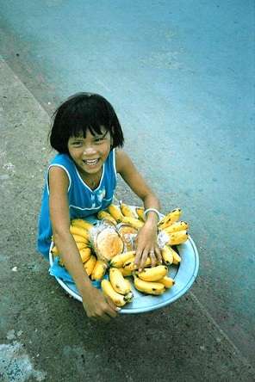
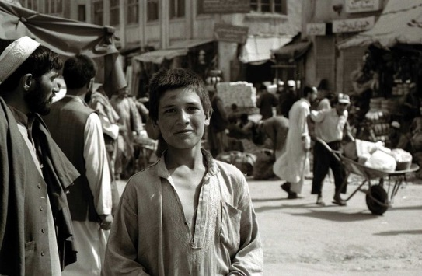
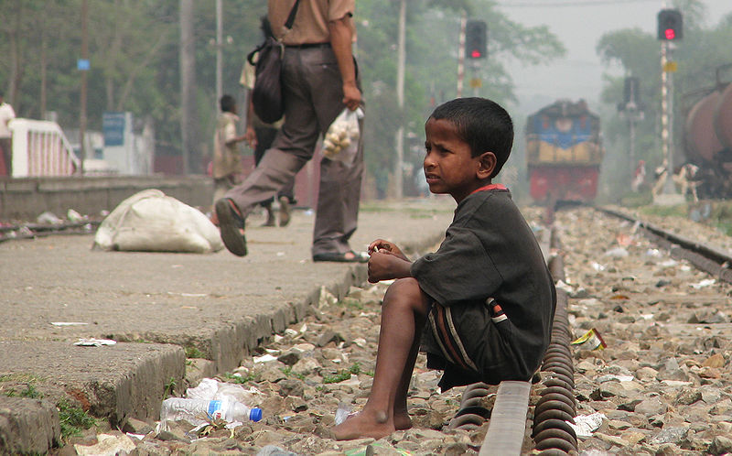
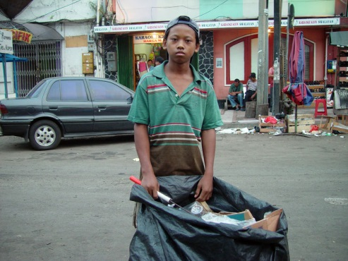
STATISTICAL, ECONOMIC AND SOCIAL RESEARCH AND TRAINING CENTRE FOR ISLAMIC COUNTRIES
ORGANISATION OF ISLAMIC COOPERATION

Slide 4
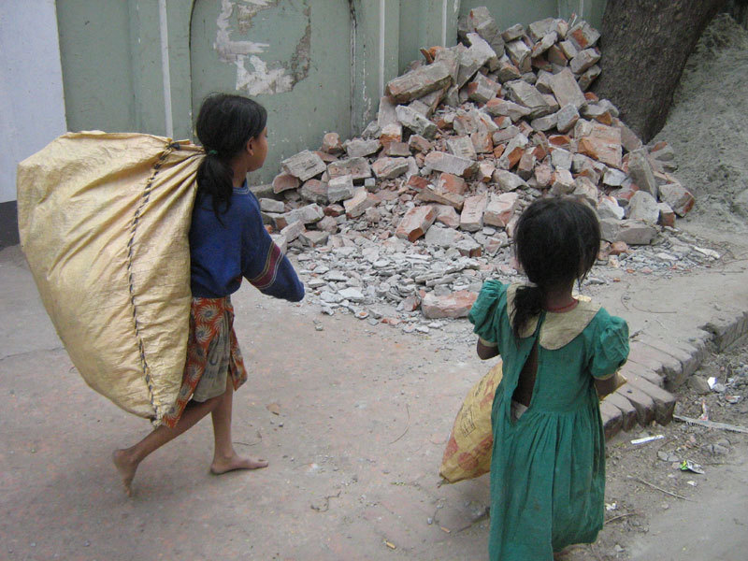
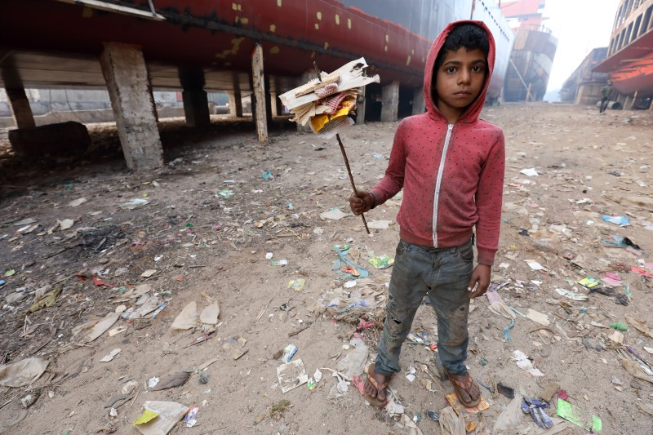
STATISTICAL, ECONOMIC AND SOCIAL RESEARCH AND TRAINING CENTRE FOR ISLAMIC COUNTRIES
ORGANISATION OF ISLAMIC COOPERATION

Slide 5
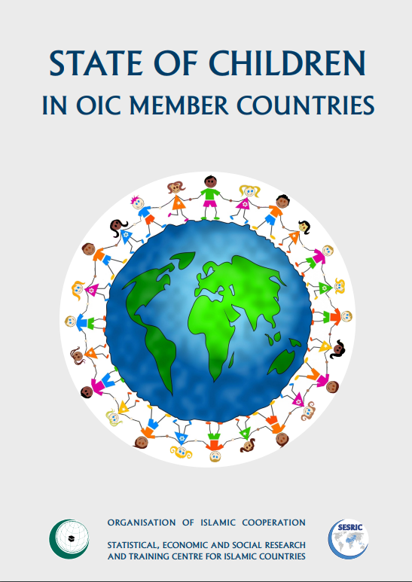
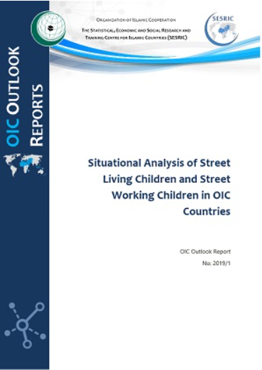
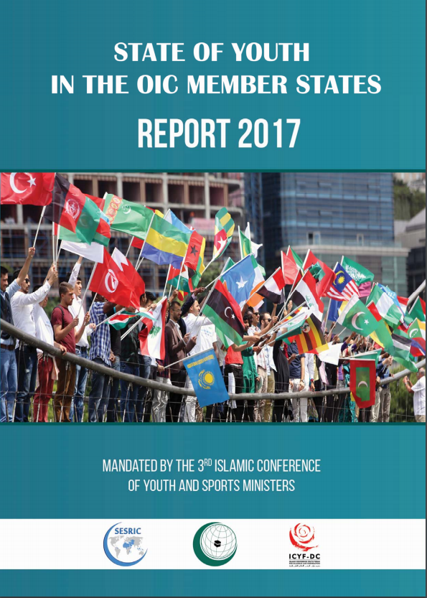
Introduction
SESRIC Reports on Children and Youth in OIC Countries.
Children amongst the most vulnerable segment of society.
Various international conventions and national legal frameworks to protect children, however, problem persists
Street children can be found across the world but highest numbers are in the developing countries.
Street children are not homogenous group.
Causes and risk differ but overarching commonalities are evident.
STATISTICAL, ECONOMIC AND SOCIAL RESEARCH AND TRAINING CENTRE FOR ISLAMIC COUNTRIES
ORGANISATION OF ISLAMIC COOPERATION

Slide 6
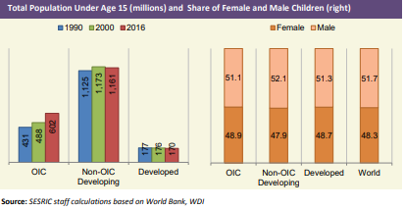
Overview of Children’s Situation in OIC Countries
Over 600 million children under 15 in OIC Countries
31% of the world’s children population
51.1% male, 48.9% female
STATISTICAL, ECONOMIC AND SOCIAL RESEARCH AND TRAINING CENTRE FOR ISLAMIC COUNTRIES
ORGANISATION OF ISLAMIC COOPERATION

Slide 7
Overview of Children’s Situation in OIC Countries
OIC countries showed significant improvement in various areas related to children since the 1990s.
Legislation
Covenant on the Rights of the Child in Islam
Islamic Ministerial Conferences on the Child
Child mortality – 1990 (126 deaths per 1000 births), 2015 (60 death per 1000 births)
Education enrolment and completion – 72.2% in 2000 to 82.8% in 2016
Literacy – Compared to 1990, 10% higher in 20162
Even with all the progress, OIC countries are still lagging behind non-OIC developing countries and developed countries in most of the areas related to children.
STATISTICAL, ECONOMIC AND SOCIAL RESEARCH AND TRAINING CENTRE FOR ISLAMIC COUNTRIES
ORGANISATION OF ISLAMIC COOPERATION

Slide 8
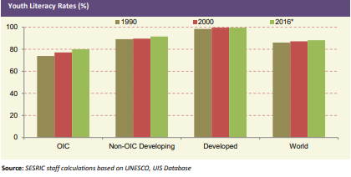
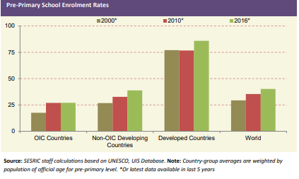
Overview of Children’s Situation in OIC Countries
1 in 17 children in OIC countries still die before their fifth birthday
Nutritional deficiencies
Education enrolment
Literacy
Access to health services
STATISTICAL, ECONOMIC AND SOCIAL RESEARCH AND TRAINING CENTRE FOR ISLAMIC COUNTRIES
ORGANISATION OF ISLAMIC COOPERATION

Slide 9
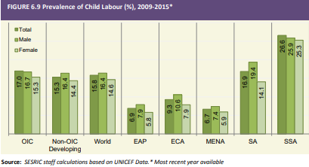
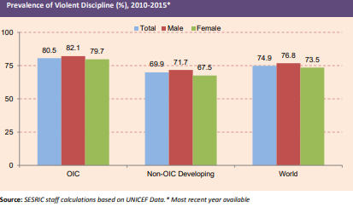
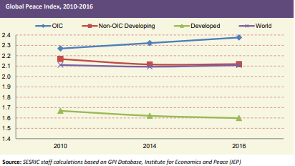
Overview of Children’s Situation in OIC Countries
Prevalence of violent discipline
Conflicts
Child labor
STATISTICAL, ECONOMIC AND SOCIAL RESEARCH AND TRAINING CENTRE FOR ISLAMIC COUNTRIES
ORGANISATION OF ISLAMIC COOPERATION

Slide 10
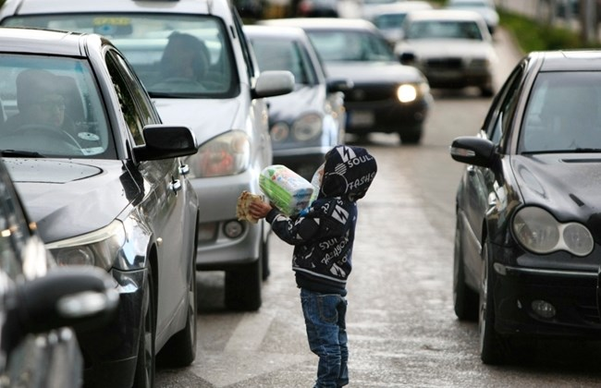
Who are Street Children?
UNICEF definition – three categories of street children.
General definition NGOs typically employ.
Standard definition does not exist.
Narrow versus broad definitions.
OIC Countries also have different legal, cultural or social definitions.
STATISTICAL, ECONOMIC AND SOCIAL RESEARCH AND TRAINING CENTRE FOR ISLAMIC COUNTRIES
ORGANISATION OF ISLAMIC COOPERATION

Slide 11
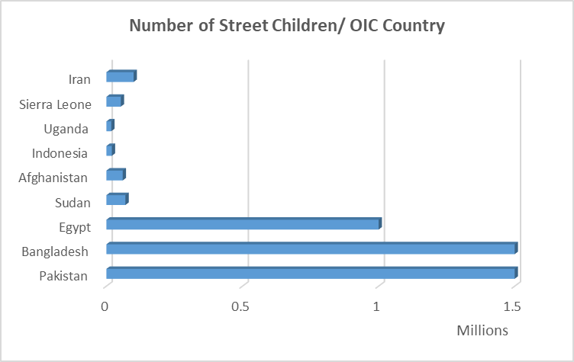
Street Children in Numbers
UN estimates 100 to 150 million street children in the world
Other estimates in the tens of millions
Variance due to a number of factors
Statistics at the OIC level do not exist – country level data
STATISTICAL, ECONOMIC AND SOCIAL RESEARCH AND TRAINING CENTRE FOR ISLAMIC COUNTRIES
ORGANISATION OF ISLAMIC COOPERATION

Slide 12
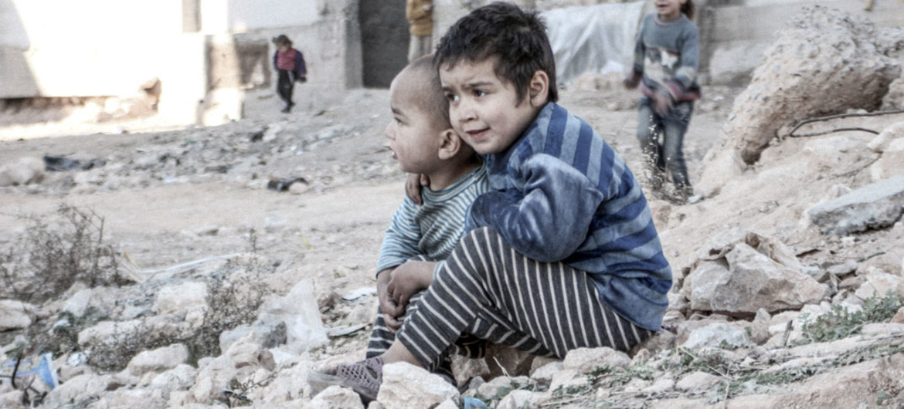
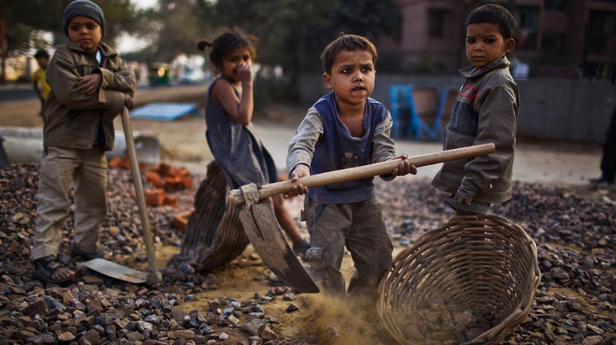
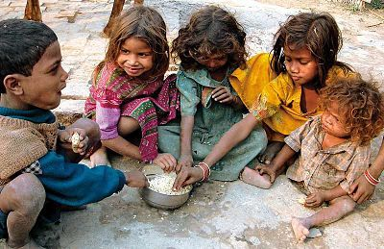
Major Causes
Poverty
Conflict, Disaster and Migration
Violence Against Children
Restricted Access to Education
Child Labor
HIV Pandemic
Family Factors/Culture
STATISTICAL, ECONOMIC AND SOCIAL RESEARCH AND TRAINING CENTRE FOR ISLAMIC COUNTRIES
ORGANISATION OF ISLAMIC COOPERATION

Slide 13
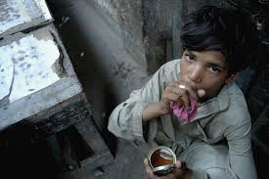
Risks Street Children Face
Violence and Exploitation
Sexual Abuse and Trafficking
Crime and Abuse by Authority
Health Risks and Diseases
Drug Use
STATISTICAL, ECONOMIC AND SOCIAL RESEARCH AND TRAINING CENTRE FOR ISLAMIC COUNTRIES
ORGANISATION OF ISLAMIC COOPERATION

Slide 14
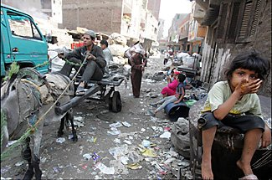
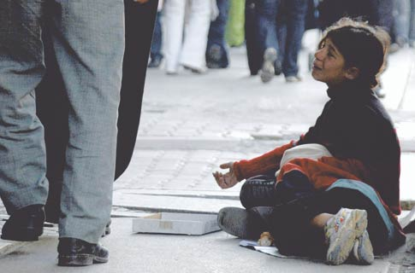
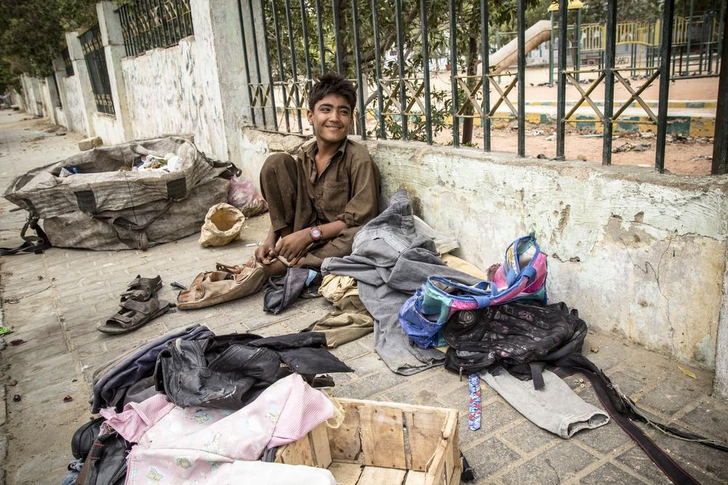
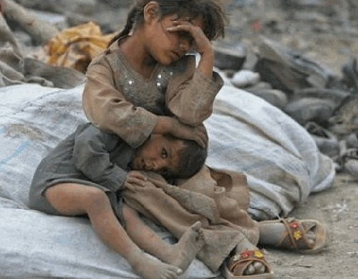
Cases from OIC Countries
Pakistan
Egypt
Lebanon
Bangladesh
Turkey
STATISTICAL, ECONOMIC AND SOCIAL RESEARCH AND TRAINING CENTRE FOR ISLAMIC COUNTRIES
ORGANISATION OF ISLAMIC COOPERATION

Slide 15
Way Forward
Islamic Teaching, Values and Virtues
Cooperation Amongst OIC Countries
Poverty Reduction
Legislative
Education
Strengthening Families
Recreational Activities
Public Awareness Campaigns
STATISTICAL, ECONOMIC AND SOCIAL RESEARCH AND TRAINING CENTRE FOR ISLAMIC COUNTRIES
ORGANISATION OF ISLAMIC COOPERATION

Slide 16
Thank you for your attention.
STATISTICAL, ECONOMIC AND SOCIAL RESEARCH AND TRAINING CENTRE FOR ISLAMIC COUNTRIES
ORGANISATION OF ISLAMIC COOPERATION

