Slide 1
STATISTICAL, ECONOMIC AND SOCIAL RESEARCH AND TRAINING CENTRE FOR ISLAMIC COUNTRIES
ORGANISATION OF ISLAMIC COOPERATION
Guidelines for Preparing, Drafting and Submitting Progress Reports on Implementing OPAAW:
NATIONAL PROGRESS REPORTS
By
Kaan Namli, Social Researcher
17-18 September 2019
Ankara, Turkey

Slide 2
Outline
Why the need for a unified mechanism?
Why the need for national progress reports?
What is the National Progress Report?
Content of National Progress Reports
Initial Report
Periodic Reports
Reporting Process and Framework
STATISTICAL, ECONOMIC AND SOCIAL RESEARCH AND TRAINING CENTRE FOR ISLAMIC COUNTRIES
ORGANISATION OF ISLAMIC COOPERATION

Slide 3
Why a unified mechanism?
Enable the OIC GS to improve intra-OIC cooperation.
Understand the overall strengths and weaknesses.
Formulate new and innovative solutions based on a comparative and thorough understanding
Provide standardized assessment
Monitor and Evaluate
STATISTICAL, ECONOMIC AND SOCIAL RESEARCH AND TRAINING CENTRE FOR ISLAMIC COUNTRIES
ORGANISATION OF ISLAMIC COOPERATION

Slide 4
Why a need for National Progress Reports?
In-depth & interpretive coverage of the status of women in any given state
Explain and elaborate on country specific achievements and challenges
Narrative, causes and factors
Member States to be able to tell their stories
Qualitative assessment – understand change or lack of change and reason for it
STATISTICAL, ECONOMIC AND SOCIAL RESEARCH AND TRAINING CENTRE FOR ISLAMIC COUNTRIES
ORGANISATION OF ISLAMIC COOPERATION

Slide 5
What is the National Progress Report?
The main document through which a given member state describes the status of women —within its territory and-or under its jurisdiction— in relation to OPAAW
There two kinds of NPRs:
Initial Report – First OPAAW Report
Periodic Report
Any report submitted after the initial report
Will be submitted every two years
STATISTICAL, ECONOMIC AND SOCIAL RESEARCH AND TRAINING CENTRE FOR ISLAMIC COUNTRIES
ORGANISATION OF ISLAMIC COOPERATION

Slide 6
Content of National Progress Reports
Both Initial and Periodic
Both initial and periodic reports should deal with and bear a description of each OPAAW objective. Descriptions should cover both:
Legal norms
Factual situation and the practice on the ground (tradition, culture, everyday life)
Both initial and periodic reports should include sufficient data and statistics disaggregated by sex relevant to each objective, whenever appropriate.
STATISTICAL, ECONOMIC AND SOCIAL RESEARCH AND TRAINING CENTRE FOR ISLAMIC COUNTRIES
ORGANISATION OF ISLAMIC COOPERATION

Slide 7
PART I
INITIAL REPORT
The initial report is meant to provide a benchmark against which subsequent progress can be measured.
STATISTICAL, ECONOMIC AND SOCIAL RESEARCH AND TRAINING CENTRE FOR ISLAMIC COUNTRIES
ORGANISATION OF ISLAMIC COOPERATION

Slide 8
Part I: Initial Report
The initial report is the first time the Member State introduces the degree and extent to which its laws and practices comply with OPAAW.
It should aim to cover:
all aspects of life that relate to the status of women
legal and administrative framework, cultural and traditional norms, political & economic status, and everyday life practices
The situation regarding each objective of OPAAW
Any progress made towards the implementation OPAAW and its objectives
Challenges that continue to hinder realization of OPAAW and any given objective
STATISTICAL, ECONOMIC AND SOCIAL RESEARCH AND TRAINING CENTRE FOR ISLAMIC COUNTRIES
ORGANISATION OF ISLAMIC COOPERATION

Slide 9
Part I: Initial Report
Provide specific number, examples, stories when possible
Provide an in-depth analysis
Mention any obstacles, weaknesses or areas of support needed to meet the OPAAW objectives
Discuss any reservations in detail and
Set goals to be achieved
STATISTICAL, ECONOMIC AND SOCIAL RESEARCH AND TRAINING CENTRE FOR ISLAMIC COUNTRIES
ORGANISATION OF ISLAMIC COOPERATION

Slide 10
PART II: PERIODIC REPORTS
STATISTICAL, ECONOMIC AND SOCIAL RESEARCH AND TRAINING CENTRE FOR ISLAMIC COUNTRIES
ORGANISATION OF ISLAMIC COOPERATION

Slide 11
Part II: Periodic Reports
Specify any progress made towards the implementation of OPAAW since the last report (or over the last 2 years)
Describe any challenges faced
Identify emerging key trends and challenges over the last two years
Detail any significant developments or changes that impact the status of women and OPAAW (limitations, reservations, change in political outlook)
Detail accomplishments or lack of it and provide justifications
STATISTICAL, ECONOMIC AND SOCIAL RESEARCH AND TRAINING CENTRE FOR ISLAMIC COUNTRIES
ORGANISATION OF ISLAMIC COOPERATION

Slide 12
Part II: Periodic Reports
Lesson learnt
Target for the next periodic report (in 2 years)
Areas of support needed from the OI GS
Justification for not meeting OPAAW objectives
STATISTICAL, ECONOMIC AND SOCIAL RESEARCH AND TRAINING CENTRE FOR ISLAMIC COUNTRIES
ORGANISATION OF ISLAMIC COOPERATION

Slide 13
PART III: REPORTING PROCESS AND FRAMEWORK
STATISTICAL, ECONOMIC AND SOCIAL RESEARCH AND TRAINING CENTRE FOR ISLAMIC COUNTRIES
ORGANISATION OF ISLAMIC COOPERATION

Slide 14
PART III: REPORTING PROCESS AND FRAMEWORK
OIC GS
Steering Committee
Focal Point
Member States
STATISTICAL, ECONOMIC AND SOCIAL RESEARCH AND TRAINING CENTRE FOR ISLAMIC COUNTRIES
ORGANISATION OF ISLAMIC COOPERATION

Slide 15
PART III: REPORTING PROCESS AND FRAMEWORK
STATISTICAL, ECONOMIC AND SOCIAL RESEARCH AND TRAINING CENTRE FOR ISLAMIC COUNTRIES
ORGANISATION OF ISLAMIC COOPERATION

Slide 16
PART III: REPORTING PROCESS AND FRAMEWORK
STATISTICAL, ECONOMIC AND SOCIAL RESEARCH AND TRAINING CENTRE FOR ISLAMIC COUNTRIES
ORGANISATION OF ISLAMIC COOPERATION

Slide 17
PART III: REPORTING PROCESS AND FRAMEWORK
STATISTICAL, ECONOMIC AND SOCIAL RESEARCH AND TRAINING CENTRE FOR ISLAMIC COUNTRIES
ORGANISATION OF ISLAMIC COOPERATION

Slide 18
STATISTICAL, ECONOMIC AND SOCIAL RESEARCH AND TRAINING CENTRE FOR ISLAMIC COUNTRIES
ORGANISATION OF ISLAMIC COOPERATION
THANK YOU
MERCI
شكرا

Slide 19
STATISTICAL, ECONOMIC AND SOCIAL RESEARCH AND TRAINING CENTRE FOR ISLAMIC COUNTRIES
ORGANISATION OF ISLAMIC COOPERATION

Slide 20
STATISTICAL, ECONOMIC AND SOCIAL RESEARCH AND TRAINING CENTRE FOR ISLAMIC COUNTRIES
ORGANISATION OF ISLAMIC COOPERATION
IMPLEMENTATION

Slide 21
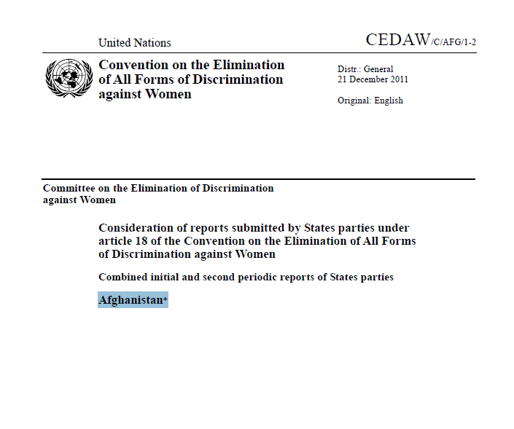
UNITED NATIONS CEDAW EXAMPLE
STATISTICAL, ECONOMIC AND SOCIAL RESEARCH AND TRAINING CENTRE FOR ISLAMIC COUNTRIES
ORGANISATION OF ISLAMIC COOPERATION

Slide 22
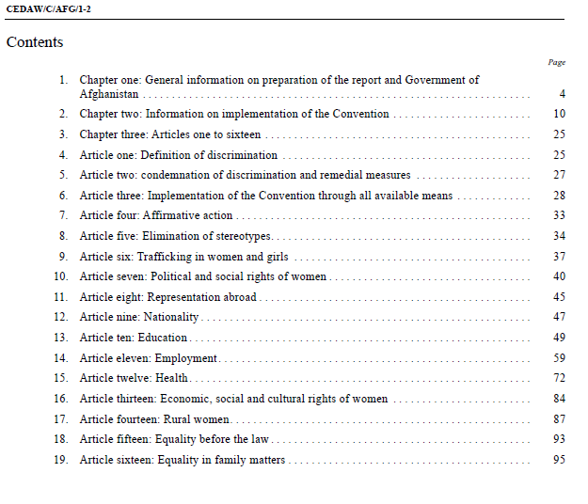
CEDAW EXAMPLE - AFGHANISTAN
STATISTICAL, ECONOMIC AND SOCIAL RESEARCH AND TRAINING CENTRE FOR ISLAMIC COUNTRIES
ORGANISATION OF ISLAMIC COOPERATION

Slide 23
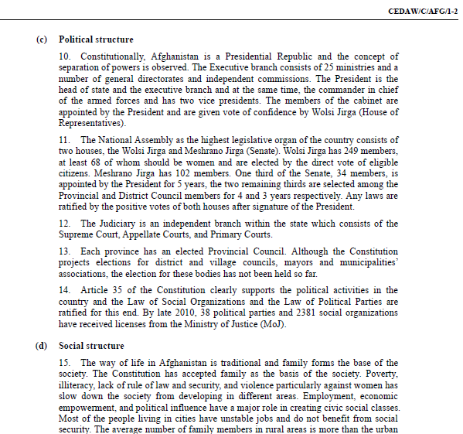
CEDAW EXAMPLE - AFGHANISTAN
First part is a detailed country profile
Legal, social, economic, political
Strategies, initiatives, policies related to women
Other mechanisms supporting women
This part is very important to set foundation
STATISTICAL, ECONOMIC AND SOCIAL RESEARCH AND TRAINING CENTRE FOR ISLAMIC COUNTRIES
ORGANISATION OF ISLAMIC COOPERATION

Slide 24
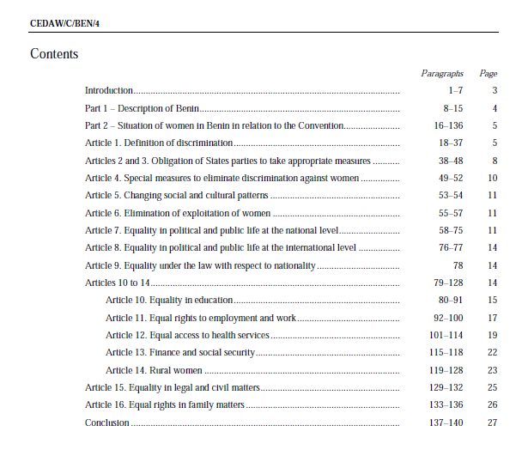
CEDAW EXAMPLE - BENIN
STATISTICAL, ECONOMIC AND SOCIAL RESEARCH AND TRAINING CENTRE FOR ISLAMIC COUNTRIES
ORGANISATION OF ISLAMIC COOPERATION

Slide 25
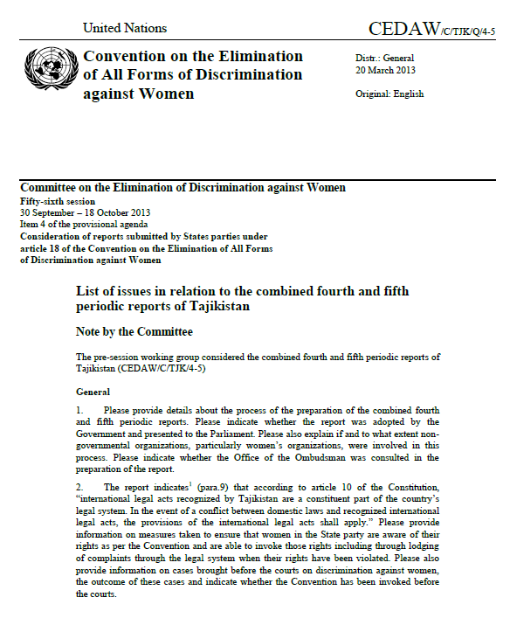
CEDAW EXAMPLE – COMMITTEE RESPONSE
STATISTICAL, ECONOMIC AND SOCIAL RESEARCH AND TRAINING CENTRE FOR ISLAMIC COUNTRIES
ORGANISATION OF ISLAMIC COOPERATION

Slide 26
STATISTICAL, ECONOMIC AND SOCIAL RESEARCH AND TRAINING CENTRE FOR ISLAMIC COUNTRIES
ORGANISATION OF ISLAMIC COOPERATION

