Slide 1

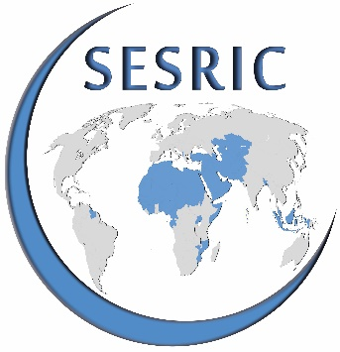
STATISTICAL, ECONOMIC AND SOCIAL RESEARCH AND TRAINING CENTRE FOR ISLAMIC COUNTRIES (SESRIC)
ORGANISATION OF ISLAMIC COOPERATION (OIC)
State of Women
in
OIC Member States
Training Session on Guidelines for Preparing, Drafting and Submitting Progress Reports on Implementing OPAAW
17-18 September 2019
Ankara, Republic of Turkey

Slide 2
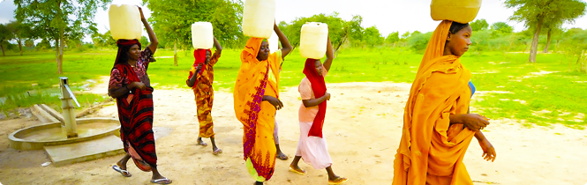
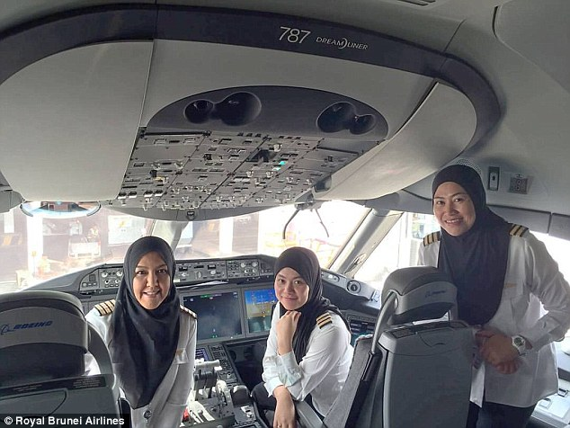

Notes:
Royal brunei airlines and sudan.

Slide 3
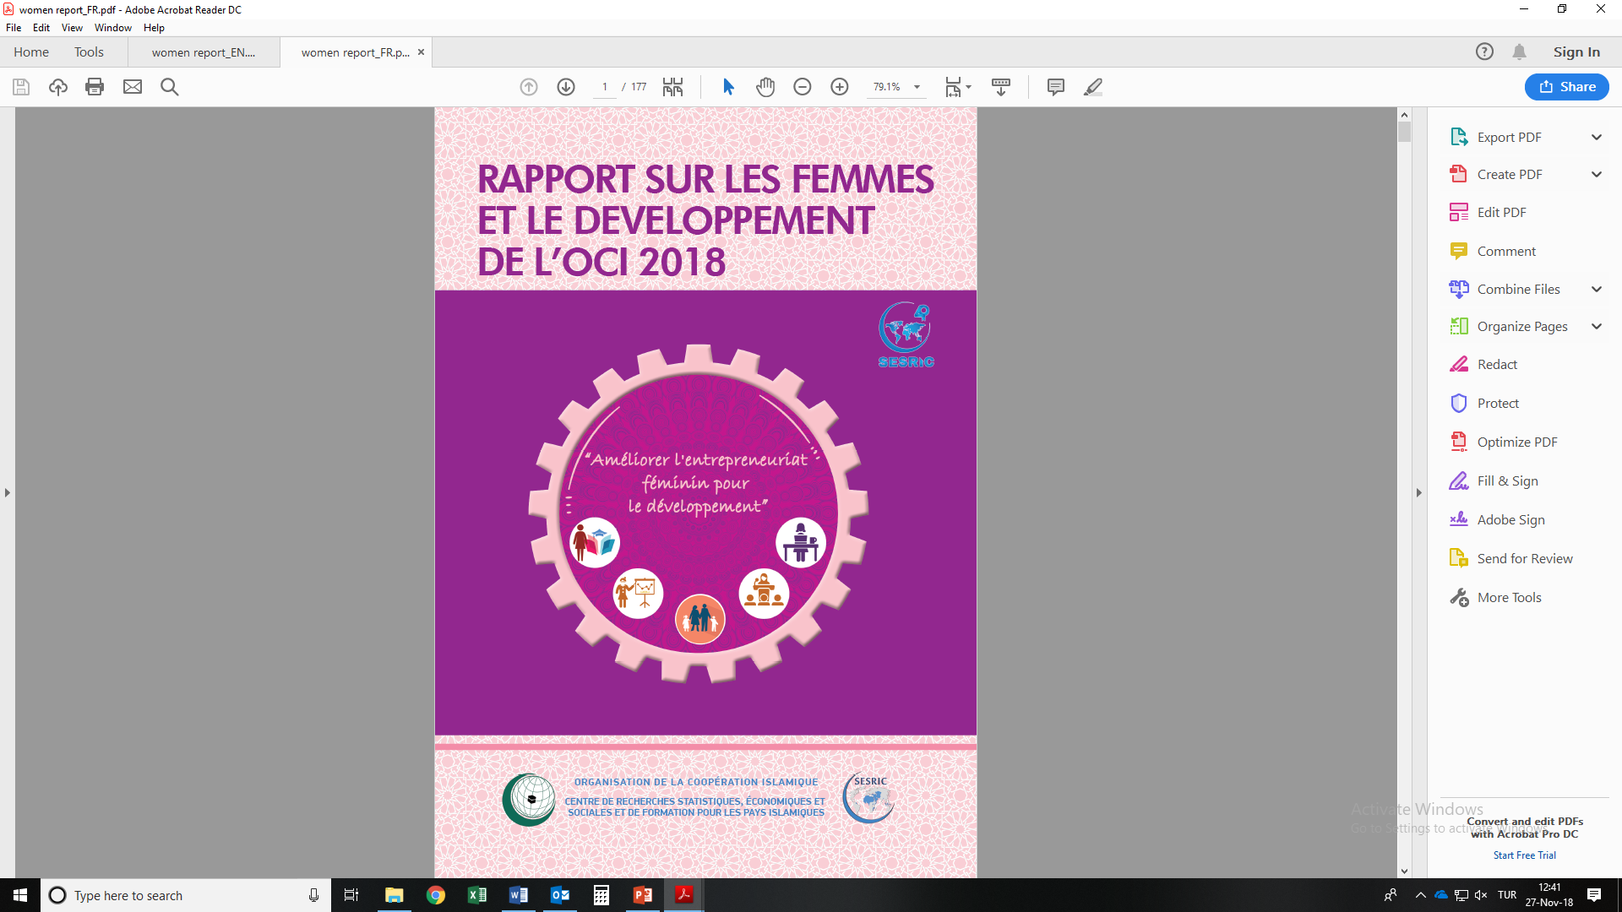
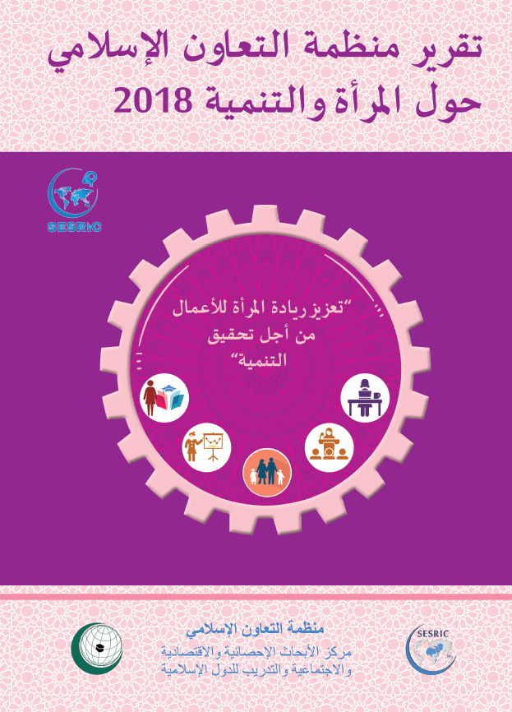
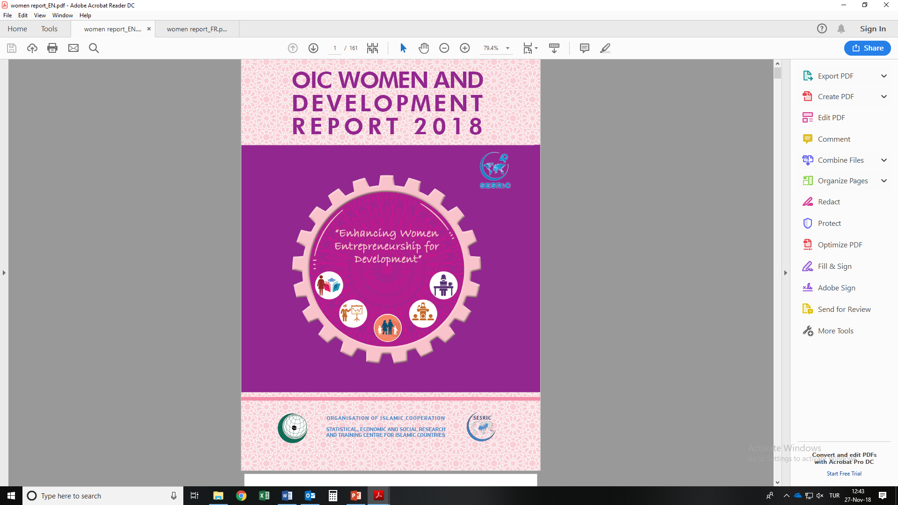

Slide 4
Outline of the Report
PART I: State of Women in OIC Countries
1 The Role of Women in Development of OIC Countries
2 Women and Education
3 Women and Economy
4 Women and Health
5 Women and Family
6 Women and Decision Making
PART II: Enhancing Women Entrepreneurship For Development
7 State of Women Entrepreneurs in OIC Countries
8 Key Challenges of Women Entrepreneurs in OIC Countries
9 Success Stories from Selected OIC Countries on Women Entrepreneurship Initiatives
10 Policy Implications on Enhancing Women Entrepreneurship for Development in OIC Countries

Slide 5
Objectives of the Report
The Report aims to assess the state of women in OIC Member States in comparative perspective and identifies key challenges faced by women in social and economic life through using qualitative and quantitative datasets.
The Report not only identifies challenges but also proposes some recommendations to serve as broad policy guidelines to overcome specific challenges faced by women in OIC Member States.
The Report was submitted to the ‘Seventh Ministerial Conference on the Role of Women in the Development in the OIC Member States’ that was held in Ouagadougou, Burkina Faso on 30 November - 1 December 2018.

Slide 6
1. Women and Development: Intro
As women represent almost 50 per cent of a society, a nation cannot achieve its development goals by ignoring or not fully addressing problems of a half of the population.
According to OECD (2011), women perform 66% of the world’s work, and produce 50% of the food, yet earn only 10% of the income and own 1% of the property.
Quentin and de la Brier (2018) estimates that in a sample of 141 countries across the globe, on a per capita basis, gender inequality in earnings could lead to losses in wealth of $24 000 per person or a total of $160 trillion.
According to WEF (2017), in non-existence of gender disparity an additional US$1.4 trillion in global tax revenue could be generated most of it (US$940 billion) in emerging economies.

Slide 7
1. Women and Development: Gender Inequality
Figure 1.1: Global Gender Gap Index (GGI) Scores in 2017
Source: SESRIC staff calculations based on the World Economic Forum, Global Gender Gap Report 2017
The gender inequality in OIC countries slightly decreased where the average gender gap index score increased from 0.60 in 2006 to 0.64 in 2017.

Slide 8
2. Women and Education
Figure 2.3: Adult Literacy Rates (%) in OIC Countries, 2008-2016*
Source: SESRIC Staff Calculations based on World UNESCO, UIS Data Centre
Note: The sample size is lacking data on multiple developed countries due to data constraints from the source
*Data refers to the most recent year available during the period specified
Over the period 2008-2016, on average, out of 100 adult women, only 70 can read and write while out of 100 adult men, 81 are literate.

Slide 9
3. Women and Economy
Figure 3.3: Labour Force Participation Rate (%) of OIC Member Countries by Gender and Country Groups, 2008 vs. 2017
Source: SESRIC staff calculations based on World Bank, Gender Statistics
During the period 2008-2017, OIC countries witnessed a slight increase in the rate of labour force participation of female population from 36 per cent to 38 per cent.

Slide 10
4. Women and Health
Figure 4.4: Adult Mortality Rate (per 1000 Adults)
Source: SESRIC staff calculations based on the World Bank, World Development Indicators
The average female adult mortality rate of OIC countries decreased from 188 in 2006 to 158 (per 1000 adults) in 2016.

Slide 11
5. Women and Decision Making
Figure 6.5: Proportion of Women in Ministerial Level Positions in the World (%), 2014-2016*
Source: SESRIC Staff Calculations based on World Bank, Gender Statistics
* Data refers to the most recent year available during the period specified. Date of access: 15th July 2018.
Only 13 per cent of all ministerial level positions in OIC countries were held by women where the world average was measured at 18 per cent over the period 2014-2016.

Slide 12
6. Women and Enterpreneurship (a)
Figure 7.2: Procedures Required for Men vs. Women to Start a Business (Number), 2018
Source: SESRIC staff calculations based on World Bank, Doing Business Report, 2018.
In 2018, the number of procedures required to start a business for men is 7 whereas women, on average, need to deal with 7.4 procedures to start the same business in the OIC group.

Slide 13
6. Women and Enterpreneurship (b)
Figure 7.8: Gender Discrimination against Women Entrepreneurs in OIC Member Countries, (Number of Countries) 2018
Source: Women, Business, and the Law Database
Note: Total number of OIC member countries in the dataset = 55.
In 2018, only in 22 OIC member countries the law prohibits discrimination by creditors on the basis of gender in access to credit.

Slide 14
6. Women and Enterpreneurship (c)
In OIC countries, key challenges faced by women entrepreneurs can be grouped as follows:
low human capital development,
high sectoral concentration,
limited access to finance,
ineffective infrastructure,
policy and legal issues, and
cultural and structural barriers.
Notes:
Some studies found that women are more risk averse and it has benefits: gender-balanced corporate boards improve firm performance, especially in high-tech manufacturing and knowledge-intensive services. Gender diversity on boards of banking supervision agencies is also associated with greater financial stability (Sahay and Čihák 2018).

Slide 15
7. Concluding Remarks (part I)
On average, there exists a disparity of 11 percentage points between men and women in terms of literacy in 2016 in favour of men.
During the period 2008-2017, OIC countries witnessed a slight increase in the rate of labour force participation of female population from 36 per cent to 38 per cent. However, it was 10 percentage-points lower than the world average recorded in the year 2017.
The average female adult mortality rate of OIC countries decreased from 188 in 2006 to 158 (per 1000 adults) in 2016. Nevertheless, the average of the OIC group went on staying almost four times higher than the average of developed countries recorded in 2016.
According to a dataset that covers the period 2010-2017, OIC countries on average, had the highest prevalance of child marriage among country groups analyzed, where 7 per cent of all marriages were exercised before 15 years old and 26 per cent of all marriages were performed before 18 years old.
Notes:
Some studies found that women are more risk averse and it has benefits: gender-balanced corporate boards improve firm performance, especially in high-tech manufacturing and knowledge-intensive services. Gender diversity on boards of banking supervision agencies is also associated with greater financial stability (Sahay and Čihák 2018).

Slide 16
7. Concluding Remarks (part II)
OIC countries, on average, achieved to improve the state of women in many dimensions from education to health. Literacy rates among women went up, maternal mortality rates declined, and female labour force participation rates climbed up.
Nevertheless, there is still a long way to go for many OIC countries to reach the world averages in many socio-economic indicators that emerge as a developmental challenge.
Kofi Annan stated ‘there is no tool for development more effective than the empowerment of women’. Without women, it is impossible to achieve SDGs.
Supporting enterpreneurship, enhancing intra-OIC cooperation, and focusing on the implementation of OPAAW can play important roles to empower women with a view to improving their contribution to the development of OIC Member States.
Notes:
Some studies found that women are more risk averse and it has benefits: gender-balanced corporate boards improve firm performance, especially in high-tech manufacturing and knowledge-intensive services. Gender diversity on boards of banking supervision agencies is also associated with greater financial stability (Sahay and Čihák 2018).

Slide 17
THANK YOU
MERCI
شكرا
Statistical, Economic and Social Research and Training Centre for Islamic Countries (SESRIC)
Organisation of Islamic Cooperation (OIC)

