Slide 1
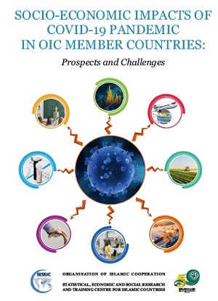
Economic Impacts of COVID-19 Pandemic and Policy Response in OIC Member Countries
Nebil DABUR
Director General
SESRIC
2nd Meeting of the OIC–COMCEC Central Banks Forum |07 October 2020| Ankara, Turkey

Slide 2
Economic Growth in World
Real GDP Growth
GDP Growth in 2020
World -4.9%
Developed -8%
Developing -3%
Source: IMF, World Economic Outlook Update, June 2020.

Slide 3
Economic Growth in OIC
Change in Growth Projections
Oct 2019: Pre COVID-19 2020 forecast for OIC countries +3.7%
Apr. 2020: Adjusted 2020 forecast for OIC countries is -2%
A strong recovery is expected in 2021 by +5.4%
Source: IMF, World Economic Outlook Update, June 2020.

Slide 4
International Trade in Goods
Possible Changes in Export Flows from OIC Countries to World
Possible Changes in Intra-OIC Export Flows
17% to 33%
4.9% to 14.9%
Source: ITC Trade Map, IMF Commodity Prices and IMF DOTS statistics

Slide 5
Foreign Direct Investment
Inward FDI Flows in OIC Countries (US$ Billion)
42 billion
US$
Source: UNCTAD STAT Database June 2019. (*) represents estimations and projections for 2019 and 2020.

Slide 6
Employment
Possible Changes in Unemployed Persons in OIC Countries (Million)
5.6 million to 7.7 million
Source: ILO Modeled Estimates.

Slide 7
Jobs Affected in Supply Chains
Supply Chains | Share of supply chain jobs in total employment (%) | Total jobs at high risk due to drop in consumer demand (millions) | Total jobs at medium risk due to drop in consumer demand (millions)
Food & beverages | 10.1 | -- | --
Textiles & garments | 3.0 | 73 | 0
Motor vehicles | 2.2 | 54 | 0
Machinery & equipment | 2.0 | 34 | 15
Electronics | 1.4 | 17 | 17
Chemicals & pharmaceuticals | 1.1 | -- | 16
Electrical equipment | 0.9 | 15 | 8
Other manufacturing | 4.3 | 99 | 7
All manufacturing | 25.0 | 292 | 63
Source: ILO (2020d). Estimates are based on data for 64 countries that account for 74% of the global labour force.

Slide 8
International Tourism
30
to 46
million
38
to 57
billion
US$
17
to 25
million
14
to 21
billion
US$
Source: UNWTO Database

Slide 9
Policy Response: Fiscal and Monitory Measures
Policy Category | Intervention Type | # of OIC Countries
Fiscal Policy | Fiscal stimulus package | 42
Monetary Policy | Interest rate cut | 26
 | Monetary stimulus package | 19
 | Other monetary policy measures | 45
Balance of Payments (BoP) and Exchange Rate Policy | Direct monetary policy intervention to control Balance of Payments (BoP) and Exchange Rate | 5
 | Accompanying monetary policy intervention to stabilize Balance of Payments (BoP) and Exchange Rate | 15
Source: Elgin et al. (2020), April 27 2020 version and IMF Policy Tracker on COVID-19. Note: Total number of OIC Countries with available in the database is 52.

Slide 10
Policy Response: Trade Policy Measures
Source: International Trade Centre, MacMap COVID-19 Temporary Trade Measures Database, v. August 25, 2020.

Slide 11
Policy Response: Financial Sector Support Measures
Source: World Bank database on COVID-19 Finance Sector Related Policy Responses

Slide 12
Summary
The impacts of COVID-19 pandemic are not distributed evenly across OIC countries and are not easy to account for as the pandemic still goes on at varying intensities.
Many OIC member countries have introduced various economic stimulus packages (fiscal and monetary) to mitigate the impacts of the pandemic and restore economic activities.
Short-term measures are to contain and mitigate the economic consequences, particularly those in the form of mass unemployment and bankruptcies.
Restoration of economic activities will be only possible after containment measures are fully lifted and supply networks are re-established.

Slide 13
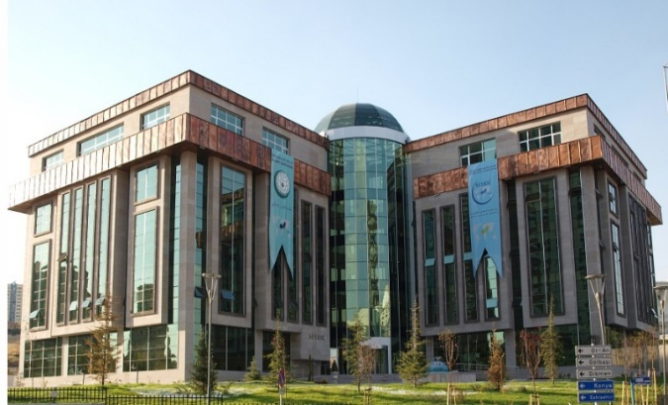
Thank you for your attention!
Statistical, Economic and Social Research and Training Centre for Islamic Countries
www.sesric.org
research@sesric.org
+90 312 468 6172
twitter.com/sesric
twitter.com/ResearchSesric

