Slide 1

Challenges of Statistical Capacity Development
Statistical, Economic and Social Research and
Training Centre for Islamic Countries (SESRIC)
V Astana Economic Forum
24 May 2012
Astana-Kazakhstan

Slide 2
Statistical Capacity Development
Statistical Capacity Development
legislative and administrative capacity
human resources and the physical infrastructure
methodologies employed in data collection

Slide 3
  Statistical Capacity Development
  Stakeholders
Capacity building programs
Donors (international agencies and countries)
Recipient countries
Technical assistance
financial support for
  data collection
  improvement of physical infrastructure
STATISTICAL, ECONOMIC AND SOCIAL RESEARCH AND TRAINING CENTRE FOR ISLAMIC COUNTRIES

Slide 4
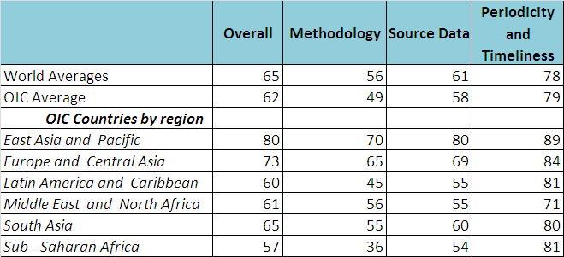
Statistical Capacity Development
World Bank Statistical Capacity indicator, 2011
available for 49 OIC countries

Slide 5
  Activities of SESRIC on Statistics
  collating, processing, and disseminating socio-economic statistics on and for the OIC member countries
  organising training programmes (OIC-StatCaB)
  facilitating the elaboration of technical cooperation projects and integration schemes with the member countries, regional and international organizations
  Website: www.sesric.org
STATISTICAL, ECONOMIC AND SOCIAL RESEARCH AND TRAINING CENTRE FOR ISLAMIC COUNTRIES

Slide 6
OIC-StatCaB Programme
The Statistical Capacity Building (StatCaB) Programme for the NSOs is a long-term training programme and large scale capacity development project steered and fully funded by SESRIC since 2007.
A twinning program whereby the countries are matched according to their demands and capacities.
Based on the bi-annual survey responses

Slide 7
OIC-StatCaB Programme
StatCaB Programme of SESRIC is an action towards the enhancement of technical cooperation among the member countries and aims to improve their statistical capacities through;
providing an opportunity for the member counties to share their experience and knowledge
deepening the expertise of the experts in the member countries

Slide 8
OIC-StatCaB Programme
Planned for the future
Enhancement of technical assistance components
  Short-term trainings, Consultancy and Study visits
Diffrent modes of training; E-learning
Development of an accreditation system for statisticians
Development of tools for data dissemination (Inhouse SESRIC Motion Chart Module)
STATISTICAL, ECONOMIC AND SOCIAL RESEARCH AND TRAINING CENTRE FOR ISLAMIC COUNTRIES
Notes:
8

Slide 9
OIC Statistical Commission
Established in 2011 as an apex entity to
coordinate statistical activities at OIC level that
aims:
To promote statistical data production and dissemination
To raise the profile of statistics
To identify the statistical areas specific to the OIC Member States and develop methodology for this niche areas of statistics (e.g. islamic finance, halal food industry)
To facilitate active cooperation and coordination towards enhanching the role of national statistical systems
STATISTICAL, ECONOMIC AND SOCIAL RESEARCH AND TRAINING CENTRE FOR ISLAMIC COUNTRIES
Notes:
*The First Session focused on defining the direction, objectives, goals and expected benefits as well as the fields in which the Commission will generate a value-added contribution to statistical systems of the OIC Member Countries.
*The Members of the Bureau were elected as:
Chair: Kingdom of Saudi Arabia / Vice Chairs: Indonesia and Sudan / Rapporteur: Senegal

Slide 10
Milestones in SCD at international level
2004 - Marrakech Action Plan for Statistics
2005 - Paris Declaration on Aid Effectiveness
2008 - Accra Agenda for Action
2009 - The Dakar Declaration on the Development of Statistics
2011- Busan Action Plan for Statistics

Slide 11
The PRESS Report

Slide 12
The PRESS Report

Slide 13
Conclusion
Although there have been a significant efforts on coordination of statistical capacity building activities there is still much work to be done
Strong sense of ownership needs to be generated among stakeholders
Development of thematic statistical capacity building programs by region or country
Wise management of available funds

Slide 14
Thank You !
http://www.sesric.org
© 2011

