Slide 1
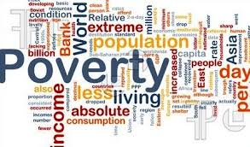
Poverty Statistics In Pakistan Presented by Rabia Awan Pakistan Bureau of Statistics

Slide 2
Main Indicators of Pakistan
Main Indicators | Total | Male | Female
Labour Force Participation rates | 32.9 | 49.3 | 15.6
Unemployment rates | 6.0 | 5.1 | 8.9
Employment by formal sectors | 26.4 | 26.2 | 28.3
Employment by informal sectors | 73.6 | 73.8 | 71.7
Sex ratio | 106
Life Expectancy at Birth |  | 64 | 67
Literacy rates | 60 | 71 | 48
Net Enrolment Rate (Primary level) | 57 | 61 | 54
Source: PSLM Survey 2012-13, LFS Survey 2012-13

Slide 3
Main Indicators of Pakistan
Main Indicators | Total | Urban | Rural
Total Fertility Rate | 3.8 | 3.2 | 4.2
Contraceptive Prevalence rate | 35 | 45 | 31
Prenatal care( from Skilled Birth Attendant) | 73 | 88 | 67
Births delivered in Health Facility | 48 | 68 | 40
Infant Mortality rate(deaths per 1000 live births) | 74 | 63 | 88
Under five mortality rate | 89 | 74 | 106
Population with access to Improved Drinking water | 59 | 83 | 48
Population with access to sanitation(Flush toilet) | 71 | 97 | 57
Source: PSLM Survey 2012-13, PDHS Survey 2012-13

Slide 4
TOWARDS DEFINING POVERTY
Poverty is considered as synonymous to deprivation
Poverty encompasses many attributes to the disadvantage of individuals/households in their struggle of survival
Poverty is strongly related to the absence of basic human and physical assets, especially health, education and land
Poverty is often defined as the inability to afford consumption expenditure necessary to meet nutritional requirements

Slide 5
TOWARDS QUANTIFYING POVERTY
Different methodologies have been used since 1970 to estimate poverty. Each methodology has its own advantages as well as limitations
Planning commission estimates poverty in terms of threshold caloric intake requirement of 2350 calories per person per day.
Poverty estimates are based on Consumption data provided by Household Integrated Economic Survey (HIES)
HIES survey has been undertaken with some breaks since 1963
HIES Survey is part of biennial cycle of Pakistan Social & Living Standards Measurement Survey(PSLM) at National/Provincial level and District level

Slide 6
Types of Poverty Lines
Subjective poverty line
Based on person’s perception of poverty
Relative poverty line
Where households are in relation to some increasing function of the “average” standard of living in the country
Absolute poverty line
Whether or not HHs or individuals command a fixed standard of living

Slide 7
World Bank Absolute Poverty Lines
Purpose: to compare poverty rates across countries and over time and to assess progress in poverty reduction
US $1 per person per day (1993)
Individual is poor if income is less than $1 per day
Current global estimate: 1,200 million people are poor
US $2 per person per day (1993)
Individual is poor if income is less than $2 per day
Current global estimate: over 2 billion people are poor

Slide 8
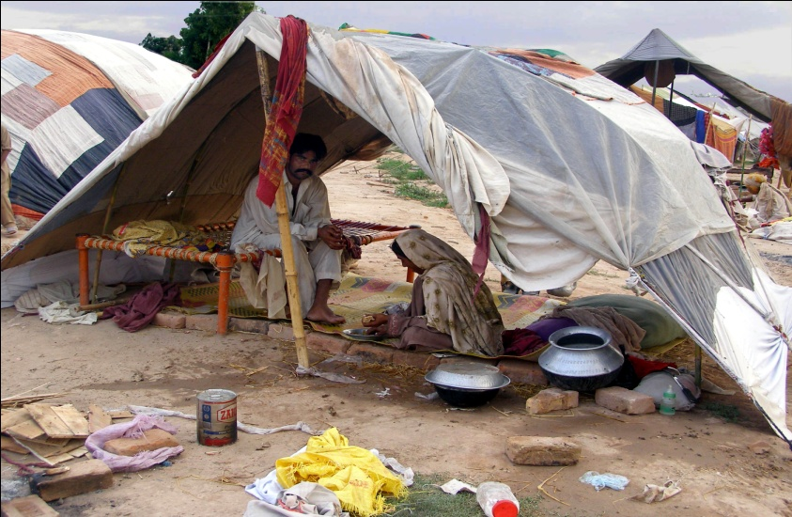
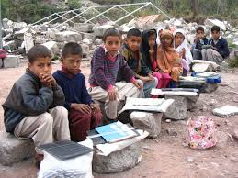
Main characteristics of the poor
Poverty is strongly related to the absence of basic human and physical assets, especially health, education and land
Poor have larger household size
Poor have a higher dependency ratio
The poor household heads are mostly employed in elementary job e.g. agriculture, construction, labours etc.

Slide 9
METHEODOLOGY OF POVERTY ASSESMENT
Six major steps constitute Poverty assessment in Pakistan
Choice of welfare Indicator
Consumption aggregate
Adjustment of Consumption
Price Adjustment
Poverty line
Choice of aggregator

Slide 10
METHEODOLOGY OF POVERTY ASSESMENT
Choice of welfare Indicator:-
Consumption expenditure has been selected to use as welfare indicator
The consumption data is based on HIES Survey of PBS
2. Consumption aggregate:-
It composes of both actual and imputed expenditure , including actual purchases ,self produced and consumed items
Includes food items, fuel and utilities, housing (rent, imputed rent and minor repair),frequent nonfood expenses and other non food expenses
Excludes expenses on taxes, fines and expenses on marriage or funeral and durable items

Slide 11
METHEODOLOGY OF POVERTY ASSESMENT
3. Adjustment of Consumption
Household consumption is converted into per month per adult consumption expenditure
Households are ranked on equivalent scales by allocating 0.8 weight to individuals younger than 18 years and 1 to all other individuals
4. Price Adjustment
The per adult equivalent consumption expenditure is adjusted for regional price differences using Paasches Price index at Primary sampling Unit(PSU)
This is done to convert welfare indicator in real values as household face different prices during the year of survey

Slide 12
METHEODOLOGY OF POVERTY ASSESMENT
5. Poverty Line
Calorie based approach is used for estimation of Poverty line
Calorie requirement: The poverty lines reflect the consumption expenditure consistent with caloric requirement
Food quantities consumed by households are converted into caloric intakes
Poverty Line is estimated by regressing consumption expenditure against caloric intakes
Calories = a + b (Consumption Exp.)
Planning Commission has notified poverty line at 673.54 (per capita food and non-food expenditure per month) on 2350 calories on the basis of HIES 1998-99
Poverty line for other years are adjusted for inflation between the two household on the basis of Consumer Price Index(CPI) calculated by PBS

Slide 13
Poverty line
Year | Poverty Line (Rs/months) | Inflation
1998-99 | 673 | -
2000-01 | 723 | 7.4
2004-05 | 879 | 21.5
2005-06 | 944 | 7.3
2007-08 | 1142 | 20.9
2010-11 | 1745 | 52.0

Slide 14
MEASURES OF POVERTY
Head count ratio , poverty gap and severity of poverty commonly known as Foster, Greer and Thorbecke measures are used for estimation of poverty
Head count ratio is the mostly used measure and is defined as the proportion of population below the poverty line
Poverty index(Head Count ratio) by region
 | Overall | Urban | Rural
PIHS 1998-99 | 31.1 | 21.4 | 35.1
PIHS 2000-01 | 34.0 | 23.0 | 39.0
PSLM 2004-05 | 24.0 | 15.0 | 28.0
PSLM 2005-06 | 23.0 | 14.0 | 27.0
PSLM 2007-08 | 17.2 | 10.0 | 20.6
PSLM 2010-11 | 12.4 | 7.1 | 15.1
Notes:
In Pakistan the relationship between Poverty and growth is not clear cut.
In sixties high growth lead to decline in poverty but in Seventies poverty declined despite of low growth
The eighties and early 2000s witnessed high growth leading to reduced poverty, but again low growth afterwards but incidence of poverty also falls

Slide 15
Trends in Poverty
Notes:
Pakistan's Decade of Urban Middle Class Growth

Slide 16
Gini-coefficient
 | All | Urban | Rural
2000-01 | 0.2752 | 0.3222 | 0.2371
2004-05 | 0.2976 | 0.3388 | 0.2519
2005-06 | 0.3018 | 0.349 | 0.2462
2007-08 | 0.2897 | 0.3245 | 0.2529
2010-11 | 0.2752 | 0.3124 | 0.2371
Notes:
Measure of inequality in access among different areas and income groups, range from 0-1, 0 perfect equality means everyone has same income and 1 shows complete inequality
Over few years Pakistan inequality has narrowed. Inequality is higher in urban and lower in rural areas and inequality is fallen faster in urban areas than in rural areas

Slide 17
Trends in Consumption based Gini coefficient

Slide 18
Sample size (number of households)
Survey | Overall | Urban | Rural
PIHS 2000-01 | 14705 | 5536 | 9169
PSLM 2004-05 | 14706 | 5808 | 8898
PSLM 2005-06 | 15453 | 62.40 | 9213
PSLM 2007-08 | 15512 | 6255 | 9257
PSLM 2010-11 | 16341 | 6589 | 9752

Slide 19
Number of consumption items
Survey | Food items | Non-food items | Total items
PIHS 2000-01 | 89 | 107 | 196
PSLM 2004-05 | 89 | 107 | 196
PSLM 2005-06 | 69 | 99 | 168
PSLM 2007-08 | 69 | 99 | 168
PSLM 2010-11 | 69 | 99 | 168
Some of the similar items were merged in 2005-06, no item is deleted

Slide 20
Households size by region
Year | Urban | Rural | Overall
PIHS 2001-02 | 6.87 | 7.00 | 6.96
PSLM 2004-05 | 6.63 | 6.8 | 6.75
PSLM 2005-06 | 6.65 | 6.93 | 6.83
PSLM 2007-08 | 6.31 | 6.72 | 6.58
PSLM 2010-11 | 6.19 | 6.49 | 6.38

Slide 21
Per equivalent adult monthly consumption expenditure at the prices of 2001
Quintile | PSLM 2010-11
 | Urban | Rural | Total
Poorest 20% | 679 | 674 | 675
Second | 911 | 901 | 904
Third | 1118 | 1111 | 1113
Fourth | 1418 | 1406 | 1411
Richest 20% | 2789 | 2281 | 2543
All | 1604 | 1181 | 1322

Slide 22
Per equivalent adult monthly consumption expenditure at the prices of 2001
Quintile | PIHS 2000-01 | PSLM 2004-05 | PSLM 2005-06 | PSLM 2007-08 | PSLM 2010-11 | Growth (10-11, 5-6) | Growth (10-11, 7-8)
 | Mean | Mean | Mean | Mean | Mean
Poorest 20% | 508 | 555 | 580 | 632 | 675 | 16.4 | 6.8
Second | 690 | 775 | 789 | 851 | 904 | 14.6 | 6.2
Third | 845 | 961 | 978 | 1048 | 1113 | 13.8 | 6.2
Fourth | 1070 | 1238 | 1255 | 1342 | 1411 | 12.4 | 5.1
Richest 20% | 1908 | 2327 | 2435 | 2487 | 2543 | 4.4 | 2.2
All | 1004 | 1171 | 1207 | 1272 | 1322 | 9.5 | 3.9
Notes:
The real growth rate in consumption expenditure from 2007-11 was less than in the period 2005-11, a larger portion of that growth has been tilted towards the poor segments of the society.

Slide 23
Percentage distribution of monthly consumption expenditure commodity groups at prices of 2001 by region
Commodity group | PSLM 2010-11
 | Urban | Rural | Total
Food | 41.9 | 55.3 | 49.9
Fuel & lighting | 7.3 | 8.1 | 7.8
Personal care | 3.6 | 3.9 | 3.8
Transport | 6.2 | 5.3 | 5.6
Clothing | 4.0 | 4.6 | 4.3
Medical | 2.3 | 3.3 | 2.9
Education | 4.7 | 2.4 | 3.4
House rent | 21.0 | 8.8 | 13.7
Others | 11.3 | 11.6 | 11.5
Total | 100.0 | 100.0 | 100.0

Slide 24
Percentage distribution of monthly consumption expenditure commodity groups at prices of 2001
Commodity groups | PIHS 2000-01 | PSLM 2004-05 | PSLM 2005-06 | PSLM 2007-08 | PSLM 2010-11
Food | 49.5 | 49.1 | 48.1 | 43.5 | 49.9
Fuel & lighting | 8.1 | 8.0 | 8.8 | 7.7 | 7.8
Personal care | 3.9 | 3.8 | 3.9 | 3.5 | 3.8
Transport | 3.7 | 4.9 | 5.2 | 6.5 | 5.6
Clothing | 5.7 | 5.0 | 5.0 | 4.2 | 4.3
Medical | 4.5 | 4.0 | 4.5 | 3.7 | 2.9
Education | 3.5 | 3.0 | 2.6 | 3.4 | 3.4
House rent | 12.0 | 11.9 | 12.2 | 17.0 | 13.7
Others | 9.0 | 10.3 | 9.7 | 14.2 | 11.5
Total | 100.0 | 100.0 | 100.0 | 100.0 | 100.0
Notes:
The empirical evidence strengthens the earlier contention that consumption based data on real household expenditure and inequality show an improvement in the nation’s well being

Slide 25
Per capita monthly consumption (quantity) of major food items
Commodity | PIHS 2000-01 |  | PSLM 2004-05 | PSLM 2005-06 | PSLM 2007-08 | PSLM 2010-11
 | Unit | QTY | QTY | QTY | QTY | QTY
Wheat | Kg | 8.94 | 8.20 | 8.18 | 7.75 | 7.98
Rice | Kg | 1.17 | 1.03 | 1.03 | 0.90 | 1.00
Pulses | Kg | 0.35 | 0.44 | 0.37 | 0.36 | 0.40
Vegetable Ghee | g | 0.64 | 0.67 | 0.66 | 0.69 | 0.74
Cooking oil | Itr | 0.09 | 0.12 | 0.15 | 0.16 | 0.17
Tea | Grams | 56.23 | 72.21 | 71.73 | 67.71 | 70.05
Milk | kg | 5.79 | 6.68 | 6.45 | 6.90 | 6.60
Mutton | kg | 0.10 | 0.07 | 0.08 | 0.06 | 0.06
Beef | kg | 0.30 | 0.33 | 0.21 | 0.22 | 0.23
Chicken | kg | 0.14 | 0.23 | 0.23 | 0.27 | 0.28
Fish | kg | 0.00 | 0.05 | 0.05 | 0.06 | 0.05
Fruit | kg | 0.53 | 0.43 | 0.63 | 0.57 | 0.58
Vegetable | kg | 3.88 | 4.20 | 3.83 | 3.89 | 4.16
Sugar | kg | 1.26 | 1.31 | 1.33 | 1.40 | 1.38
Gur | Kg | 0.15 | 0.18 | 0.12 | 0.08 | 0.08

Slide 26
Issues/Challenges related to Poverty Statistics
Poverty Statistics are highly debatable in Pakistan
Uni dimensional
Poverty figures are not released regularly
Different organizations are releasing numbers using different methodology
Poverty figures are usually released at National level with urban/Rural breakdown
Efforts are also being made to calculate Multi- dimensional poverty with the help of Oxford Poverty & Human Development Initiative(OPHI)
Notes:
Multidimensional poverty is made up of several factors that constitute poor people’s experience of deprivation – such as poor health, lack of education, inadequate living standard, lack of income (as one of several factors considered), disempowerment, poor quality of work and threat from violence.

Slide 27
Initiatives to Combat Poverty
Benazir Income Support Program (BISP).
This program would serve as a platform to provide cash transfers to vulnerable identified on the basis of a poverty scorecard.
Imparting training to one member of each vulnerable family.
BISP cover 3.4 million families or 22.75 million people.
Waseela-e-Haq Scheme:- Under this scheme 2.2 million families have been divided into 731 units. Every month 731 Female head of households will be given Rs.0.300 million in lump sum to start their own business. First draw was made on 15th September, 2009.
Pakistan Bait-ul-Mal
Child Support Program
Health Insurance for the Poor and the vulnerable
Social Mobilization
Community Investment Fund (CIF)

Slide 28
Initiatives to Combat Poverty
Pakistan Poverty Alleviation Fund (PPAF)
Zakat Fund
Microfinance
Punjab Government initiatives to eradicate poverty
Tractor Subsidy Scheme.
Sasti Roti Program
Punjab Food Support Scheme
Ramzan Sastay Bazar
Subsidy of 8 million for Atta and Sugar

Slide 29
Thank You

