Slide 1



Enhancing national capacities in poverty statistics
REPORT OUTLINE & PRELIMINARY QUESTIONNAIRE
7- 8 August 2014
Ankara, Turkey

Slide 2
WHO IS THE POOR?
Many people struggle with poverty around the world. But statisticians and researchers have hard time to have reliable, consistent, and comparable measures of poverty.
WHY?
It is not easy to define and measure poverty both conceptually and empirically.
Notes:
*Poverty is multifaceted condition as the standard of living is closely related to quality of life. The right to an adequate standard of living is recognized as a human right in international human rights instrument and is generally understood to establish a minimum entitlement to food, clothing and housing at a subsistence level.
* In this regard, being poor is generally viewed in terms of depriation of some of life’s basic needs, such as food, shelter, clothing, health care, education and security.
(manifested by condications that include malnutrition, inadequate shelter, unsanitary living conditions, unsatisfactory and insufficient supplies of clean water, poor solid waste disposal, chronic ill health, low educational achievement, absence of quality schooling,, widespread common crime. Here, determining what are the most important constitutens of poverty is also an issue.
*Governments around the world define and measure poverty in ways that reflect their own circumstances. Although income is a universally agreeable concept, most agree money metrics are too narrow to capture all relevant aspects of poverty.

Slide 3
    NEW EMPHASIS ON
    POVERTY MEASUREMENT
  Economic growth is not always inclusive
  Reduction of income poverty is important but not sufficient
  MDG dashboards of indicators are dazzlingly complex
  Lack of attention in capturing joint distribution of deprivations
Notes:
Poverty is a complicated phenomenon that goes beyond the monetary terms. From this standpoint, poverty arises not only when people have inadequate income, but also when they lack key capabilities or education, have poor health or insecurity, or when they experience the absence of rights.
Reduction of income poverty is important but not sufficient as decline in income poverty does not reduce other MDG deprivations automatically. Hence, more attention should be devoted to capture joint distribution of deprivations and to investigate the non-monetary terms of poverty.
RECENT DEBATES
Political critique of current metrics (Stiglitz, Sen & Fitoussi 2009)
Measures in HDR sparked interest and debate (UNDP 2010)
Post-2015 requires re-thinking Data and Measures

Slide 4
Economic Growth is Not Always Inclusive
Indicators | Year | India | Bangladesh | Nepal
Gross National Income per Capita (in International $) | 1990 | 860 | 550 | 510
 | 2011 | 3620 | 1940 | 1260
 | Growth (p.a.) | 6.8% | 5.9% | 4.2%
Under-5 Mortality | 1990 | 114.2 | 138.8 | 134.6
 | 2011 | 61.3 | 46.0 | 48.0
 | Change | -52.9 | -92.8 | -86.6
DPT Immunization Rate | 1990 | 70 | 69 | 43
 | 2010 | 72 | 95 | 82
 | Change | 2 | 26 | 39
Adult Pop. with no Education | 1990 | 51.6 | 55.5 | 65.8
 | 2010 | 32.7 | 31.9 | 37.2
 | Change | -18.9 | -23.6 | -28.6
Access to Improved Sanitation (rural pop) | 1990 | 7 | 34 | 7
 | 2010 | 23 | 55 | 27
 | Change | 16 | 21 | 20
Source: Alkire and Seth (2013). The table is inspired by Drèze and Sen (2011), with minor additions.
Notes:
Poverty is a complicated phenomenon that goes beyond the monetary terms. From this standpoint, poverty arises not only when people have inadequate income, but also when they lack key capabilities or education, have poor health or insecurity, or when they experience the absence of rights.

Slide 5
Eradicating Income Poverty is not Sufficient
$1.25/day
Reduction in income poverty does not reduce other MDG deprivations automatically.
Source: World Bank Data & Global Monitoring Report Progress Status, 2013
Notes:
Reduction of income poverty is important but not sufficient as decline in income poverty does not reduce other MDG deprivations automatically. Hence, more attention should be devoted to capture joint distribution of deprivations and to investigate the non-monetary terms of poverty.

Slide 6
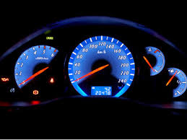
MDG Dashboards
Millennium Development Goals (UN, 2000):
48 indicators to monitor 18 targets to achieve the 8 goals
  Proportion of population
  below $1 (PPP)/day
  Literacy rate of 15-24 years-old
  Maternal mortality ratio
  Share of women in wage employment in the non-agricultural sector
  Under five mortality rate
  Proportion of births attended by skilled personnel
  Net enrolment ratio
  in primary education
  Prevalence of underweight children under 5 years of age
  Proportion of tuberculosis cases detected and cured under DOTS
  Proportion of seats held by women in national parliament
  Prevalence of deaths associated with malaria

Slide 7
Disadvantages of Dashboards
Lack of a single outline figure as GDP
  Stiglitz, Sen, and Fitoussi (2009)
Ignore identification
      Who is poor? How many poor people are there? How poor are they? (Alkire, Foster and Santos, 2011)
Ignore joint distribution even when possible to capture
  Alkire, Foster and Santos (2011)

Slide 8
Joint Distribution of Deprivations
A simple example (deprived=1, non-deprived=0)
MDG1 | MDG2 | MDG3
1 | 0 | 0
0 | 1 | 0
0 | 0 | 1
0 | 0 | 0
MDG1 | MDG2 | MDG3
0 | 0 | 0
0 | 0 | 0
0 | 0 | 0
1 | 1 | 1
Case 1
Case 2
In both cases, 25% (1/4) deprived in each indicator
BUT, in Case 2, one person is severely deprived

Slide 9
Need for a Meaningful Measure
  What Can a Meaningful Multidimensional Poverty Measure Do?
  Provide an overview through a single summary measure
  Show progress quickly and directly: Monitoring /Evaluation
  Inform planning and policy design
  Can be used as a targeting instrument (distinguish the poorest from the poor)
  Can be decomposed by regions, social groups
  Can be broken down by dimensions to see contributions

Slide 10
The Adjusted Headcount Ratio (M₀)
One such muldimensional poverty measure with certain meaningful properties has been proposed by Alkire and Foster (2011 JPubE)
  The Adjusted Headcount Ratio
The Adjusted Headcount Ratio can be expressed as:
H: The percent of people identified as multidimensionally poor, it shows the incidence of multidimensional poverty
A: The average of the deprivation counts/scores of the poor people; it shows the intensity of people’s poverty
M₀ = H × A

Slide 11
Global Multidimensional Poverty Index (MPI)
An adaptation of the M₀, was introduced by Alkire and Santos (2010) and UNDP (2010) with following indicators and weights
Notes:
The MPI uses 10 indicators to identify deprivations across the same three dimensions of HDI: education, health and living standards. Each dimension is equally weighted, each indicator within a dimension is also equally weighted, and these weights are shown in brackets within the diagram.

Slide 12
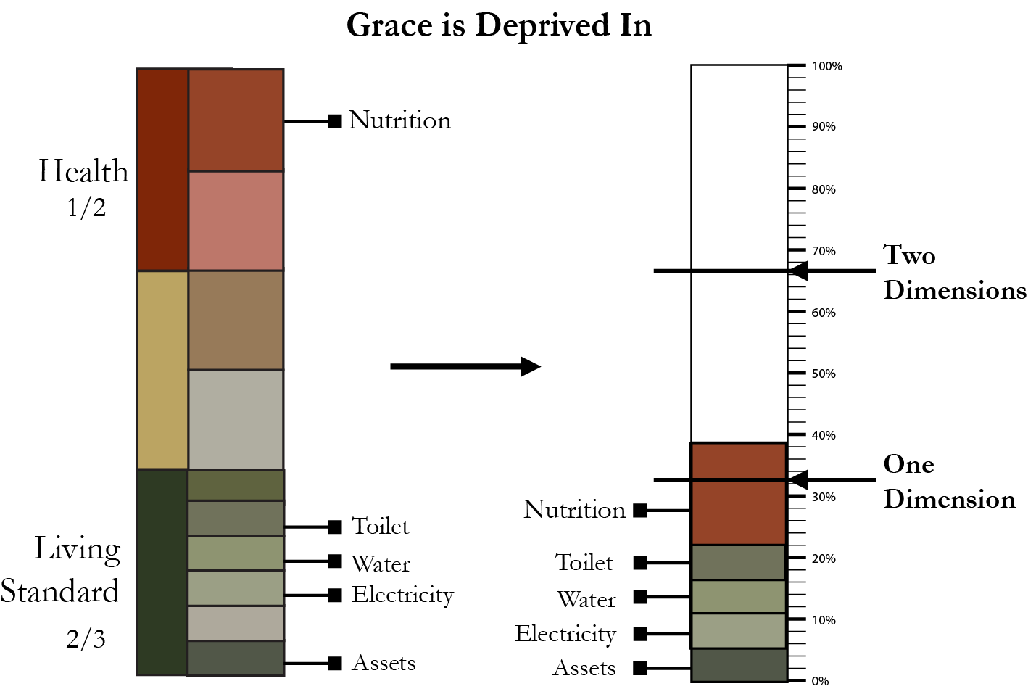
Who is Identified as Multidimensionally Poor?
A person is poor if she is deprived in 1/3 or more of the weighted indicators (poverty cutoff = 1/3)
(censor the deprivations of the non-poor)
39%
33.3%
Notes:
A person is identified as multidimensionally poor (or ‘MPI poor’) if they are deprived in at least one third of the weighted indicators shown below; in other words, the cutoff for poverty (k) is 33.33%.
The MPI is calculated by multiplying the incidence of poverty by the average intensity of poverty across the poor; as a result, it reflects both the share of people in poverty and the degree to which they are deprived. MPI score value ranges from 0 to 1.

Slide 13
MPI vs. $1.25-a-day
Height of the bar:
MPI Headcount Ratio
Height at ‘•’ :
$1.25-a-day Headcount Ratio

Slide 14
How Can MPI Help?
Can reflect on joint distribution of deprivations
National MPIs can be tailored to context & priorities
National MPI can be reported like national income poverty measure
Political incentives from MPI are more direct
Data needs: Global MPI uses only 39 of 625 questions in Demographic Health Survey
Notes:
As MPI provides an overview about poverty deprivations through a single summary measure, it shows progress quickly and directly which will be beneficial in terms of monitoring, planning and more direct policy design. It can be deconstructed by region, ethnicity and other groupings and can be tailored to context and priorities, making it an apt tool for policymakers

Slide 15

The Multidimensional Poverty Peer Network
*Launched in June 2013 at University of Oxford with:
*Connects policymakers engaged in exploring or implementing multidimensional poverty measures from 23 countries (Angola, Bhutan, Brazil, Chile, China, Colombia, Ecuador, El Salvador, Dominican Republic, Germany, India, Iraq, Malaysia, Mexico, Morocco, Mozambique, Nigeria, Pakistan, Peru, Philippines, Tunisia, Uruguay and Vietnam) and 5 institutions (ECLAC, OECD, OECS, OPHI and SADC)
Notes:
MPPN, launched in 2013, is a high-level international peer network for policymakers engaged in exploring or implementing multidimensional poverty measures. At present, ministers and senior officials from 23 countries, including 6 OIC countries (namely Iraq, Malaysia, Morocco, Mozambique, Nigeria, Pakistan, Tunisia) participate in the Network.

Slide 16
CURRENT STANCE OF OIC COUNTRIES
18 OIC countries are currently classified by the World Bank as low-income countries and 32 are middle-income countries.
21 out of the world 48 LDCs are OIC members.
21 OIC countries, mostly located in Sub-Saharan Africa, are classified as Heavily Indebted Poor Countries (HIPCs), out of 39 HIPCs in the world
27 out of the world current 55 low income food deficit countries (LIFDCs) are OIC countries
24 OIC countries are placed in the category of Low Human Development countries based on the latest UNDP HDI (2013)
Among the 48 OIC countries with available data, Comoros and Suriname had the most severe income inequality reflected by Gini coefficients of 64.3 and 52.9, respectively. The income inequality in 15 of the member countries were measured to be “high”(GI between 40-49.9) while 29 of them were placed within medium inequality group (GI between 30-39.9).
Notes:
*In contrast, only 7 OIC countries are classified as high-income countries.
*On the other hand, only Afghanistan and Kazakhstan were classified as low income inequality countries (GI below 30)

Slide 17
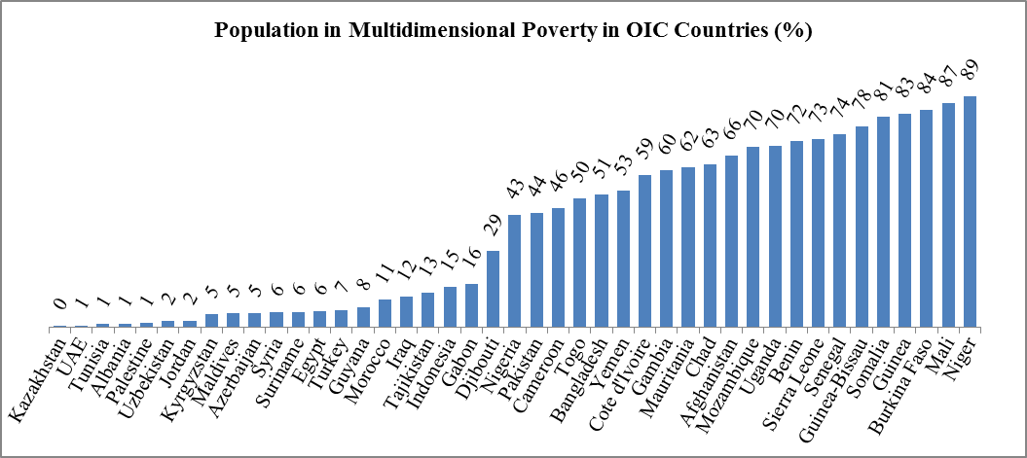
Multidimensional Poverty in OIC Countries
Notes:
…. more than half of total population is multi-dimensionally poor in 19 member countries .…16 of them from Sub-Saharan Africa
*In many OIC member countries, poverty has been on such a large scale that it has become a structural phenomenon of human deprivation in terms of hunger, malnutrition, diseases, illiteracy, and low level and quality of consumption of hundreds of millions of people. Like everywhere else, poverty in OIC countries is a multi-dimensional phenomena and a result of a complex socio-economic and political structure of a particular country. It is associated with poor economies, poor human resources, poor social services provision, and poor policies to tackle the challenges facing human and socio-economic development.

Slide 18
Multidimensional Poverty in OIC Countries
Multidimensional Poverty in OIC Countries (2010) | Headcount ratio: Population in multidimensional poverty (%) | Number of MPI poor people (millions)
OIC (n=43) | 35.0 | 465
Non-OIC Developing (n=60) | 28.1 | 1139
Developed (n=5) | 2.1 | 0.45
World (n=108) | 29.7 | 1604
Notes:
…. 35% of OIC total population is multidimensional poor (accounting for 29% of the world total multidimensional poor) compared to 30% in the world and 28% in other developing countries.…

Slide 19
Multidimensional Poverty in OIC Countries
Multidimensional Poverty in OIC Regions (2010) | Headcount ratio: Population in multidimensional poverty (%) | Number of MPI poor people (Millions)
EAP (n=1) | 15.5 | 37.2
ECA (n=7) | 5.1 | 7.2
LAC (n=2) | 7.0 | 0.1
MENA (n=11) | 14.8 | 33.2
SA(n=4) | 48.9 | 172.8
SSA (n=18) | 58.3 | 214.5
Notes:
…. 83% of OIC total multidimensional poor are living in member countries located in Sub-Saharan Africa (46% of OIC total) and South Asia (37% of OIC total)….

Slide 20
PART III: IMPROVING CAPACITIES FOR THE MEASUREMENT OF POVERY AND INEQUALITY
Current Capacity of National Statistical Offices
Data/Statistical Needs for Poverty Assessment
Requirements for Enhancing National Capacities in Poverty Statistics
Notes:
Summarizing the experiences of OIC Member Countries
Highlighting the major sources of non-comparability of poverty statistics
Exploring ways for harmonizing the practice of poverty measurement to improve comparability of poverty statistics in OIC member Countries

Slide 21
DRAFT QUESTIONNAIRE: PART A
DRAFT QUESTIONNAIRE FOR ENHANCING POVERTY STATISTICS
Adopted in 2012, the Strategy Document of the Standing Committee for Economic and Commercial Cooperation (COMCEC) is the first vision document for the COMCEC for six main cooperation areas including poverty alleviation. To achieve strategic objectives defined in the COMCEC Strategy, COMCEC Coordination Office launched the COMCEC Project Cycle Management (PCM) Programme in 2013. Carried out under the support of COMCEC PCM Programme and coordinated by SESRIC, the project titled “2013-SESRIC-028 Enhancing National Capacities of OIC Member Countries in Poverty Statistics ” aims at building statistical capacity in poverty statistics and overall contributing to the National Statistical Systems (NSS) of the member countries of the Organisation of Islamic Cooperation (OIC). This questionnaire has the objective to identify capacities and needs of the OIC countries in poverty statistics.
Please fill the Form electronically and send it back to statistics@sesric.org no later than xx September 2014.
For "Close-Ended" questions, please check the relevant box.
For "Open-Ended" questions, please write or type only in the space provided under each question. If needed, please add a separate page.
DISCLAIMER:
SESRIC will gather the responses and summarize the results of the survey which can be used by SESRIC and COMCEC in related research. SESRIC and COMCEC may also share and discuss them with its partner organizations on regional and international level to reach a more refined and internationally applicable analysis.
PART A: INSTITUTIONAL INFORMATION
1. Please provide contact details of your institution:
Name of the Institution:
Name of the Institution's Head:
Title of the Institution's Head:
Phone Number: |  |  |  | Country Code |  | City Code |  | Number
Fax Number: |  |  |  | Country Code |  | City Code |  | Number
Web Address:
E-mail(s):
Twitter Account (if exists):
Postal Address:
 |  |  |  | City |  |  |  | Country
2. Please provide contact details of the focal point responding to the questionnaire:
Name of the Contact Person:
Title of the Contact Person:
Department:
Phone Number: |  |  |  | Country Code |  | City Code |  | Number
Fax Number: |  |  |  | Country Code |  | City Code |  | Number
E-mail(s):

Slide 22
DRAFT QUESTIONNAIRE: PART B
PART B: CAPACITIES, PRIORITIES AND NEEDS IN POVERTY STATISTICS
No | Question | Answer
1 | Does your country collect / compile data on poverty issues? | YES |  | NO
1.a | If YES, is National Statistical Office (NSO) responsible for collecting poverty statistics? | YES |  | NO
1.b | If NO, please state the institution responsible for collecting poverty statistics?
2 | Which approach is used for poverty assessment?
2.a | Basic Needs Approach | YES |  | NO
2.b | Unmet Basic Needs Approach | YES |  | NO
2.c | Other | (please specify)

Slide 23
DRAFT QUESTIONNAIRE: PART B
BASIC NEEDS APPROACH
3 | Does your country estimate a poverty line? |  | YES |  |  |  |  | NO
3.a | If YES, which types of poverty line have been estimated? |  | ABSOLUTE |  |  | RELATIVE |  |  |  | OTHER
3.b | If YES, please indicate the number and type of poverty lines that have been constructed:
 | Only 1 poverty line |  | national |  |  | urban |  |  | rural
 | 2 poverty lines |  | national |  |  | urban |  |  | rural
 | more than 2 poverty lines |  | (please specify the number)
 | per capita poverty line specified for each household

Slide 24
DRAFT QUESTIONNAIRE: PART B
4 | If YES to question 3, what are the components of poverty line? | food poverty line |  |  | non- food poverty line |  |  |  | no separation
4.a | If a FOOD POVERTY LINE has been estimated, please indicate the NUMBER and LEVEL of CALORIE THRESHOLDS: | number |  |  |  |  | level
4.b | Please check the relevant criteria taken into consideration while determining required minimum calorie threshold in your country | age |  |  |  |  | location
 |  | gender |  |  |  |  | economic activity
 |  | other | (please specify)
4.c | Please indicate the NUMBER of items in the FOOD BASKET:
4.d | How is the COST of the FOOD BASKET estimated? | general CPI |  |  | poverty specific CPI |  |  | Community Price Questionnaire of HH Survey
 |  | other |  | (please specify)
4.e | If a NON-FOOD POVERTY LINE has been estimated, please indicate the method of estimation: | DIRECT |  |  |  | INDIRECT

Slide 25
DRAFT QUESTIONNAIRE: PART B
5 | Which welfare calculation method is used for measuring poverty?
5.a | HH Income | YES |  |  | NO
5.b | HH Expenditure | YES |  |  | NO
6 | Please indicate the sources used to estimate the level of welfare:
6.a | Household Surveys | YES |  | NO |  | PERIODICITY
6.b | Other Surveys (i.e. priority, employment, time use, etc.) | YES |  | NO |  | PERIODICITY
6.c | Non-Survey Sources (i.e. population census, administrative records, etc.) | YES |  | NO |  | PERIODICITY

Slide 26
DRAFT QUESTIONNAIRE: PART B
UNMET BASIC NEEDS APPROACH
7 | If UNMET BASIC NEEDS APPROACH is used to assess poverty, please check the relevant component of basic needs | access to safe water |  |  | basic education |  |  | housing
 |  | access to sanitation |  |  | health |  |  | infrastructure
 |  | other |  | (please specify)
8 | Is an index constructed to combine the components of basic needs? | YES |  |  |  | NO
8.a | If YES, please indicate weights assigned to the components: | equal weights |  |  |  | based on statistical model
 |  | other |  | (please specify)
9 | What is the base for measuring poverty?
9.a | Income | YES |  |  |  | NO
9.b | Consumption | YES |  |  |  | NO

Slide 27
DRAFT QUESTIONNAIRE: PART B
CAPACITY BUILDING IN POVERTY STATISTICS
10 | Does your institution have partnership and/or receive consultation from international organizations in the are of statistics? | YES |  |  | NO
10.a | If YES, please indicate the name of organization(s)
11 | What are the problems your institution encounter while estimating poverty statistics? Or hardships that prevent your institution from collecting poverty statistics?
12 | Does your institution need short-term training on poverty statistics? | YES |  |  | NO
12.a | If YES, please indicate the themes that your institution need training under poverty statistics?
13 | What are the strong aspects of your institution while estimating poverty statistics?
14 | Can your institution provide short-term training on poverty statistics? | YES |  |  | NO
14.a | If YES, please indicate the themes that your institution can provide training under poverty statistics?
15 | Please specify language preference for STATCAB trainings on poverty statistics (use 1: the first, 2: second, 3: third preference) | Arabic | English |  |  | French

Slide 28
DRAFT QUESTIONNAIRE: PART B
FUTURE PLANS AND FEEDBACK
16 | What are the future plans/ strategies of your institutions in terms of estimating poverty statistics?
17 | Please state all your comments and feedback on the questionnaire. It is also expected to provide your future plans

Slide 29
DRAFT QUESTIONNAIRE: PART C
PART C: DATA
Please provide the available data for poverty statistics collected by your institution.
No | Indicator Name | Definition Used | 1990 | 1991 | 1992 | 1993 | 1994 | 1995 | 1996 | 1997 | 1998 | 1999 | 2000 | 2001 | 2002 | 2003 | 2004 | 2005 | 2006 | 2007 | 2008 | 2009 | 2010 | 2011 | 2012 | 2013
1 | ...
2 | ...
3 | ...
4 | ...
5 | ...
6 | ...
7 | ...
8 | ...
9 | ...
10 | ...

Slide 30
THANK YOU!
www.sesric.org
www.oicstatcom.org

